Slide 1


Your Employer-Sponsored
Retirement Savings Plan
Plan Now for the Life
You Want in Retirement
Notes:
[V22N1]

Slide 2
Securities and advisory services are offered through LPL Financial (LPL), a
registered investment advisor and broker/dealer (member FINRA/SIPC).

Slide 3



Retirement: A New Beginning
Notes:
Close your eyes for a moment — now try to picture yourself on the first day of your retirement. Your last day of work is behind you; there is no alarm clock jolting you out of sleep. You awaken on your own and you have the rest of your life ahead of you. Are you happy about your prospects? Relaxed? Energized? Excited? Now open your eyes.
Your retirement can be whatever you want it to be. In decades past, retirement was a time of rest and relaxation. That might be what you want — but it might not be. Today’s retirees are:
<CLICK> traveling and going back to school
<CLICK> helping to care for their grandchildren and volunteering
<CLICK> starting new businesses, playing sports, and exploring hobbies.
Put simply, today’s retirees are living long and active lives. So what do you see yourself doing?
Some people even continue to work, not necessarily because they have to, but because they want to. However, even these folks should plan for the possibility that they may not be able to work at some point.
Today, we’re here to help you wake up on the first day of retirement with the confidence of knowing you have planned well. So let’s not spend any more time daydreaming. Let’s get started.

Slide 4

Today’s Retirement Can Last Longer Than Ever Before
Your retirement could last:
10
15
20
25 years or longer…
Notes:
First, let’s consider how long retirement might last.
With advancements in medical care and more attention being paid to healthy lifestyles, today’s retirees are living longer than ever before. You could live to be 75, 85, 95, maybe even 105!
While that’s great news, the other side of the coin is that you’ll need enough money to provide income for a retirement that could last <CLICK>
<CLICK> 10
<CLICK> 15
<CLICK> 20
<CLICK> even 25 years or longer.

Slide 5

How Much Will You Need?
Have enough set aside to provide 70% to 100% of your final year’s salary each year during retirement.
Salary at retirement: $75,000
70% = $52,500
80% = $60,000
90% = $67,500
Notes:
So how much will you need for retirement?
<CLICK> A general rule of thumb says that you should plan for between 70% and 100% of your final working income each year during retirement to live comfortably. Of course, the exact percentage will depend on a number of factors, including your desired lifestyle and your health. But those percentages provide a good estimate.
<CLICK> For example, if you retire making $75,000 a year and decide that you can live on 70% of that amount during retirement, that means you would need about $52,500 in your first year of retirement. Part of that $52,500 could come from Social Security, a traditional pension plan, rental income from properties you may own, or other assets. But part of it —perhaps a large part of it — will likely come from how much you save through your employer’s retirement savings plan, if you take advantage of this opportunity.

Slide 6
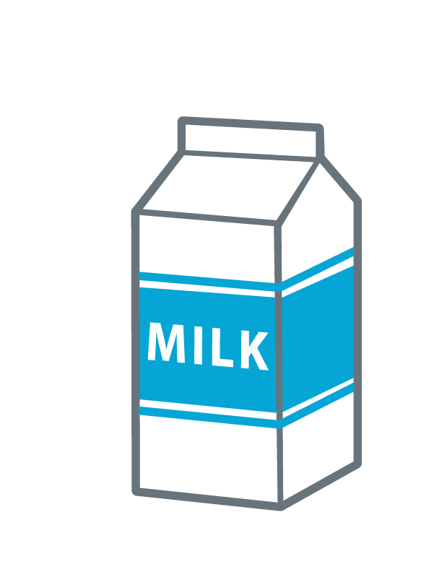



Inflation Keeps on Going —
Your Income Needs to Keep Up!
Cost Today
Cost in 20 Years
$4.00 $7.22
$45 $81.28
$100 $180.61
$35,000 $62,214
Gallon
of milk
Haircut
Running
shoes
New car
Assumes a 3% annual inflation rate, which cannot be guaranteed. This hypothetical example of mathematical principles is used for illustrative purposes only.
Notes:
But that $52,500 won’t be enough every year of your retirement. Since the overall cost of everyday living typically rises each year, your annual retirement income will need to increase each year as well.
This table provides an idea of how much the costs of a few common items could rise over 20 years. At just a 3% inflation rate, which is the approximate average over the long term (Source: Bureau of Labor Statistics, Consumer Price Index, 2022), those goods would nearly double in price.

Slide 7
How Much Does It Take to
Provide 70% of Income for 25 years?
Current Salary | Years Until Retirement
 | 10 | 20 | 30
$40,000 | $822,189 | $1,104,953 | $1,484,965
$60,000 | $1,233,284 | $1,657,430 | $2,227,448
$80,000 | $1,644,378 | $2,209,907 | $2,969,930
Figures are hypothetical, for illustrative purposes only, and do not represent the performance of any specific investment. They assume that salary rises each year until retirement by 3%, a 3% inflation rate, and a rate of return during retirement of 4% per year. Actual inflation and returns will fluctuate over time and cannot be guaranteed. Taxes and fees are not considered. If they had been, the amount needed would have been higher.
Notes:
Now let’s take a minute to look at this table and understand what it’s illustrating. Before we review the numbers more closely, consider that these figures assume that you start with no savings, and that you will have no other sources of income in retirement — not even Social Security. Basically, it’s a worst-case scenario. The table is simply meant to give you a general idea of how much it might actually take to provide 70% of your final working salary for a retirement that will last 25 years, given certain assumptions.
For example, someone who currently makes $40,000 a year and is planning to retire in about 10 years may need to accumulate more than $800,000 to provide the equivalent of 70% of his or her final working income for 25 years.
On the other end of the spectrum, someone who makes $80,000 and is planning to retire in 30 years may need nearly $3 million! That’s a big nest egg.
Keep in mind that this table is for illustrative purposes only and assumes many factors that cannot be guaranteed. These include a 3% annual rise in salary before retirement, a 3% annual inflation rate both before and during retirement, and a 4% annual rate of return earned on savings during retirement. Inflation, salary increases, and rates of return will change from year to year.
The main reason we’re looking at this table is to get an idea of the true cost of retirement, and to shine a spotlight on the importance of planning and contributing now.

Slide 8

Won’t Social Security Provide
What I Need?
May help as one source of income
Intended to be a safety net
Notes:
So what about Social Security?
<CLICK> Can’t you just assume your Social Security benefits will be enough?
Though Social Security is an important source of retirement income for many, it was never intended to be the main source of retirement income. And due to the increasing strain put on the system in future years due to rising numbers of retirees, some changes may be inevitable.
<CLICK> So it’s probably best to view Social Security with a bit of caution. Think of your Social Security payments as a safety net, and assume that they will provide a source of income, but not your main source of income.

Slide 9
Why Start Now? Compounding!
Contributions
$350,000
Earnings
$300,000
$224,7815
$250,000
$200,000
$150,000
$100,000
$73,435
$93,600
$50,000
$13,900
$62,400
$0
$31,200
10 Years
20 Years
30 Years
This hypothetical example shows the results of investing $120 in a retirement savings plan every other week. It is used for illustrative purposes only and does not represent the performance of any specific investment. It assumes a 7% annual rate of return, which of course cannot be guaranteed. All investment strategies involve risk, including the possible loss of principal, and there can be no guarantee that any investing strategy will be successful. Examples do not take into account the effects of taxes and fees, which would reduce the performance shown. Withdrawals are subject to ordinary income tax. Early withdrawals prior to age 59½ will be subject to a 10% penalty tax, unless an exception applies. Actual results will vary.
Notes:
Now that you understand why it’s so important to plan ahead for retirement, let’s examine why it’s also important to start contributing now rather than putting it off until later.
This chart shows the benefits of compounding. Basically, when you contribute to your retirement savings account, the intention is that your contribution dollars will earn returns. Then those returns could potentially earn returns themselves … and so on. The more you contribute to your plan, the more you may earn, and the more those earnings can work for you by earning additional returns. Of course, keep in mind that your investments may earn very little or even nothing at all; it’s also possible that you could lose your contribution dollars. But assuming you do earn money, and those earnings earn returns themselves, over time the process can snowball. That’s compounding. And the longer your time horizon, the more powerful the effects of compounding can potentially be.
This hypothetical example shows the results of investing $120 in a retirement savings plan every other week. It assumes a 7% annual rate of return, which of course cannot be guaranteed.
Let’s take a close look at the results. After 10 years, you would have invested a total of $31,200 and had earnings of $13,900, for a total of $45,100. That’s pretty good. After 20 years, you would have invested $62,400 and had earnings of $73,435, for a total of $135,835 — even better. And after 30 years, you would have invested $93,600 and had earnings of $224,781, for a total of more than $300,000. That’s compounding at work. The sooner you start saving, the less you may have to set aside to adequately pursue your goals.
There will always be competition for your hard-earned dollars — mortgage, rent, car payments, college payments, tablets, mobile phones, and other gadgets (and perhaps kids who want their own tablets, mobile phones, and other gadgets). But when you look at the examples in this chart, you can see how delays in saving for retirement can be very costly. Even if it’s just a small amount every pay period, start contributing today. Small amounts can add up over time through the power of compounding.

Slide 10

The Benefits of Participating in Your Retirement Savings Plan
Notes:
So hopefully by now you recognize how important it is to chart your course to retirement and contribute to your plan today, rather than put it off.
<CLICK> Now we’re going to switch gears a bit and look at why your retirement savings plan is an ideal way to help you save for retirement.

Slide 11

Why Save Through Your Retirement Savings Plan?
1 Convenience
2 Tax advantages
3 Investment choice
Notes:
There are three key reasons why your retirement savings plan can be an important tool in saving for your future:
<CLICK> convenience
<CLICK> tax advantages, and
<CLICK > investment choice.
Let’s take a look at each one in more detail.

Slide 12

Reason #1:
Contributing Is Convenient
Automatic payroll deduction
Pay yourself first
What you don’t see,
you won’t spend
Notes:
One of the main benefits of participating in your retirement savings plan is that it puts your retirement savings plan on autopilot.
<CLICK> After you make the decision to enroll and decide how much to contribute, those contributions are deducted automatically from your paycheck each pay period and invested in your plan account.
<CLICK> This process, called “payroll deduction,” helps you make yourself and your future a priority.
That’s because <CLICK> what you don’t receive in your pocket each pay period, you can’t spend.
<IF THE EMPLOYER PROVIDES A MATCH OR PROFIT-SHARING CONTRIBUTIONS, INTRODUCE TOPIC HERE AND CUSTOMIZE NEXT SLIDE AS NEEDED.> Your employer will also contribute to your account through a <MATCHING CONTRIBUTION/PROFIT-SHARING CONTRIBUTION>, which is how your employer can help you pursue your savings goals. We’ll provide more details on this contribution in a moment.

Slide 13

Employer Contributions
<Optional slide>
<Summarize contribution
and vesting details>
Notes:
<OPTIONAL SLIDE>
<IF EMPLOYER PROVIDES MATCHING CONTRIBUTIONS, EXPLAIN DETAILS OF MATCH. INCLUDE THE FOLLOWING POINTS:>
Matching contributions are a guaranteed return on your contribution dollars. Don’t pass up this free money. Try to contribute at least enough to get the full match.
<IF EMPLOYER PROVIDES PROFIT-SHARING CONTRIBUTIONS, EXPLAIN DETAILS AND INCLUDE THE FOLLOWING POINT:>
Profit-sharing contributions are one way you can share in your organization’s success.
<IF EMPLOYER IMPOSES A VESTING SCHEDULE, BE SURE TO INCLUDE DETAILS.>

Slide 14

Reason #2:
Your Plan Offers Tax Benefits
Potential tax advantages both now and in the future, depending on
plan type
Notes:
The second reason for using your employer’s retirement savings plan to save for your future is that it offers tax benefits.
Depending on the type of plan you have, you could benefit from tax advantages now, in the future, or perhaps both.

Slide 15
Tax Benefit: Pre-tax Contributions
    Employee 1 Employee 2
    Bi-Weekly Pay $2,000 $2,000
    Plan Contribution $0 $120
    Taxable Pay $2,000 $1,880
    Taxes Paid $440 $414
Amount Invested: $120
Immediate Savings: $26
This example assumes a 22% federal tax rate an a 6% plan contribution, and has been simplified
for illustrative purposes. Your results will differ based on your unique circumstances.
Notes:
<OPTIONAL SLIDE: PRE-TAX CONTRIBUTIONS>
With traditional “pre-tax” retirement savings plans, your contributions are taken out of your pay before taxes are assessed. That means the amount of your pay that is subject to income tax is lower, which means your overall annual tax payment is lower.
This table illustrates how current contributions to your employer-sponsored retirement plan help lower your current tax bill. In the example, Employee 1 makes $2,000 each pay period and does not contribute to his plan. If we assume a flat 22% tax rate (which is hypothetical and for illustrative purposes only), the amount of taxes he would have to pay for that pay period would be $440.
Employee 2 makes the same amount of money, but has chosen to contribute 6% of her salary, or $120 each pay period, to her retirement savings plan. Because her taxable pay is reduced by this $120, the amount of taxes she has to pay is just $414 (based on the same flat 22% tax rate).
So although she’s contributing $120 to her plan account, it only “feels” like $94 out of her pocket because of that $26 tax savings. And more of her money is going to work for her instead of Uncle Sam.
You’ll have to pay taxes on those contribution dollars eventually, but that will likely be in retirement, when you may be in a lower tax bracket. Note that you are required to begin taking distributions from your retirement savings plan the year you reach age 72, or the year you retire, whichever is later. Special rules apply to 5% owners.

Slide 16

Tax Benefit: Tax-Free Withdrawals
Roth account
No up-front tax benefit; contributions made in
after-tax dollars
Qualified withdrawals of earnings are tax free
Notes:
<OPTIONAL SLIDE: ROTH CONTRIBUTIONS>
Your plan also offers a Roth account. With these types of accounts, your contributions are made in after-tax dollars, so there is no immediate tax benefit. However, the main benefit of a Roth account is that qualified withdrawals are tax free. In order for a withdrawal to be qualified, two requirements must be met:
The account must have been held for at least five years, and
The withdrawals are made after you reach age 59½, unless an exception applies
If a withdrawal is not qualified, the amount of your withdrawal that is considered “earnings” will be includable in your taxable income for that year, and subject to a 10% tax penalty, which we’ll discuss in more detail in a moment. The portion of your withdrawal that is considered “contribution dollars” will not be included in your taxable income because your contributions were already taxed before they went into the account.

Slide 17

Tax Benefit: Tax-Deferred Growth
No annual tax filing
More of your earnings
go to work for you
Possible tax penalties
Notes:
Perhaps the biggest potential tax benefit of your retirement savings plan is that your account can earn returns each year without having to be subject to taxes. That means more of your money can potentially go to work for you annually than would be possible in a taxable investment account. You are also not subject to the same annual tax filing requirements as you would be in a taxable investment account.
<PLEASE EDIT THE FOLLOWING BASED ON THE TYPE OF ACCOUNT THAT APPLIES.>
Withdrawals from pre-tax retirement savings accounts will be taxed at then-current rates. This means that in retirement, you will have to pay taxes on your withdrawals from your pre-tax account, but consider that in retirement, you may be in a lower tax bracket.
As noted earlier, qualified withdrawals from Roth accounts will be tax free.
The taxable portion of early withdrawals from all types of retirement savings accounts will be subject to both regular income taxes and a potential 10% penalty tax. This means that if you take withdrawals from your retirement account before you reach age 59½ (50 or 55 in some cases), you will have to pay regular income taxes plus an additional 10% on the portion of the withdrawal that represents pre-tax contribution dollars and earnings.
Note: The early-withdrawal penalty for SIMPLE IRAs is 25% for the first two years of participation, 10% thereafter.

Slide 18

Reason #3:
Investment Choice
Plan offers a mix of various investments
Allows you to put together
a portfolio that’s right for you
<Or you may choose a
“one-stop-shop”
type of investment>
Notes:
And finally, reason #3 for using your employer’s retirement savings plan: Your plan offers a variety of different types of investments to choose from. Options range from lower to higher risk. Once we review how to choose investments for your plan account, you may feel comfortable choosing a mix of investments that’s appropriate for you.
<THE FOLLOWING SENTENCES ARE OPTIONAL, AND MAY BE USED TO CUSTOMIZE THE PRESENTATION AS NEEDED.>
Those who prefer not to put together a mix themselves may want to consider a one-stop-shop investment, also known as <TARGET DATE/LIFESTAGE/LIFESTYLE FUNDS>. These mutual funds are designed to help ease the decision-making process.
The target date is the approximate date when an investor plans to withdraw the money. The mix of investments in the target-date fund typically becomes more conservative as the date grows closer. The principal value is not guaranteed at any time, including at the target date. There is no guarantee that a target-date fund will meet its stated objectives. The return and principal value of target-date funds fluctuates with changes in market conditions. Shares, when sold, may be worth more or less than their original cost. It is important to note that no two target-date funds with the same target date are alike. Typically, they won’t have the same asset allocation, investment holdings, turnover rate, or glide path. So it is important for an investor to look beyond the target date to determine if a particular target-date fund is an appropriate investment.
Before investing in a mutual fund, however, carefully consider the investment objectives, risks, charges, and expenses of the fund. This information can be found in the prospectus, which can be obtained from the fund. Read it carefully before investing.
But before you decide which mix may be appropriate for your needs, let’s review some investment basics.

Slide 19

Choosing Investments for Your Retirement Savings Strategy
Notes:
As we noted, when you invest in your plan, you’ll have the option to choose among many different investments. Now we’re going to take a look at the types of investments you may have and how to choose among them.

Slide 20
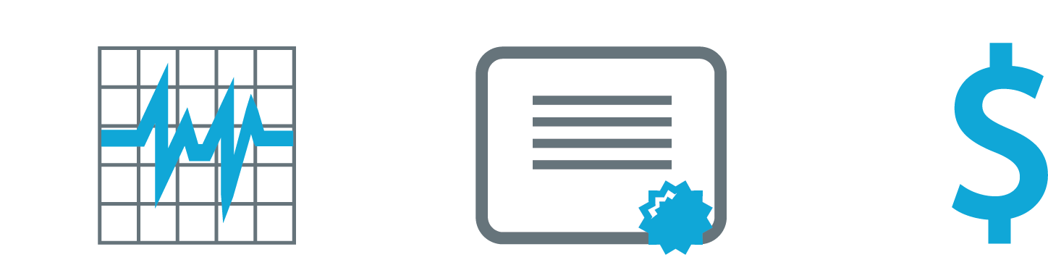
Types of Investments
Diversification: putting together a mix of investments
Investments can typically fit into one of three asset classes:
Stocks
Bonds
Cash
Higher Risk,
Higher Potential reward
Moderate Risk,
Moderate Potential Reward
Lower Risk,
Lower Potential Reward
All investment strategies involve risk, including the possible loss of principal.
Notes:
As noted earlier, the investments in your plan range from not so risky to really risky. Typically, the greater an investment’s potential for return, the riskier it tends to be, and vice versa. If you want to strive for higher possible returns in your plan, you’ll need to understand that with the potential for higher returns comes a greater chance of losing money. That’s why it’s important to follow the old cliché of not putting all your eggs in one basket.
Putting together a mix of different types of investments is an investment strategy called “diversification.” Although there’s no guarantee that you won’t lose your contribution dollars, diversification can help you manage risk in your plan by spreading your money around. While some investments may be losing money, others may be rising or holding steady. This can potentially help reduce your losses (although no investment strategy can fully protect against losses).
The investments in your plan will generally fit into one of three categories called “asset classes”:
<CLICK> Stocks, the first asset class, represent ownership in a company. When you own a stock in a company, you actually own a tiny piece of that company. Stocks are typically the most risky type of investment offered in retirement savings plans, and therefore tend to offer the potential for the highest returns over the long term, though past performance cannot guarantee future results.
Bonds represent loans you make to a government entity or a company. You are the lender and the organization is the borrower, or issuer. In return for the loan, the issuer promises to pay you interest at a stated rate. However, there is the risk that the issuer may default, i.e., not be able to maintain the income payments or return the original amount of your loan. And if you need or want to sell the bond before its maturity date, there’s no guarantee you’ll get back the full amount you put into it. Although there are many different kinds of bonds--some of which can be quite risky--bonds typically fall somewhere in the middle of the risk/return spectrum.
Cash alternative investments (also known as capital preservation investments) are designed to help preserve your money. Although they tend to be among the lowest-risk investments that may be in a plan, if you invest too much in them, you lose the potential for higher growth and run the risk that your account will not stay ahead of the rising cost of living and adequately pursue your savings goals. The principal value of cash alternatives may be subject to market fluctuations, liquidity issues, and credit risk. It is possible to lose money with this type of investment.

Slide 21

About Mutual Funds
Bring together the money of many different investors
Hold a mix of individual stocks, bonds, and/or cash
Automatic diversification
Choose investments based on objective
No investment strategy, including diversification, can ensure a profit or guarantee protection against a loss in declining markets.
Before investing in a mutual fund, make sure you understand the fund’s objectives, risks,
fees, and expenses. This information can
be found in the fund’s prospectus, which
should be read carefully before investing.
Notes:
Most retirement plans offer access to these three asset classes through investments known as mutual funds.
<CLICK> These investments pool the money of many different investors to buy a portfolio of individual stocks, bonds, and cash investments. <CLICK> When you own shares in a mutual fund, you actually own a tiny piece of all the securities held within that fund.
<CLICK> Because most mutual funds hold many different investments — although there are exceptions — they automatically follow the principle of diversification. Although diversification helps to manage risk, it cannot guarantee a profit or protect against a loss.
In addition, before you invest in a mutual fund, you should be sure to review its prospectus. A prospectus, which is kind of like the mutual fund’s guidebook, contains more information about objectives, risks, fees, and expenses and should be read carefully before investing. If you do not receive a prospectus automatically from your plan, you should be sure to request it.
<CLICK> Mutual funds choose their investments, or “holdings,” based on their stated objective, which is a brief summary of what the fund strives to achieve for its investors. Let’s take a quick look at some common fund objectives.

Slide 22
Examples of Fund Objectives
Typical objective
Growth
Income
Capital
Preservation
Description
  Growth of investment dollars over time (can be more or less aggressive
  Provide stream of income over time
  Help preserve investment dollars
Invests in
  Mainly stocks
  Mainly bonds
  Cash alternative investments
  and lower-risk bonds
Risk level
  Tend to offer higher long-term average returns, but carry most risk of loss
  Generally fall in the middle of the risk/return spectrum
  Most conservative offerings in the plan; tend to offer lowest returns
Notes:
Here are some examples of common fund objectives.
Growth funds usually invest in stocks and are typically appropriate for investors seeking the potential for long-term growth of their investment dollars. These funds tend to offer higher returns over time, but come with a greater degree of risk. The value of your investment is likely to go up and down more than with other asset classes. They may be aggressive growth funds, which are among the riskiest of all investments.
Income funds strive to provide regular income, which can help balance out value swings in other parts of your portfolio. However, the value of a bond investment can fluctuate and there is no guarantee it will be worth what you paid for it when you sell it.
There are also funds called growth and income funds and balanced funds, which are not pictured here on this slide. These funds typically strive for income while also trying to provide a bit of growth. They too fall in the middle of the risk/return spectrum.
Cash or capital preservation funds strive to help preserve your investment dollars. These are generally the most conservative of all the investments offered in the plan and may be most appropriate for those nearing or in retirement, or those looking for a place to park their investment dollars while they consider other potential investments. Among these types of funds are money market funds. Although money market funds strive for protection of principal, there is no guarantee they can maintain a stable $1 share price. An investment in the fund is not insured or guaranteed by the Federal Deposit Insurance Corporation or any other government agency. It is possible to lose money by investing in a money market fund.
<OPTIONAL TEXT: AS NOTED EARLIER, YOUR PLAN MAY ALSO OFFER ONE-STOP SHOP FUNDS, ALSO KNOWN AS TARGET DATE/LIFESTAGE/LIFESTYLE FUNDS. WITH THESE FUNDS, YOU SIMPLY ELECT TO INVEST ALL OF YOUR MONEY IN ONE FUND BASED ON (INSERT DETAILS HERE, SUCH AS “YOUR ANTICIPATED RETIREMENT YEAR”).>
A basic rule of thumb is to choose a mix of the different types of funds based on your own unique circumstances. In the next section, we will look at the how to make this important decision.

Slide 23
Choosing Investments: Asset Allocation
How you divide your investment dollars among the three asset classes
  Example: 75% growth, 15% income, 10% cash
Savings
Goal
Time
Horizon
Risk
Tolerance
Investment
Mix
Investment Mix
Your savings goal, time horizon and risk tolerance help to determine your investment mix.
All investment strategies involve risk. Asset allocation cannot guarantee a profit
or eliminate the potential for loss, including the loss of principal.
Notes:
The process of choosing investments for your retirement portfolio and determining how much of your contribution dollars to invest in each one is called “asset allocation.” Specifically, asset allocation is the percentage of your assets invested in each class. A few examples of hypothetical asset allocations would be:
75% stocks, 15% bonds, 10% cash
50% stocks, 30% bonds, 20% cash
35% stocks, 50% bonds, 15% cash
The three factors that can help you determine your asset allocation are: <CLICK>
Your savings goal, or how much you are trying to accumulate through your savings plan account
Your time horizon, or how long it will be until you will need to tap into your savings plan account
And your risk tolerance, or how well you can withstand changes in the value of your savings plan account
Generally speaking, the higher the goal and/or the longer the time horizon, the greater the allocation to riskier investments, like stocks, might be.
The lower the goals and/or the shorter the time horizon, the greater the allocation to bonds and capital preservation funds would typically be.
Keep in mind that no investment strategy can protect you from losing your money.

Slide 24
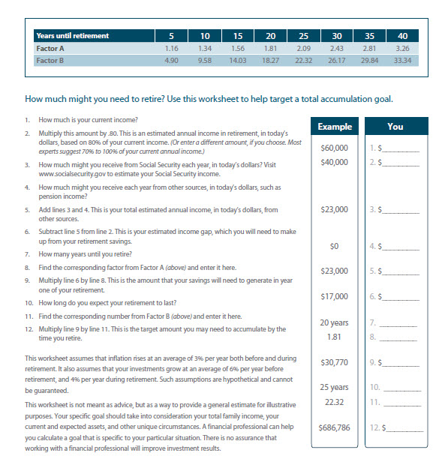
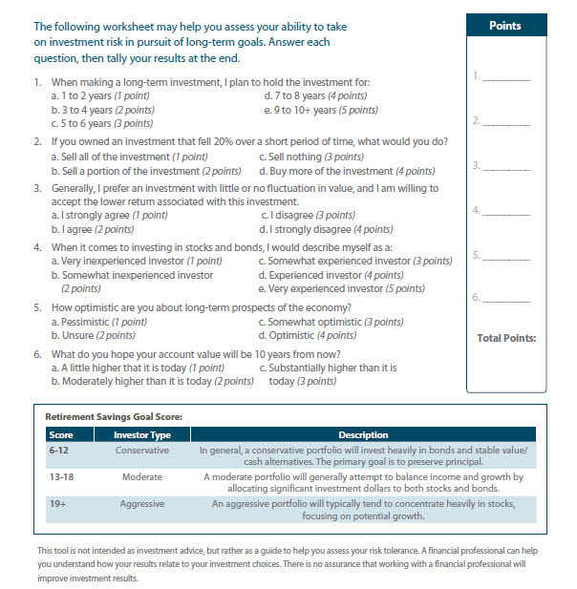
Tools to Help You Decide
Goal-Setting Worksheet
Risk Tolerance Worksheet
Notes:
Along with this presentation comes an e-guide (workbook) that summarizes all of what we discussed here today. In the e-guide, you’ll also find two worksheets that can help you gauge two of those important factors that contribute to your asset allocation decision.
There’s a savings goal worksheet that will help you determine how much you may need to accumulate, and there’s another worksheet to help you assess your own risk tolerance.

Slide 25
Summary
Retirement has changed, is longer than ever before
Most people will need a large nest egg to live comfortably
in retirement
View Social Security as a safety net
Compounding and time can work for you
Your retirement savings plan can become an important element in your planning
  Convenience
  Tax advantages
  Investment choice
Three key factors contribute to your asset allocation decision
Notes:
We’ve reviewed a lot of information today.
<CLICK> First we talked about the different face of retirement — how retirement lasts longer than ever before, <CLICK> and how it will take a sizable nest egg to afford to live comfortably in retirement.
<CLICK> Then we talked about viewing Social Security as a safety net rather than a primary source of income.
<CLICK> Next, we considered the potential benefits of starting to save now versus waiting until there’s more money in your budget. It’s especially important to remember the benefits of compounding — and how time can be one of your strongest allies when saving for retirement.
<CLICK> Then we discussed why your retirement savings plan may be an ideal way to plan for your future — because it offers the three main benefits of convenience, <CLICK> tax advantages, and <CLICK> investment choice.
<CLICK> And then finally, we examined the different types of investments in your plan and the three key factors that go into the asset allocation process. Does anyone remember them? [Pause for answers — savings goal, time horizon, and risk tolerance.]
That’s a lot of information for a brief presentation.

Slide 26

Enroll Today
Notes:
Now it’s up to you to make the next move. Will you commit to taking the first steps toward your retirement? Enroll in your plan and start contributing today.

Slide 27

Thank You
Notes:
Small steps can help enhance your financial life one day at a time. Questions are always welcome.

Slide 28
Disclaimer
Content in this material is for general information only and not intended to provide specific advice or recommendations for any individual. All performance referenced is historical and is no guarantee of future results. All indices are unmanaged and may not be invested into directly.
The information provided is not intended to be a substitute for specific individualized tax planning or legal advice. We suggest that you consult with a qualified tax or legal professional.
LPL Financial Representatives offer access to Trust Services through The Private Trust Company N.A., an affiliate of LPL Financial.

