Slide 1


Turning Clients into Raving Fans
WEBINAR NOTES

Slide 2
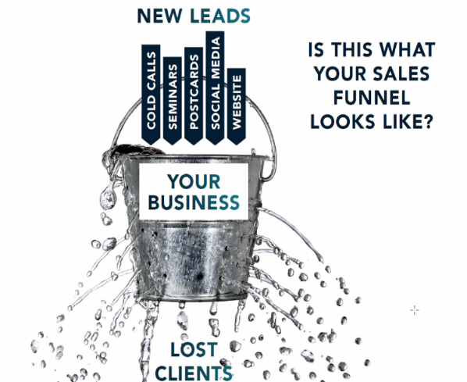
Did you know?
Research shows that over 50% of leads are wasted. Why?
  Advisors don’t have the correct “framework” in place to nurture their relationships. Especially with their clients’ families.
    70% of widows move their assets to someone else 2-10 months after their spouse passes
    Women are 3x more likely to refer than men
    2% of inheriting children keep their parents’ financial advisor

Slide 3
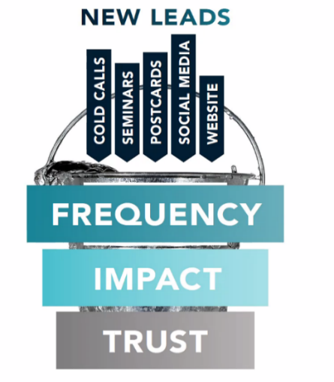
Did you know?
The average high-net worth client has 4.4 advisors
  How do you stand out among the others & increase AUM?
  How do you become the trusted #1 go-to advisor?
    The answer is applying the F.I.T. framework to every relationship.
    F.I.T. (Frequency, Impact, Trust)

Slide 4
F is for “Frequency”
  Frequently communicating is not only crucial, but being able to communicate the way your prospect likes to communicate is equally important
        Rule of 7 – It takes 7 touchpoints to even become memorable
        Recommended to build a touchpoint system of 26 touches a year through a variety of mediums
        Example advisor brings in on average $6M AUM/year, had 250 touches a year
        Think of the analogy of a relationship with your spouse. You are likely going to communicate with them often which nurtures your relationship. If you rarely talk to them, you are not going to have much of a relationship
          Why reaching out to clients 1x a year for a yearly checkup only or executing a quarterly newsletter only will not make you memorable
        The more frequent you are reaching out, the more familiar you become and the more comfortable prospects/clients will be with you which is building trust
          If you lack frequency, you will not gain trust
        However, you cannot just be “frequent”. You must be “frequent” with “impact”.

Slide 5
I is for “Impact”
  There are two ways to be impactful. Through personalization and quality.
      Look at your CRM system. Can you apply the F.O.R.D (Family, Occupation, Recreation, and Dreams) method to each of them?
      Do you know about every F.O.R.D. aspect for each of your clients?
      This allows you to create more avenues for touchpoints throughout the year by knowing more about them and what their likes are and picking messaging tailored to those likes, or just shooting them an article saying (e.g. “I know you love hitting the gym, here’s an article I thought you’d appreciate..”)
      Consider sending personalized video texts

Slide 6
T is for “Trust”
  You want to be the Subject Matter Expert “SME” of your industry. Can do so through:
      Showcasing your accolades (building credibility) but must be careful. Be humble, but strategic
      If permissible, testimonials. Challenges in the regulatory world, but having a way for clients to be able to speak to each other, will be valuable
      Providing free educational content consistently (signing up for a newsletter, sending articles, videos, etc.)

Slide 7
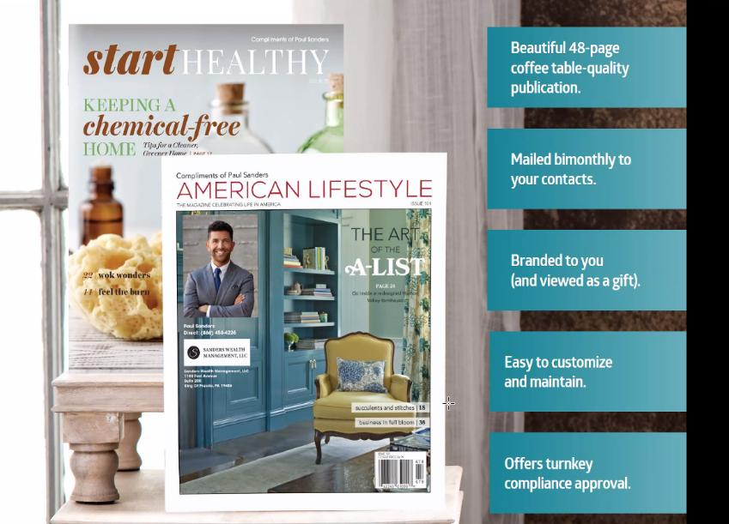
ReminderMedia
    ReminderMedia pitched the following product that they customize for their advisors’ clients.
      It hits all 3 pillars of the F.I.T. framework.
      Not just about financial info.
      High Quality
      Clients enjoy sending this for generational leads (tailored to their interests). Includes tear out cards (recipes, etc.)

Slide 8
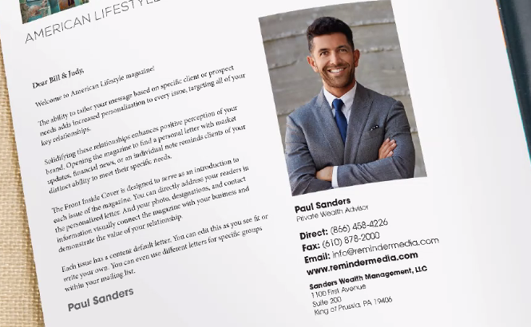
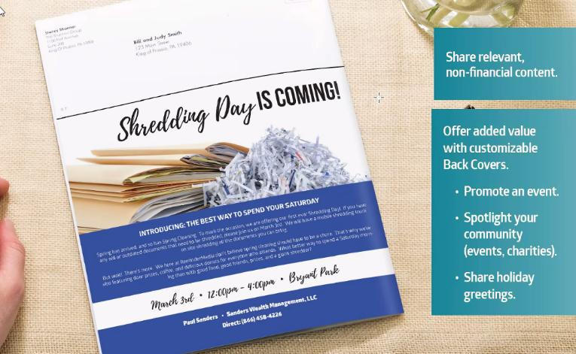
ReminderMedia (Cont.)
    Customization
    Event Promotion

Slide 9
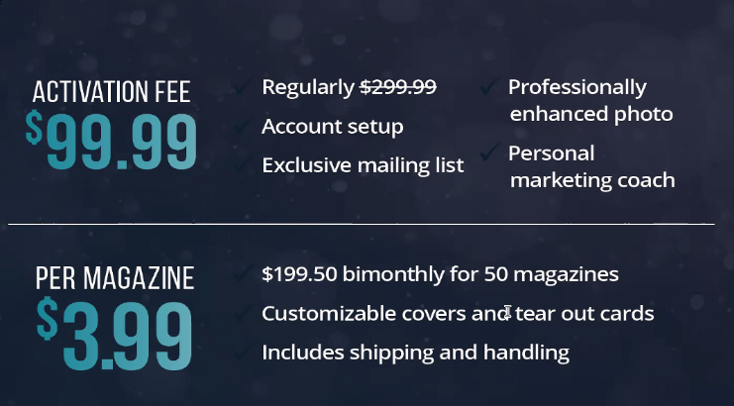

ReminderMedia (Cont.)
One time activation fee for the entire account. In client interface, they have ability to customize the info for each client. 15-20 min initial set up. Goes out 6x a year. 7 articles per publication. Non-confrontational articles. Different themed magazines. Different each issue.

Slide 10
How can FRG Marketing Help?
  We can help our advisors work towards their 26 touches a year through some the following ways:
      Having consultations with them on how to implement their touches based on target audience
      Create an annual marketing calendar for them to follow
      Design custom content for their target audience and format for the mediums of their choosing
      Walk them through the marketing resources available and how to use strategically including, Marketing on Demand, the Resource Center, FRG’s Resource Library.

Slide 11
Sample Touches
  Automated Campaign Tool
  Available through Marketing on Demand
  Pre-approved email marketing campaigns to launch monthly, quarterly, etc. as a “set it and forget it” concept
  Includes LPL’s Weekly Market Commentary
  Annual Birthday & Holiday Greetings
  Custom content function available
  Social Media integration option
  Delegates & ACT Metrics

Slide 12
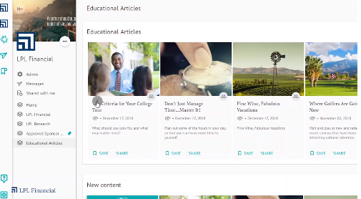
Sample Touches
  Gainfully
  Available through the Resource Center
  Social media marketing campaigns to launch monthly, quarterly, etc. as a “set it and forget it” concept
  Robust content with attractive hero images to appear in their feed

Slide 13

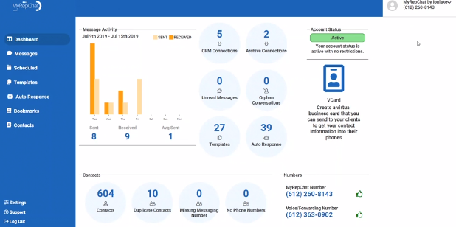
Sample Touches
  My Rep Chat
  Available through the Resource Center
  Ability to text prospects and clients in a compliant manner
  Texting is a highly effective communication channel, and the data supports that people are more likely to open text messages before any other form of mobile communication.
  95% of text messages sent are opened and responded to within the first 3 minutes of being delivered
  Ability to group into separate distribution lists

Slide 14
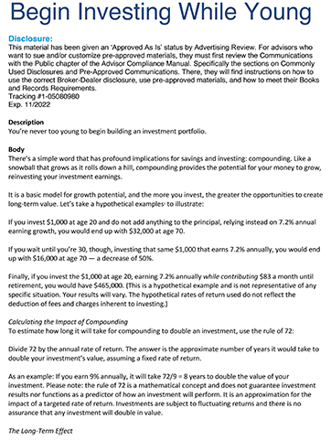
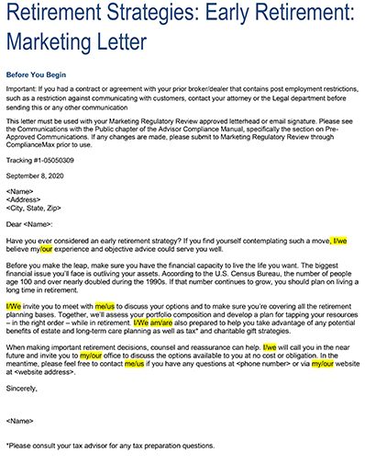
Sample Touches
  Articles & Letters
  Available through LPL’s Marketing on Demand
  Numerous articles and ghost-written letters available
  All content is pre-approved for use
  Sample Article
  Sample Letter

Slide 15
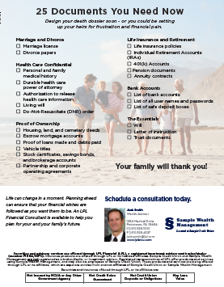

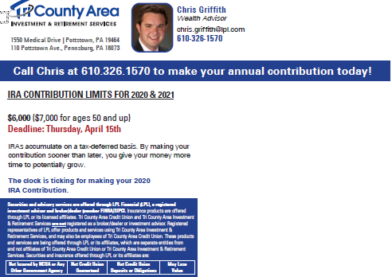
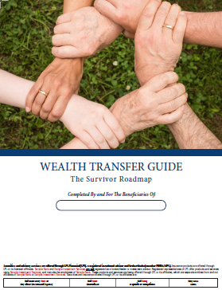
Sample Touches
  Marketing Collateral
  Pre-approved templates available through FRG’s Marketing Resource Library
  Customized collateral designed for your target audience
  Personalized with advisors brand, info, headshot and includes call to actions
  Customized for the medium for which they like to be communicated through

Slide 16

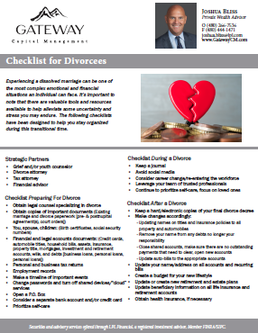

Sample Touches
  Webinars/Seminars
  Checklist
  Preapproved webinars available through FRG’s Marketing Resource Library & Marketing on Demand
  Can also create custom webinar materials (presentation, handouts, invites, etc. (Sample shown)
  Promote through the mediums of which clients/prospects like to be communicated through
  Lunch & Learns are a convenient way to hold webinars that fit into clients/prospects schedules
  PowerPoint
  Social Media Post

Slide 17
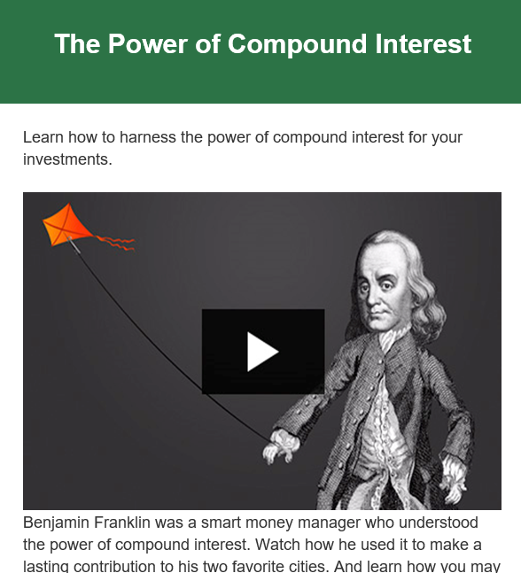
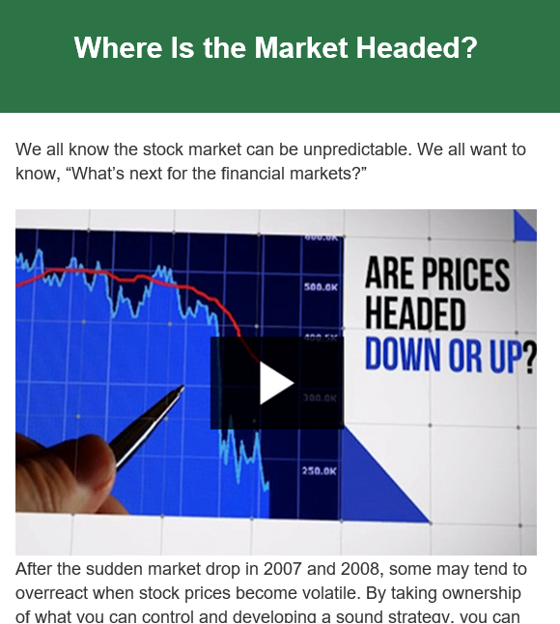
Sample Touches
  Newsletters
  Available through LPL’s third party approved vendors (FMG, Broadridge, etc.)
  Provides access to branded newsletter templates
  Can use original or pre-approved content
  Sample Newsletters: FMG Suite

Slide 18
Webinar Replay
  Turning Clients into Raving Fans
  Click Here to Watch Webinar Replay

