Slide 1

Social Security:
Seven keys to enhancing benefits
[Name, title]
ENT-843-N (R-11/2023)
Notes:
[Note to presenter: Populate your name and title in the customizable section if you are an employee of Allianz.]
<Welcome / Introductions / Announcements>

Slide 2

Social Security provides options
    Many believe it is cut and dried
    It is a retirement income source with some control
    Managing your Social Security benefit
    is part of your retirement income process
Notes:
One of the most confusing but most important steps in your retirement strategies is understanding Social Security retirement benefits.
Many believe it is cut and dried and do not realize there are options.
However, it is a retirement income source with some control and a variety of elections you will need to make.
In addition, since Social Security may be the basis of all your retirement income decisions, it is important to fully understand the implications of the decisions you make.
Managing your Social Security income benefit is an important part of your retirement income process.

Slide 3
Agenda
01 | Benefit basics | 05 | Tax implications
02 | Income benefits | 06 | Spousal and survivor benefits
03 | When to start benefits | 07 | Medicare basics
04 | Working in retirement
As we discuss this material, please be aware that you should seek guidance from the Social Security Administration regarding your particular situation.
Notes:
While many of you know the basics of Social Security, we are going to structure our session so that as you work with your financial professional, you will feel more comfortable in making decisions affecting your 401(k), IRAs, etc.
As we discuss this material, please be aware that you should seek guidance from the Social Security Administration regarding your particular situation.
Today, we will cover 7 keys to enhancing your Social Security benefits.
Let’s start with the basics.
General Social Security benefit basics
We’ll cover income benefits
When to start benefits
Working in retirement
Tax implications
Spousal and survivor benefits
And finally, we will wrap it up with Medicare basics.

Slide 4

01
KEY
Social Security
Benefit basics
Notes:
Starting with Key 1: Benefit basics

Slide 5
Social Security is more than just retirement
June 2023
66.6 million beneficiaries
$1.2 trillion dollars in benefits
Retired workers and their dependents
78%
Average monthly amount:
Retired workers $1,837
Aged widow(ers)/parents $1,713
Disabled workers $1,486
Survivors and their dependents
9%
Disabled workers and their dependents
13%
Social Security Program Fact Sheet, “Fact Sheet on the Old-Age, Survivors, and Disability Insurance Program,” June 2023.
Notes:
A snapshot of month for Social Security. Using June 2023 beneficiary data from Social Security fact sheet, about 66.6 million beneficiaries (66,633) were estimated to receive over $1 trillion ($1.2) in Social Security benefits. 78% of the benefits are paid to retired workers and their dependents.
But Social Security is more than just retirement. Almost 9% (8.8%) paid to survivors of deceased workers. And 13% paid to disabled workers and their dependents.
The average monthly amount a retired worker receives is $1,837, aged widow(er) and aged parents $1,713, and $1,486 for a disabled worker.

Slide 6
Will it be there?
OASI (old age and survivor income)
DI (disability income)
OASI and DI trust fund expected to be depleted in 2034.
Enough revenue coming in
to pay about 80% of
scheduled benefits.
Will it be there when I retire?
“THE 2023 ANNUAL REPORT OF THE BOARD OF TRUSTEES OF THE FEDERAL OLD-AGE AND SURVIVORS INSURANCE AND FEDERAL DISABILITY INSURANCE TRUST FUNDS,” March 31, 2023.
Notes:
Many are concerned about the future of Social Security.
The gap between benefits and promised payment continues to grow.
Will it be there when I retire? This is a common question for many people.
By 2034, the Social Security Administration says the OASI and DI trust funds are expected to be depleted. However, it appears today that projected tax revenues will be adequate to pay about 80% of scheduled benefits in the depletion year of 2034.
Congress will have to make further changes to either reduce future benefits or increase taxes, as a couple of examples of options.

Slide 7
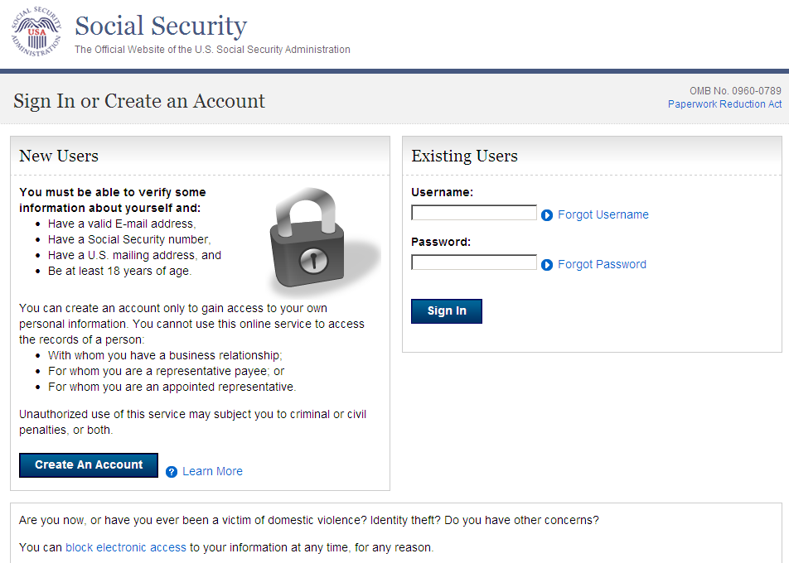
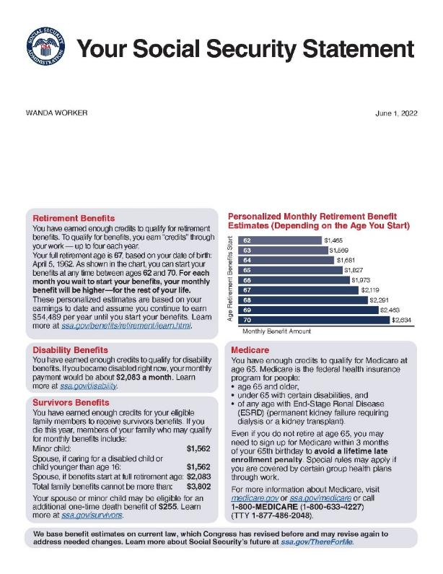
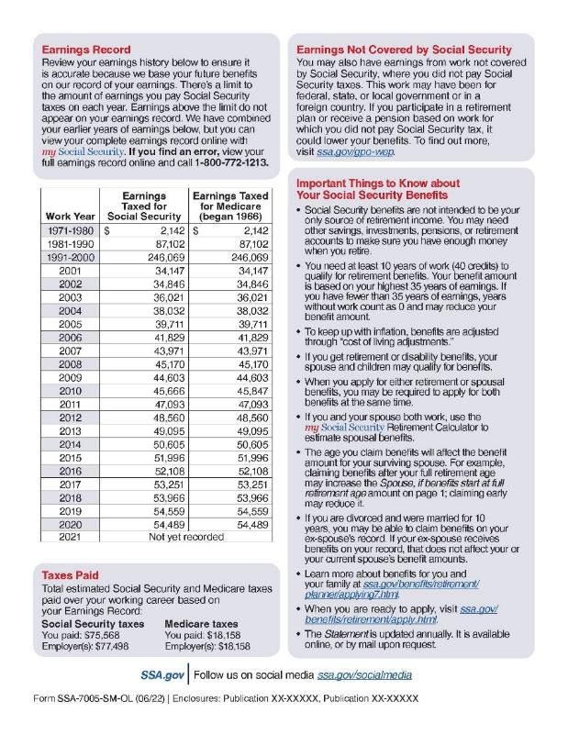
Statements online
https://secure.ssa.gov/RIL/SiView.do
Notes:
Social Security statements are now automatically mailed to you based on your age. But you can go online and create an account.
Once you set up an account, [click] you have several options including getting your Social Security statement. However, statements are not automatically mailed if you have an online account.

Slide 8

02
KEY
Social Security
Income benefits
Notes:
Moving now to key #2: Income benefits.

Slide 9
How to qualify for benefits
Must be fully insured (earned required number of Social Security credits to qualify)
  Most workers need 40 credits or about 10 years of work
2024
One credit recorded for every $1,730 earned in a year with four credits if you earn
$6,920 or more.
  Since 1978 you earn credits on the basis of your annual earnings up to four credits in any year.
  Prior to 1978 you earned one credit for each calendar quarter in which you had wages or salary of at least $50 in covered employment.
Social Security Administration, 2024 Social Security Changes, Fact Sheet.
Notes:
How do you qualify for benefits?
You must be fully insured, which means you earned the required number of Social Security credits.
Most workers need 40 credits. That is about 10 years of work (at four quarters each year).
Through the years the way you earn credits has changed. In 2024, one credit is recorded for every $1,730 you earn in a year, with four credits if you earn $6,920 or more.

Slide 10
How are benefits calculated?
PIA
$
primary insurance amount
full retirement age (FRA)
    Benefit is reduced if taken prior to FRA
AIME
average indexed monthly earnings
Born after 1929, uses highest
35 years to calculate indexed benefits
    Benefit is adjusted up if your start is delayed
Social Security Administration, Primary Insurance Amount.
Notes:
So, how are your benefits calculated?
Your retirement benefit is based on your primary insurance amount (PIA)
[click] Your primary insurance amount (PIA) is the amount you receive at your full retirement age (FRA). Your FRA is based upon the date you were born. I will show you a date chart later in the presentation.
Your average indexed monthly earnings (AIME) are used to calculate your PIA.
If you were born after 1929, you use your highest 35 years to calculate your benefits (Social Security Administration, Benefit Amounts)
Your actual earnings are “indexed” to account for average wage changes since the year your earnings were received.
We will discuss later how your benefits are reduced if taken prior to your full retirement age.

Slide 11

03
KEY
Social Security
When to start benefits
Notes:
Moving to Key 3: When to start benefits

Slide 12
Starting benefits
Can start benefits:
Early at age 62
Full retirement age
Delay until age 70
Year of birth | Full retirement age (FRA) | Age 62 benefit reduction
1943 - 1954 | 66 | 25.00%
1955 | 66 and 2 months | 25.83%
1956 | 66 and 4 months | 26.67%
1957 | 66 and 6 months | 27.50%
1958 | 66 and 8 months | 28.33%
1959 | 66 and 10 months | 29.17%
1960 and later | 67 | 30.00%
Delaying past FRA results in delayed retirement credits (DRCs).
Social Security Administration, Retirement Planner: Starting Your Benefits Early.
Notes:
You can start benefits as early as age 62. But, depending on your full retirement age, as shown in the chart, you will receive 25-30% less in benefits.
Delaying start date after FRA results in delayed retirement credits (DRCs).
Selecting the time for you to retire should be based on your health, life expectancy, how much you have in other retirement plans, etc.

Slide 13
Enhancing benefits by delaying start date
Start benefits at various ages and living to various ages. The following is for an individual born 1960 or later:
 | Accumulated benefits age
 | 70 | 75 | 80 | 85 | 90
62 | $134,400 | $218,400 | $302,400 | $386,400 | $470,400
64 | $115,200 | $211,200 | $307,200 | $403,200 | $499,200
67 | $72,000 | $192,000 | $312,000 | $432,000 | $552,000
68 | $51,840 | $181,440 | $311,040 | $440,640 | $570,240
70 | $0 | $148,800 | $297,600 | $446,400 | $595,200
Start age
Longevity a key factor to consider.
Delaying past FRA results in DRCs
Assumes full retirement age of 67, full retirement benefit $2,000/month, no cost-of-living adjustment (COLA), no discounting. Social Security benefits are first received the month following the month they are due. However, this table reflects 12 monthly payments in the first year and all subsequent years. For illustration purposes only, not an actual client.
Notes:
Let’s examine briefly how you can enhance your benefits by delaying your start date. The following is for an individual born in 1960 or later:
[Note, these calculations are based on a FRA of 67 and a benefit of $2,000/month @ 8% per each year delayed retirement benefits, no COLA, no discounting]
In the accumulated benefits age 70 column, the chart shows the total that you would receive in benefits starting at different ages. So, if you start benefits at age 62 and live to age 70, you will have received $134,400. If you delayed your benefits until age 68 and only lived to age 70, you can see how the amount you would have received decreases.
This is why it is important to consider when you want to start benefits, as well as consider your projected longevity. Depending on your health and life expectancy (which is often in your family genes) you might opt to delay benefits. Obviously, if you are in ill health, starting at age 62 makes sense. But you must also look at life expectancy. If you start at age 62 and are expected to live to only age 70, that maximizes your Social Security benefit. However, if you are in good health, choose to work to age 68 before beginning Social Security, and are expected to live to 80 or 85 years of age, your benefits are significantly better. This is why life expectancy is important to consider when deciding to start your benefits.
As noted, this chart is simplified for illustrative purposes only and does not take into account projected cost of living adjustments (COLAs) or adjust for expected interest rates.

Slide 14

04
KEY
Social Security
Working in retirement
Notes:
Let’s now review working in retirement, our fourth key to Social Security.

Slide 15
Age 60
widow(er)
Age 62
own benefit
FRA
FRA
(up to birthday month)
FRA
(and after)
Working and collecting Social Security benefits
Any reduction in Social Security income in early retirement (due to working) will result in positive adjustment to your monthly benefit when you reach your full retirement age.
2024
Reduced $1
for every $2
above $22,320
Reduced $1
for every $3
above $59,520
No reduction
Social Security Administration, 2024 Social Security Changes, Fact Sheet.
Notes:
Because of a number of reasons - market down turns, loss of job earlier in career than expected, not saving enough, etc. - many people are now “phasing” into retirement and choose to take Social Security benefits at the same time.
In 2024, if you work into your retirement and are between age 62 (age 60 if widow(er)) and your full retirement age, there is a reduction of $1 in benefits for every $2 you earn above $22,320.
If you work into retirement in the year of your full retirement age up to your birthday, there is a reduction of $1 in benefits for every $3 you earn above $59,520 in 2024.
And finally, if you work after your full retirement age there is no reduction.
Any Social Security income reduced in early retirement (due to working) will result in a positive adjustment to your monthly benefit when you reach your full retirement age.

Slide 16

Hypothetical example of Tamera
Tamera
Born 1960
Eligible for maximum benefits
My Social Security
Annual Social Security benefit $22,044
(70% of FRA benefits) $15,431
Current year earnings $40,000
Social Security 2024 earnings limit $22,320
Excess earnings $17,680
Working reduction in benefits $ 8,840
Net Social Security benefits $ 6,591
Average monthly amount:
Retired workers $1,837
    Retired in 2024 on 62nd birthday and returned to work less than one year later
This hypothetical example is for illustrative purposes only and does not represent an actual client.
Notes:
Let’s see how this might work for a hypothetical example of Tamera. Assuming she was born in 1960 and that she is eligible for the maximum amount of Social Security benefit. Lets also assume she wants to retire early at age 62. But, she realized after a while that she enjoyed working and returned to work less than one year later.
[click] So, what would that look like? Remember earlier when we said that according to the Social Security Administration, the average retired worker benefit in June of 2023 was $1,837? Let’s use that number for our example and multiply that times 12 months to get $22,044 for her hypothetical annual benefit. But, Tamera wants to retire early at age 62 so she will receive a reduced benefit or $15,430. [22,044 ($1,837 x 12 mo) x 70% = (15,430)]
Let’s also assume that her current earnings are $40,000. Recall that the Social Security earnings limit for 2023 is $22,320. So we subtract the limit from the earnings to find her excess earnings. [$40,000 - $22,320 = $17,680]. That means we have to reduce $2 for every $1 over $22,320 for working from her excess earnings. This leaves her benefit working reduction to be about half of her excess earnings. Tamera’s net Social Security benefit is $6,591.
This can get a little complicated so make sure your strategies take into account all these various factors.

Slide 17

05
KEY
Social Security
Tax implications
Notes:
Key 5: Tax implications.

Slide 18
Benefits are subject to income tax
Combined income
adjusted gross income
+ nontaxable interest
+ ½ of your Social Security benefit
= Your combined income
up to
50%
up to
85%
Single, or head of household
0%
$25,000
$34,000
Married,
filing jointly
$32,000
$44,000
  % amount of Social Security benefit included in income
  (not the tax rate on the Social Security benefit)
Social Security Administration, Benefits Planner: Income Taxes And Your Social Security Benefits.
Notes:
Social Security benefits are income-tax-free for the majority of beneficiaries; however, many people with higher total incomes are surprised that their Social Security benefits may be subject to federal income tax.
Whether and how your Social Security retirement benefits are taxed is based on your combined income. That is defined as the sum of the adjusted gross income plus nontaxable interest plus one-half of Social Security benefits.
The percentages are the amount of Social Security benefit included in income, not the tax rate on the Social Security benefit.
If you are single or Head of Household (HOH) with a combined income less than $25,000 you may not have to include any of your Social Security benefits received as part of your taxable income for the year (under $32,000 for Married, filing jointly (MFJ).
If you are Single or HOH with a combined income between $25,000 and $34,000 you may have to include up to 50% of your Social Security benefits received as part of your taxable income for the year (between $32,000 and $44,000 for MFJ).
If you are single or HOH with a combined income over $34,000 you may have to include up to 85% of your Social Security benefits received as part of your taxable income for the year (over $44,000 for MFJ).

Slide 19

06
KEY
Social Security
Spousal and survivor benefits
Notes:
Key 6 is spousal and survivor benefits.

Slide 20

When one spouse does not qualify on own record
Nonqualified spouse can collect on the record
of the spouse who is qualified to receive benefits
Must have been married at least one year to
the qualifying spouse or be the parent of their child
If at FRA or later, receives an amount equal
to 50% of the PIA of the qualifying spouse
(not necessarily their benefit amount)
If age 62, they may receive permanently
reduced benefits
  The rules are complicated and vary depending on your situation, so talk to a Social Security representative about the options available to you.
Notes:
If a retiree is married, there is another set of considerations you need to understand. This brings us to the final key number 7 or spousal benefits.
There are calculations and considerations for enhancing benefits for your spouse as well as yourself.
The nonqualifying spouse can collect on the record of the spouse who is qualified to receive benefits. If the nonqualifying spouse is at FRA, he or she will receive 50% of the PIA of the qualifying spouse (not necessarily their benefit amount). If the nonqualifying spouse is age 62, he or she may receive permanently reduced benefits.

Slide 21

When both spouses qualify on their own records
Generally, the spouse with the lower benefits would:
OR
Take benefits generated by own earnings history
Take half of the other spouse’s retirement
benefit if greater
(made up of personal benefit plus the difference to make up half of the primary wage earner’s benefit)
  The rules are complicated and vary depending on your situation, so talk to a Social Security representative about the options available to you.
Notes:
When both spouses qualify, generally the spouse with the lower benefit would receive the benefit based on their own earnings history, or 50% of their spouse’s retirement benefit, if greater.

Slide 22
When both spouses qualify on their own records
ADVANCED OPTION
    At FRA, spouse A could delay receiving their own retirement benefit and start a spousal benefit which is half of spouse B’s benefit.
      Either spouse B is receiving own benefits
      OR
      Spouse B filed and suspended prior to April 30, 2016
      If spouse A’s retirement benefits are delayed, a higher benefit may be received at a later date based on the effect of delayed
      retirement credits.
Spouse A who was
age 62 or older in 2015
  The rules are complicated and vary depending on your situation, so talk to a Social Security representative about the options available to you.
Notes:
Let’s review the advanced option of delaying one’s own benefit and starting a spousal benefit when both spouses qualify for their own retirement benefits. This possibility is only available to someone who was at least age 62 or older in 2015.
With this option, spouse A would receive half of spouse B’s benefit starting at their full retirement age and delay receiving their own retirement benefits until a later date.
To use this strategy either spouse B is already receiving own benefit; OR spouse B filed and suspended benefits prior to April 30, 2016.
If spouse A chooses to delay own benefit, a higher benefit may be received at a later date based on the effect of delayed retirement credits.
This strategy could potentially be used with divorced spouses if certain requirements are met.
The rules are complicated and vary depending on your situation, so talk to a Social Security representative about the options available to you.

Slide 23
Benefits for survivors
Earliest a widow(er) can start receiving Social Security benefits is age 60
(age 50 if disabled)
If you receive survivor benefits early:
  Benefits based on your age can begin any time between age 60 and your FRA
  Starting early, however, your survivor benefits are reduced a fraction of a percentage for each month before your FRA
  If you receive benefits AND you qualify for retirement benefits that are more than your survivor benefits you can switch to your own benefit as early as age 62
  The rules are complicated and vary depending on your situation, so talk to a Social Security representative about the options available to you.
Notes:
And, what about survivor benefits?
A surviving spouse is eligible to receive survivor benefits as early as age 60 (age 50 if disabled).
If you receive benefits early:
You can receive widow’s or widower’s benefits based on your age at any time between age 60 and your full retirement age (FRA) as a survivor. However, if you start at an earlier age, your survivor’s benefits are reduced a fraction of a percentage for each month before your full retirement age.
If you receive widow’s or widower’s benefits, AND you will qualify for a retirement benefit that’s more than your survivor’s benefit, you can switch to your own retirement benefit as early as age 62.
The rules are complicated and vary depending on your situation, so talk to a Social Security representative about the options available to you.

Slide 24

Benefits for divorced spouse
Ex-spouse can receive Social Security benefits based on other ex-spouse’s record
Were married at least 10 years
Ex-spouse receiving benefits must be age 62 or older and unmarried
Own work record is less than benefit based on the divorce
Amount of benefit has no effect on other ex-spouse or their current spouse
Divorced at least two years and if both spouses are at least age 62, divorced spouse can get benefits even if the other spouse is not retired (has not started Social Security benefits)
  The rules are complicated and vary depending on your situation, so talk to a Social Security representative about the options available to you.
Notes:
Ex-spouse can get Social Security benefits based on other ex-spouse’s record if the marriage lasted at least 10 years.
The ex-spouse (the person receiving benefits) must be 62 years of age or older and unmarried.
The benefit that the receiving person is entitled to receive based on his or her own work is less than the benefit based on the divorce.
The amount of benefit has no effect on other ex-spouse or their current spouse.
Also, if divorced for at least 2 years and both ex-spouses are at least age 62, divorced spouse can get benefits even if other ex-spouse has not started Social Security benefits.
The rules are complicated and vary depending on your situation, so talk to a Social Security representative about the options available to you.

Slide 25

07
KEY
Social Security
Medicare
Notes:
Finishing up with Medicare; Key 7.

Slide 26

Medicare eligibility
  Regardless of retirement age, Medicare benefits start at age 65.
  Eligible the first day of the month you turn age 65.
  If you are already receiving Social Security benefits in the month you attain age 65, you are automatically enrolled in Medicare.
  If you are not currently receiving Social Security benefits, you must enroll to receive Medicare benefits. You should apply three months before reaching age 65.
Centers for Medicare & Medicaid Services, “Medicare & You 2023.”
Notes:
You become eligible for Medicare on the first day of the month you turn 65.
If you are already receiving Social Security benefits, you are automatically enrolled.
If you are not receiving Social Security benefits, you must enroll to receive benefits. When you enroll can affect your premiums so it’s important to enroll when you turn age 65, because if you delay, you may pay higher premiums. It is recommended you apply three months before reaching age 65.

Slide 27
Medicare parts
Part A
Hospital insurance
Part B
Medical insurance
Part C
Medicare Advantage Plans
Part D
Prescription drug coverage
Pays for some of the costs for hospitalization, hospice care, and home health services.
Usually premium free, but there are copays and deductibles.
Primarily covers physicians’ services, most outpatient hospital services, and certain related services.
Long-term nursing home care is currently not covered.
There is a premium.
Includes managed care plans, private fee-for-service plans, and medical savings accounts.
May offer extra coverage such as vision, dental, and/or health and wellness programs.
Voluntary prescription drug coverage.
Notes:
There are four parts to Medicare:
Part A is free but there are deductibles and co-pays. It pays for some of the cost of hospitalization, limited skilled nursing home care, hospice care, and home health services.
Part B primarily covers physicians’ services, most outpatient hospital services, and certain related services. Long-term nursing home care is currently not covered. There is a premium for Part B coverage.
Part C includes managed care plans, Private Fee-for-Service plans, and Medical Savings Accounts. It may offer extra coverage such as vision, dental, and/or health and wellness programs.
Part D is a voluntary prescription drug coverage.
Note that Medicare does not cover everything.

Slide 28
Medicare coverage decisions
Original
Medicare
Medicare Advantage Plan
DECISION 1
How do you want to
get coverage?
Parts A&B
Parts A, B, C &
usually D¹
Part D
Part D
DECISION 2
Do you need to add prescription drug coverage?
Medigap
DECISION 3
Do you need to add supplemental coverage?
¹ Most plans cover but you may be able to add coverage in some plan types if not already included.
Notes:
There are a few decisions to make.
First decision is, how you want to get coverage.
There are two main ways to get your Medicare coverage: Original Medicare and Medicare Advantage Plan, which is like an HMO or PPO.
Second decision is, do you need to add prescription drug coverage? Most Medicare Advantage Plans cover prescription drugs but it can be added to some plans if not already included.
A third decision is, do you need to add supplemental coverage like Medigap under original Medicare plans? If you join a Medicare Advantage Plan, you don’t need (and therefore can’t buy) a Medigap (Medicare Supplement Insurance) policy.

Slide 29
Summary
01 | Benefit basics | 05 | Tax implications
02 | Income benefits | 06 | Spousal and survivor benefits
03 | When to start benefits | 07 | Medicare basics
04 | Working in retirement
Remember, you should seek guidance from the Social Security Administration regarding your particular situation.
Notes:
So, Social Security is just one extremely important part of your retirement sources of income. It is the base on which you and your financial professional will make other decisions.
Today we covered 7 keys to enhancing your Social Security benefits.
We started with seven of the basics for knowing the numbers behind the benefits.
Basic facts to know
Benefit basics
When to start benefits
Working in retirement
Tax implications
Spousal and survivor benefits
And finally, we wrapped it up with Medicare, for 7 keys.
Please remember to seek guidance from the Social Security Administration regarding your particular situation.
Hopefully, you can now feel more comfortable in looking at your retirement strategies with help from your financial professional, attorney and tax professional.

Slide 30

Next steps
Social Security is the foundation of your retirement strategies.
    Understand all filing options available to you to enhance your Social Security benefit.
    Evaluate whether your essential income needs in retirement are likely to be covered by your retirement income sources.
    Consider annuities to add to your retirement income strategies.
    Let’s meet to review your
    specific situation.
Notes:
So, we covered a lot of things to think about. Social Security is the foundation to your retirement income sources. What should you do next?
Make sure you understand all filing options available to you to help enhance your Social Security benefits.
Evaluate if your basic retirement income needs are likely to be covered by your retirement income sources.
Consider annuities to help fund any potential retirement income gaps. Annuities can help you meet your long-term retirement goals by offering tax-deferred growth potential, a death benefit during the accumulation phase, and a guaranteed stream of income at retirement.
Then, let’s meet to review your specific situation.

Slide 31


This content is for general educational purposes only. It is not intended to provide fiduciary, tax, or legal advice and cannot be used to avoid tax penalties; nor is it intended to market, promote, or recommend any tax plan or arrangement. Allianz Life Insurance Company of North America, Allianz Life Insurance Company of New York, their affiliates, and their employees and representatives do not give legal or tax advice or advice related to Medicare or Social Security benefits. You are encouraged to consult with your own legal, tax, and financial professionals for specific advice or product recommendations, or to go to your local Social Security Administration office regarding your particular situation.
All annuity contract and rider guarantees, or annuity payout rates, are backed by the claims-paying ability of the issuing insurance company. They are not backed by the broker/dealer from which this annuity is purchased, by the insurance agency from which this annuity is purchased, or any affiliates of those entities, and none makes any representations or guarantees regarding the claims-paying ability of Allianz Life Insurance Company of North America or Allianz Life Insurance Company of New York. Guarantees do not apply to the performance of the variable subaccounts, which will fluctuate with market conditions.
Products are issued by Allianz Life Insurance Company of North America, 5701 Golden Hills Drive, Minneapolis, MN 55416-1297. www.allianzlife.com. In New York, products are issued by Allianz Life Insurance Company of New York, 1633 Broadway, 42nd Floor, New York, NY 10019-7585. www.allianzlife.com/new-york. Variable products are distributed by their affiliate, Allianz Life Financial Services, LLC, member FINRA, 5701 Golden Hills Drive, Minneapolis, MN 55416-1297. www.allianzlife.com. Only Allianz Life Insurance Company of New York is authorized to offer annuities and life insurance in the state of New York.
Questions?
Thank you!
THANK YOU.
Questions?

