Slide 1



Retirement
Building a Comfortable Lifestyle for Tomorrow
Notes:
Welcome to our retirement seminar on building a comfortable lifestyle for tomorrow. We’re glad that you could join us here today.
Before we get started, I’d like to introduce myself and my company.
[Note to presenter: Give a brief personal background, then talk about your organization and give its location. If appropriate, introduce other members of your organization who are in the room and discuss any housekeeping issues.]
SLIDE 0010

Slide 2
Securities and advisory services are offered through LPL Financial (LPL), a registered investment advisor and broker/dealer (member FINRA/SIPC). Insurance products are offered through LPL or its licensed affiliates. Sample Federal Credit Union (SCU) and Sample Wealth Management are not registered as a broker/dealer or investment advisor. Registered representatives of LPL offer products and services using Sample Wealth Management, and may also be employees of SCU. These products and services are being offered through LPL or its affiliates, which are separate entities from and not affiliates of SCU or Sample Wealth Management. Securities and insurance offered through LPL or its affiliates are:
Not Insured by NCUA/FDIC or Any Other Government Agency | Not Credit Union or Bank Guaranteed | Not Credit Union or Bank Deposits or Obligations | May Lose Value

Slide 3

When You Imagine Your Retirement,
What Do You See?
Notes:
When you close your eyes and imagine your own retirement, what do you see? Most people imagine retirement as a happy time, a reward for a lifetime of hard work, full of possibility and potential.
Many of us look forward to pursuing hobbies and traveling, while others might envision an opportunity to go back to school, start a new career or business, or simply spend more time with friends and family.
We have good reasons to see retirement in a positive light. After all, Americans are living longer, healthier lives than ever before. In fact, retirement could make up a full third of our lives. Of course, this means that our retirement assets will have to do more for us over a longer period of time.
SLIDE 0040

Slide 4

With So Many Financial Challenges,
How Do You Make Retirement a Priority?
Notes:
When you open your eyes from your retirement daydream, the reality may seem a bit daunting.
With so many financial challenges — bills, housing expenses, college savings (if you have children), and just the basic costs of everyday life — how do you make saving for retirement a high priority when you might not retire for decades?
The key is to understand why you need to plan so far ahead and then learn more about how to balance today’s challenges with tomorrow’s goal.
Your presence here today is an important first step in the pursuit of a comfortable retirement. Together, we will explore the “whys” and the “hows” and look at actions you can take both today and in the future.
SLIDE 0050

Slide 5


Three Keys to Funding a
Comfortable Retirement
1. Evaluate Your Needs and Set a Goal
2. Develop a Strategy
3. Protect Your Nest Egg
Notes:
There are three keys to funding a comfortable retirement.
First, you need to evaluate your retirement income needs. This involves understanding those all-important “whys” — the factors that will influence your personal situation — as well as taking a quick look at some of the income resources that may be available to you in retirement, such as Social Security. Then we’ll put pen to paper and describe how to calculate a total retirement savings goal, breaking it down into an annual amount.
Next, we’ll look at the “hows,” which represent the bulk of our conversation today. How do you develop a strategy to pursue your retirement savings goal? We’ll walk through several retirement savings tools and then explore the process of building a retirement investment portfolio.
Finally, we’ll spend a few brief moments covering how to help protect your nest egg from some of life’s most serious financial risks — both before and during retirement.
Let’s discuss these key steps in greater detail.
SLIDE 0060

Slide 6

Factors That Influence Your Retirement Income Needs: The “Whys”
• Retirement age
• Length of retirement
• Health-care needs
• Inflation
• Lifestyle
Notes:
Many factors will significantly influence how much income you will need in retirement. These “whys” are some of the most important reasons why you need to make retirement planning a key financial goal throughout your lifetime.
The reasons are: the age when you plan to retire, the length of your retirement, your health-care needs and expenses, the effects of inflation, and the type of retirement lifestyle you envision.
SLIDE 0070

Slide 7

Retirement Age
The earlier you retire, the shorter the period of time you have to accumulate funds, and the longer those dollars will need to last
Social Security isn’t available until age 62*
Medicare eligibility begins at age 65
*Claiming Social Security at age 62 results in a permanently reduced
benefit amount.
Notes:
Have you thought about the age when you’d like to retire?
This is important, because the earlier you retire, the shorter the period of time you have to accumulate funds, and the longer the period of time those dollars will need to last.
Although you can retire at any time, many people target the age when they’re eligible for Social Security retirement benefits. You can claim Social Security as early as age 62, but keep in mind that the longer you wait (up to age 70), the more you’ll receive each month. We’ll take a more detailed look at Social Security in a little while.
Also, you’re not eligible for Medicare health coverage until age 65, so if you want to retire before then, you’ll want to plan for private health insurance.
SLIDE 0080

Slide 8
Planned and Actual Retirement Age
Expected
(workers)
Actual
(retirees)
39%
37%
34%
25%
18%
18%
17%
11%
Before 60
60–64
65
66 or older
Source: Employee Benefit Research Institute, 2021 (numbers don’t add up to 100 due to rounding)
Notes:
Keep in mind that you can’t always control your retirement age.
A recent survey found that the ages when workers expect to retire were later than the actual ages when retirees left the workforce. In fact, the vast majority of retirees said they retired prior to age 65 — some for reasons beyond their control.
Consider the possibility that you might be unable to continue working because of poor health or changes at your company, such as downsizing or workplace closure. This is a major reason why it’s important to save for retirement throughout your life — you can never be sure what the future may bring, despite your best-laid plans.
Source: Employee Benefit Research Institute, 2021 (numbers don’t add up to 100 due to rounding)
SLIDE 0090

Slide 9
Length of Retirement
At age 65, a healthy individual may expect to spend 20 years or longer in retirement.
Chance of living to: Age 85
Age 90
Man
33%
54%
Chance of living to: Age 85
Age 90
Woman
65%
44%
Source: Society of Actuaries, 2022
Notes:
We alluded to the second factor a moment ago: the length of your retirement.
With recent advances in technology and medicine, life expectancies are stretching considerably. As you can see, chances are good that you’ll be spending a large portion of your life in retirement. In fact, a 65-year-old in average health is likely to live another 20 to 25 years. Are you prepared, financially speaking, to live this long?
[Note to presenter: Discuss chances that a 65-year-old man and woman will live to age 85 or 90.]
Source: Society of Actuaries, 2022
SLIDE 0100

Slide 10
Health-Care Needs
7.0%
A 65-year-old retired couple may need $296,000 to cover their health-care expenses in retirement.
4.6%
Health-care costs
General inflation
2.3%
2.2%
2.0%
1.9%
1.9%
1.8%
1.4%
2018
2019
2020
2021
Sources: Employee Benefit Research Institute, 2022; U.S. Bureau of Labor Statistics, 2022
Notes:
Longevity is related to health care, which is our third factor to consider.
This chart shows that in three out of the last four years, health-care costs increased at a faster rate than general inflation, and the trend may well continue.¹
As a result, fewer employers are offering health-care benefits to retirees, and many that do offer benefits are scaling back.
In fact, if Medicare benefits remain at current levels, it’s estimated that a 65-year-old couple who retired in 2021, live an average life expectancy, and have average prescription drug expenses might need nearly $300,000 just to pay their health expenses in retirement.²
Under the circumstances, it’s little wonder that paying for medical expenses has become one of the biggest worries that many retirees face — and one of the most important reasons to plan ahead. During retirement, you won’t have to make sacrifices in other areas of your budget in order to pay your medical bills.
Sources: 1) U.S. Bureau of Labor Statistics, 2022; 2) Employee Benefit Research Institute, 2022 (estimate is based on savings needed to cover premiums for Medicare Part B and Part D, the Part B deductible, premiums for Medigap Plan G, and median out-of-pocket prescription drug expenses)
SLIDE 0110

Slide 11




Inflation
Item
Cost Today
Future Cost in 20 Years
$4.00 $7.22
$45.00 $81.28
$100.00 $180.61
$47,000 $84,887
Gallon
of milk
Haircut
Running
shoes
New car
Assumes a 3% inflation rate
Future costs in this hypothetical example are based on mathematical principles and used for illustrative purposes only. A 3% annual inflation rate cannot be guaranteed. Actual results will vary.
Notes:
Inflation is another important factor that could affect the amount you will need to save for retirement.
Inflation is the rise in consumer prices over time. Because inflation makes it more expensive to buy the things you need to live comfortably from day to day, it can effectively lower the value of your savings from year to year.
For example, this table shows how a low 3 percent inflation rate could affect the cost of everyday items over 20 years. Essentially, the purchasing power of your money would be cut nearly in half in about 20 years.
Over the past 30-year period ended in 2021, inflation averaged 2.4 percent on an annual basis, but this average hides years of unexpected spikes. For example, inflation in 2021 was 7.0 percent, the highest annual rate since the early 1980s.¹
Future costs in this hypothetical example are based on mathematical principles and are used for illustrative purposes only. A 3 percent annual inflation rate cannot be guaranteed. Actual results will vary.
Source: 1) U.S. Bureau of Labor Statistics, 2022 (Consumer Price Index for the period 1/1/1992 to 12/31/2021)
SLIDE 0120

Slide 12

Lifestyle
You may need anywhere
from 70% to 100% of your
pre-retirement income
to live comfortably in retirement.
Notes:
And finally, the last retirement income factor we’ll consider is your lifestyle. Unlike several of the other factors, this one is largely under your control.
For example, you may plan to travel extensively, be involved in philanthropic endeavors, or maintain a membership at the local country club. Or you may simply want to spend more time reading and playing board games with your grandchildren.
Depending on your specific goals, you may need anywhere from 70 percent to 100 percent of your pre-retirement income to live comfortably in retirement.
SLIDE 0130

Slide 13

Possible Sources of Income
  Social Security
  Continued employment earnings
  Personal savings and investments
  – Tax deferred
  – Taxable
Notes:
Now that you have some idea of the factors that could affect your retirement savings and income needs, the next question becomes: What resources will you have available?
The primary sources of retirement income are Social Security, continued employment earnings, and personal savings and investments, including both tax-deferred and taxable vehicles.
Some retirees are still fortunate enough to have a traditional pension plan (also known as a defined benefit plan), but these benefits are gradually becoming a relic of the past. In the private sector, they have been replaced by employer-sponsored retirement plans such as 401(k)s, which generally require that you, the plan participant, be responsible for your own retirement savings and investment decisions.
For that reason and because time is limited, we won’t be discussing traditional pensions today. But if you’re lucky enough to have one, a pension could be a very important component of your retirement income strategy and will need to be considered in relation to everything else we discuss here today.
SLIDE 0140

Slide 14

Social Security
  Benefits are based on career earnings and the age when you claim Social Security
  Social Security replaces about 40% of
  pre-retirement income
  The estimated average monthly benefit for all retired workers in 2022 is $1,657
  Visit ssa.gov/myaccount to create your own personal account and view your estimated Social Security benefits online
Sources: Social Security Administration, 2022
Notes:
Let’s take a minute or two to look at how Social Security works.
Social Security benefits are based on two factors: your highest 35 years of earnings in the workforce and your age when claiming benefits.
If you retire at your “full retirement age” (66 to 67, depending on birth year), you will receive your “full” Social Security benefit. However, you can choose to retire as early as age 62 and receive a reduced benefit — as much as 25 to 30 percent less than your full retirement age benefit. If you retire later (up to age 70), you’ll receive a larger benefit (24 to 32 percent more than the full benefit amount). In your workbook on page 6, you’ll find a table that shows how claiming age affects your benefit amount.
Social Security currently replaces about 40 percent of pre-retirement income. The estimated average monthly Social Security benefit for all retired workers in 2022 is $1,657.
Typically, the monthly benefit increases annually to keep pace with the rising cost of living; however, there have been years with no increases because the overall inflation rate was too low to trigger an increase.
Visit ssa.gov/my account to create your own personal Social Security account on the Social Security website and view your estimated benefits online.
Source: Social Security Administration, 2022
SLIDE 0150

Slide 15


Continued Employment Earnings
72% of workers expect to continue working for pay after reaching retirement age
30% of retirees say they
have worked for pay in retirement
Source: Employee Benefit Research Institute, 2021
Notes:
Continued employment earnings can also help provide income during retirement. Nearly three-fourths of workers in one survey said they plan to continue working for pay after they reach retirement age; however, consider that just 30 percent of current retirees said they have actually worked for pay in retirement.
Although it’s good to hope for the best, consider that 46 percent of today’s retirees stopped working earlier than they had planned, often because of unexpected crises.
The best way to prepare for the unexpected in retirement may be to strive to save enough so that if you are unable to work for pay, you can still enjoy the kind of lifestyle you have envisioned.
Source: Employee Benefit Research Institute, 2021
SLIDE 0160

Slide 16

Personal Savings and Investments
  Tax-deferred vehicles
  – Work-based retirement savings plans
  – IRAs
  – Annuities
  Taxable vehicles
  – Stocks, bonds, cash alternatives
  – Mutual funds, ETFs
Notes:
Personal savings and investments will make up the bulk of retirement income for many of today’s workers.
People often choose to save for retirement using tax-deferred retirement savings vehicles, such as work-based retirement savings plans and IRAs. Annuities are an additional option to consider.
And some investors supplement their tax-deferred savings and investments by investing in stocks, bonds, cash alternatives, mutual funds, and exchange-traded funds.
We’ll discuss each of these options in a bit more detail in the next section of this presentation on developing a strategy.
SLIDE 0170

Slide 17
The Value of Tax Deferral
$70,000
$60,000
$50,000
$40,000
$30,000
$20,000
$10,000
$0
Taxable investment
$57,435
($43,651 after-tax)
Tax-deferred investment
$10,000 initial investment
6% annual rate of return
24% tax rate
$38,104
0
5
10
15
20
25
30
This hypothetical example is used for comparison purposes only and does not reflect the actual performance of any specific investments. The taxable account assumes that a portion of assets is used to pay taxes (24%) attributable to the account’s earnings. Rates of return will vary over time, especially for long-term investments. Actual results will vary. Investment fees and expenses are not considered and would reduce the results shown if they were included. Lower maximum tax rates for capital gains and qualifying dividends, as well as the tax treatment of investment losses, could make the taxable investment return more favorable, reducing the difference in performance between the two accounts.
Notes:
Let’s take a quick look at how tax deferral can help you pursue your savings goal.
Generally, deferring current taxes can help you save money. That’s why so many people choose to contribute to work-based savings plans and traditional IRAs.
When you contribute funds to a tax-deferred account, you pay no current taxes on the contributions or any earnings until you withdraw funds, generally in retirement. This may allow your savings to accumulate faster over time because you have your full contribution working for you.
Let’s assume you have $20,000 to invest. You put $10,000 into a taxable account that earns a 6 percent annual return and use a portion of these assets to pay taxes attributable to the account’s earnings. You put the other $10,000 into a tax-deferred account such as a 401(k) that also earns 6 percent annually. Assuming a 24 percent tax rate, in 30 years your taxable account would be worth about $38,000, while your tax-deferred account would be worth over $57,000. That’s a difference of almost $20,000.
Even if the funds invested in the tax-deferred account are subject to federal income tax upon withdrawal — as they would if you made pre-tax contributions to a 401(k) plan — you would come out ahead. This is true even if you took the entire amount in the tax-deferred account as a lump-sum distribution after 30 years and paid tax on the full amount. (At a 24% tax rate, you’d end up with a little over $43,600.) Of course, most individuals draw on their retirement savings gradually during their retirement years — when they may be in a lower tax bracket — rather than taking a large lump-sum distribution.
This hypothetical example is used for comparison purposes only and does not reflect the performance of any specific investments. The taxable account assumes that a portion of assets is used to pay taxes (24%) attributable to the account’s earnings. Rates of return will vary over time, especially for long-term investments. Actual results will vary. Investment fees and expenses are not considered and would reduce the results shown if they were included. Lower maximum tax rates for capital gains and dividends, as well as the tax treatment of investment losses, could make the taxable investment return more favorable, reducing the difference in performance between the accounts shown.
SLIDE 0180

Slide 18

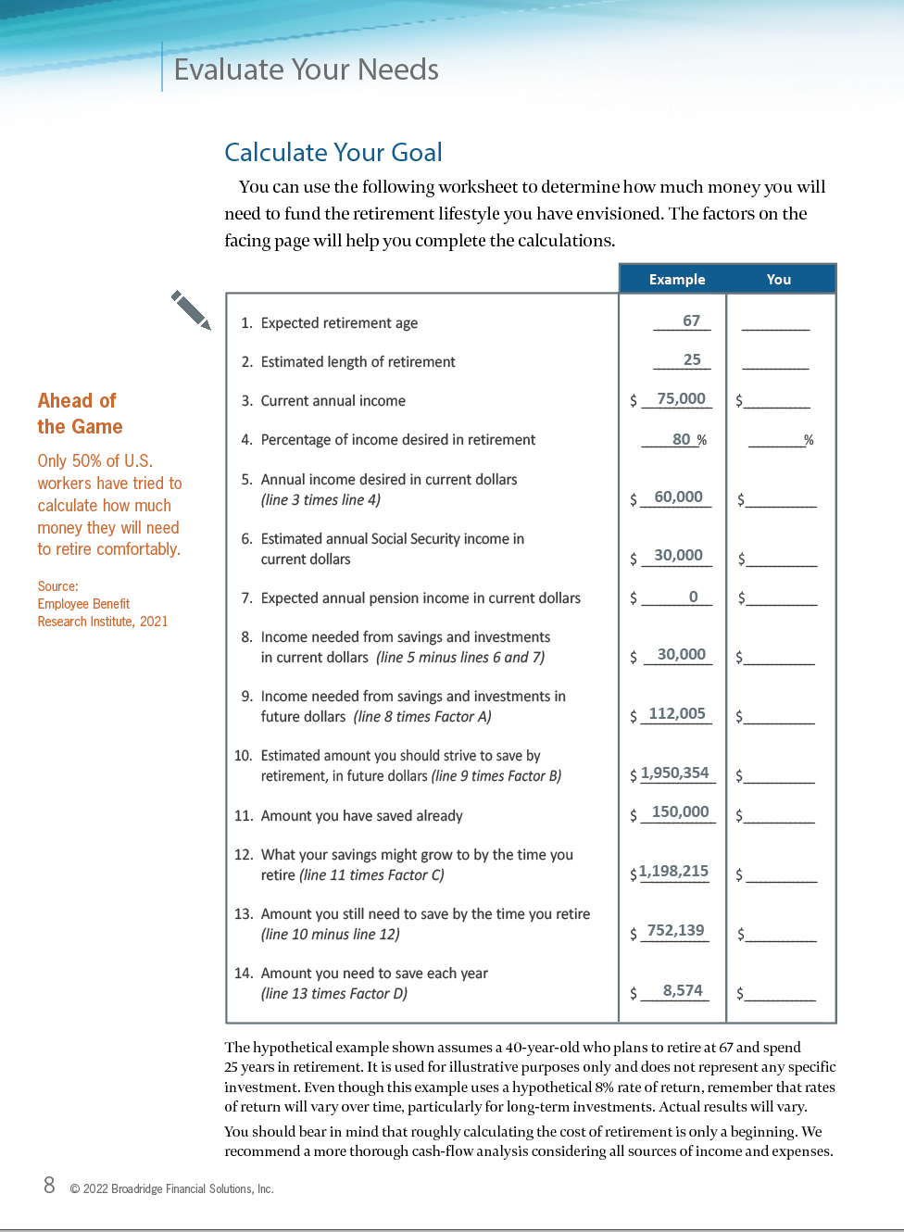
Calculate Your Goal
  Only 50% of U.S. workers have tried to calculate how much they need to save for a comfortable retirement
  49% have estimated how much income they’ll need each month in retirement
Pa10
Source: Employee Benefit Research Institute, 2021
Page 8
Notes:
Now that we’ve reviewed several of the reasons why it’s important to plan ahead for retirement and briefly reviewed some of the key resources that may be at your disposal, it’s time to estimate the amount of money you may need to save to pursue your dreams.
Only half of U.S. workers have tried to calculate how much money they will need to live comfortably in retirement.¹ Yet this is the first step in putting together a well-thought-out retirement savings strategy.
In your workbook, you’ll find a worksheet to help you estimate the amount of money you may need to save each year, based on a number of different factors. Please turn to page 8.
[Pause to give participants sufficient time to locate the worksheet.]
As you can see, the first column shows an example of how the worksheet works. The second column is for you to fill out after you return home and have access to your records. Use the factors on page 9, which use various assumptions for inflation and rates of return, to complete the worksheet. Note that none of the assumptions can be guaranteed; the worksheet is meant to give you a general idea of how much you should be saving.
[Note to presenter: You can go through the worksheet during the presentation or provide a brief overview of the steps and encourage participants to complete it at home at their convenience.]
Source: 1) Employee Benefit Research Institute, 2021
SLIDE 0190

Slide 19
Three Keys to Funding a
Comfortable Retirement
1. Evaluate Your Needs and Set a Goal
2. Develop a Strategy
3. Protect Your Nest Egg
Notes:
Once you have set a retirement savings goal, the second key is to develop a strategy to pursue it. That involves understanding the variety of available tools and putting together an investment portfolio appropriate for you and your family’s specific needs and circumstances.
First we’ll look at a few common tax-deferred tools, and then we’ll discuss some taxable investment options. We’ll conclude this section by getting into the investment portfolio details.
SLIDE 0200

Slide 20
Work-Based Retirement Savings Plans
  Pre-tax contributions
  Tax-deferred accumulation
  Possible employer match
  Annual contribution limits
Retirement Savings Plan
Contribution Limits
$6,500
Catch-up limit (age 50+)
$20,500
Annual contribution limit
2022
Notes:
Work-based retirement savings plans such as 401(k) and 403(b) plans offer a number of benefits.
First, you generally contribute a percentage of your salary using pre-tax funds, and you don’t have to pay current taxes on contributions or any earnings until you withdraw money, generally in retirement. As we discussed, this can greatly enhance the growth potential of the investment by allowing each year’s savings to build on the pre-tax accumulation of previous years.
In addition, making pre-tax contributions may help lower your current income tax liability and may enable you to contribute more each month.
Employers may offer to match a percentage of your employer-plan contributions with additional funds. This is essentially extra money provided by your employer to help you save for retirement. Whatever your savings strategy, it is usually a good idea to contribute at least enough to qualify for the full employer match, if one is offered.
Defined contribution plans are subject to federal contribution limits. In 2022, workers may contribute up to $20,500 to a 401(k) or 403(b) plan, and workers who are 50 and older may save an additional $6,500 thanks to a special “catch-up” provision.
You should also remember that distributions from most work-based retirement plans are taxed as ordinary income. Withdrawals taken prior to reaching age 59½ may be subject to a 10 percent early-distribution penalty. Generally, required minimum distributions (RMDs) from tax-deferred plans must begin for the year in which you reach age 72. The required beginning date (latest date to take the first distribution) is April 1 of the year after the year in which you reach age 72. In some cases, if you’re still working, you might be able to delay required distributions from your current employer’s retirement plan until after you retire.
SLIDE 0210

Slide 21

Roth Contributions
After-tax contributions
Funds grow tax deferred until withdrawn
Qualified distributions are free of
federal income tax
Must meet 5-year holding requirement AND have reached age 59½ or be disabled
Nonqualified distributions are taxable
Notes:
Your work-based plan may also allow you to make Roth contributions. Roth contributions are made with after-tax dollars, so you don't get an immediate tax savings the way you do with pre-tax contributions. On the other hand, if you meet certain conditions, the earnings in your Roth account will be entirely free of federal income tax (any distribution that represents a return of your own contributions is always tax-free).
The limits for Roth 401(k) contributions are the same as the limits for pre-tax contributions ($20,500 in 2022; $27,000 if you are age 50 or older). But the annual limit applies to your total pre-tax and after-tax Roth contributions. For example, you can choose to make $9,000 of pre-tax contributions and $11,500 of Roth contributions, or split your contributions any other way you wish.
In order for a distribution from your Roth account to be tax-free, you must satisfy a five-year holding requirement and have reached age 59½ or be disabled when you receive the payment.
If you receive a nonqualified distribution, your payment will generally include your own contributions, which are nontaxable, and a pro-rata portion of earnings, which are subject to income tax and a potential 10 percent early-distribution penalty if you are under age 59½.
Roth contributions are treated the same as pre-tax contributions for all other work-based plan purposes. For example, access to your funds is generally limited while you’re still employed, your employer can match your Roth contributions (although any employer contributions go into your pre-tax account), and you may be able to borrow from your Roth account.
Whether you should make pre-tax or Roth contributions depends on your personal goals and circumstances. Not all work-based plans allow Roth contributions, so check with your plan administrator.
SLIDE 0220

Slide 22

Traditional IRA
Broad eligibility
Tax-deductible contributions
Tax-deferred accumulation
Typically, more investment options
Annual contribution limits
Subject to required minimum distributions
Notes:
IRAs are another popular way to save for retirement on a tax-deferred basis.
There are two main types of IRAs: traditional and Roth. Anyone who has earned income from a job can contribute to either type of IRA.
A traditional IRA offers a number of distinct benefits. Contributions are generally tax deductible, unless you participate in a work-based retirement plan and your income exceeds certain limits. On page 11 in your workbook, you can see the potential tax savings when making tax-deductible contributions to a traditional IRA.
Your contributions and any earnings accumulate tax deferred, so no current taxes are due until you make withdrawals, generally in retirement.
IRAs may offer a broader range of investment options than a work-based retirement plan.
However, IRAs are subject to lower federal contribution limits than most work-based plans. In 2022, individuals may contribute up to $6,000 to all IRAs combined, or $7,000 for those age 50 and older.
As is the case with work-based retirement plans, you generally must begin taking required minimum distributions (RMDs) from a traditional IRA each year once you reach age 72.
Remember that distributions from traditional IRAs are taxed as ordinary income. Withdrawals taken prior to reaching age 59½ may be subject to a 10 percent early-distribution penalty.
SLIDE 0230

Slide 23

Roth IRA
  After-tax contributions
  Tax-deferred accumulation
  Tax-free qualified withdrawals
  No required minimum distributions
  (if you’re the original owner)
  Annual contribution limits
  Income eligibility phaseouts
Notes:
The Roth IRA has become attractive in recent years. It differs from a traditional IRA in that contributions are made with after-tax dollars (as well as assets converted from traditional IRAs and work-based retirement plans), and qualified Roth distributions are free of federal income tax. Any earnings accumulate tax deferred.
Having a tax-free source of income could be beneficial in retirement because distributions aren’t included in your taxable income and thus don’t affect the taxability of Social Security benefits.
If you are the original owner of a Roth IRA, you never have to take required minimum distributions (RMDs) due to age. Beneficiaries who inherit Roth IRAs are subject to different rules, but withdrawals are free of federal income tax. (Most nonspouse beneficiaries must liquidate inherited retirement accounts within 10 years of the original owner’s death; spousal beneficiaries may take RMDs that can be stretched over their lifetimes.)
Roth IRAs are subject to the same contribution limits as traditional IRAs. You may contribute up to $6,000 ($7,000 for those age 50 and older) to all IRAs combined. However, eligibility to contribute to a Roth IRA begins to phase out at higher income levels. Your workbook includes income thresholds for Roth IRA eligibility.
To qualify for the tax-free and penalty-free withdrawal of earnings (and assets converted to a Roth), Roth IRA distributions must meet the five-year holding requirement and take place after age 59½, or they need to result from the original owner’s death, disability, or a qualifying first-time home purchase ($10,000 lifetime maximum).
[Note to presenter: You might mention that you can discuss the potential benefits of converting tax-deferred assets to a Roth IRA at the complimentary, no-obligation consultation.]
SLIDE 0240

Slide 24

Annuities
  After-tax contributions
  Tax-deferred accumulation
  No federal contribution limits
  No mandatory distributions
  Guaranteed returns*
*The guarantees of fixed annuity contracts are contingent on the financial
strength and claims-paying ability of the issuing insurance company.
Notes:
Annuities offer another tax-deferred way to accumulate funds for retirement, yet they don’t have some of the restrictions associated with IRAs and employer-sponsored retirement plans.
An annuity is a contract between you and an insurance company. In return for your payments, the company agrees to pay you a regular income for a set number of years or for the length of your retirement.
Contributions to annuities are made with after-tax dollars, but any earnings accumulate tax deferred.
Unlike IRAs and work-based retirement plans, annuities are not subject to federal contribution limits, so they can be funded with a lump sum from an inheritance or the sale of a home or business. In addition, annuity owners are not required to take mandatory distributions due to age.
Finally, some types of annuities offer guaranteed returns and lifetime payments (for an additional cost), which could significantly enhance your income in retirement.
Generally, annuities have mortality and expense charges, account fees, investment management fees, and administrative fees. The earnings portion of annuity withdrawals is taxed as ordinary income; withdrawals prior to age 59½ may be subject to a 10 percent early-distribution penalty. Surrender charges may also apply during the contract’s early years if the annuity is surrendered. The guarantees of fixed annuity contracts are contingent on the financial strength and claims-paying ability of the issuing insurance company. Annuities are not guaranteed by the FDIC or any other government agency; they are not deposits of, nor are they guaranteed or endorsed by, any bank or savings association.
SLIDE 0250

Slide 25

Types of Annuities
  Fixed
  Variable
  Indexed
Variable annuities are sold by prospectus. Please consider the investment objectives, risks, charges, and expenses carefully before investing. The prospectus, which contains this and other information about the variable annuity contract and the underlying investment options, is available from your financial professional. Be sure to read the prospectus carefully before deciding whether to invest.
Notes:
There are three main types of annuities: fixed, variable, and indexed.
Fixed annuities offer a guaranteed rate of return, so your investment pays a set yield no matter how the market performs. Fixed annuities may be set up to pay you guaranteed income for a certain number of years or for the entire length of your retirement.
With variable annuities, you can invest in a variety of investment options, often called subaccounts, whose value may fluctuate with market conditions. The investment objectives of the subaccounts can range from conservative to aggressive. A variable annuity may outperform a fixed annuity, but there are no guarantees. If the markets experience hard times, investors run the risk of losing accumulated earnings and even principal.
Indexed annuities (equity-indexed annuities) are designed to combine the benefits of fixed and variable annuities by offering guaranteed protection of principal with the potential for additional gains. The performance of an indexed annuity is tied to a market index such as the Standard & Poor’s 500.* When the index rises, so does the return on the annuity. But if the index tumbles, typically the worst the annuity can do is earn no interest — or a guaranteed minimum, if one is offered. This minimum guarantee is contingent upon holding the indexed annuity until the end of the term. Thus, indexed annuities allow investors to pursue stock market gains while still protecting their principal.
The guarantees of fixed and indexed annuity contracts are contingent on the financial strength and claims-paying ability of the issuing insurance company. Generally, annuities contain mortality and expense charges, account fees, investment management fees, and administrative fees. Most annuities have surrender charges that are assessed during the early years of the contract if the annuity is surrendered. In addition, withdrawals prior to age 59½ may be subject to a 10 percent early-distribution penalty. The earnings portion of annuity withdrawals is taxed as ordinary income.
The guarantees of indexed annuities may cover only a certain percentage of the initial investment. The participation rate (which is the amount of index gain that the insurance company will credit to the annuity) is set and limited by the issuing insurance company. Sometimes there is a cap rate, which is the maximum rate of interest the annuity can earn. Some insurance companies reserve the right to change participation rates, cap rates, and other fees either annually or at the start of each contract term; these types of changes could affect the investment return. Any guaranteed minimum rate of return is contingent on holding the annuity until the end of the term. Based on the guarantees of the issuing company, it may be possible to lose money with this type of investment. Therefore, it is recommended that you understand how the contract handles these issues before deciding to invest.
Variable annuities are sold by prospectus. Please consider the investment objectives, risks, charges, and expenses carefully before investing. The prospectus, which contains this and other information about the variable annuity contract and the underlying investment options, is available from your financial professional. Be sure to read the prospectus carefully before deciding whether to invest.
*The performance of an unmanaged index is not indicative of the performance of any specific security. Individuals cannot invest directly in an index.
SLIDE 0260

Slide 26

Taxable Investments
Stocks
Bonds
Cash alternatives
Mutual funds and ETFs
Mutual funds and exchange-traded funds are sold by prospectus. Please consider the investment objectives, risks, charges, and expenses carefully before investing. The prospectus, which contains this and other information about the investment company, is available from your financial professional. Be sure to read the prospectus carefully before deciding whether to invest.
Notes:
Taxable investments most commonly take one of three forms: stocks, bonds, or cash alternatives.
With mutual funds and exchange-traded funds (ETFs), investors can purchase a combination of securities that may include stocks, bonds, and cash. Mutual funds and ETFs are portfolios of securities assembled by an investment company. Their underlying investments are typically selected to track a particular index, asset class, or sector — or they may follow a specific strategy. Because these funds can hold dozens or hundreds of securities, they could provide greater diversification at a lower cost than you might obtain by investing in individual stocks and bonds. Diversification does not guarantee a profit or protect against loss; it is a method used to help manage investment risk.
In spite of their similarities, there are key differences between these types of pooled investments. You can invest in mutual funds through investment companies and employer-sponsored retirement plans. Mutual fund shares are typically purchased from and sold back to the investment company, and the price is determined by the net asset value at the end of the trading day.
By contrast, ETFs can be bought and sold throughout the trading day like individual stocks. You typically pay a brokerage commission when buying or selling ETF shares. The price at which an ETF trades on an exchange is generally a close approximation to the market value of the underlying securities, but supply and demand may cause ETF shares to trade at a premium or a discount. However, the ability to buy or sell ETF shares quickly during market hours could encourage investors to trade ETFs more often than might be necessary, or to make emotional trading decisions during bouts of market volatility. ETFs are not widely available to investors who participate in employer-sponsored retirement plans.
The return and principal value of mutual fund and ETF shares fluctuate with changes in market conditions. Shares, when sold, may be worth more or less than their original cost. You should be aware that mutual funds and ETFs are generally subject to the same risks as the underlying securities in which they invest. For example, bond funds are subject to the same interest-rate, inflation, and credit risks associated with the underlying bonds in the fund. As interest rates rise, bond prices typically fall, which can adversely affect a bond fund’s performance.
Mutual funds and exchange-traded funds are sold by prospectus. Please consider the investment objectives, risks, charges, and expenses carefully before investing. The prospectus, which contains this and other information about the investment company, is available from your financial professional. Be sure to read the prospectus carefully before deciding whether to invest.
SLIDE 0270

Slide 27

Invest Wisely
Three Fundamental Principles
  Diversification
  Asset allocation
  Dollar-cost averaging
Notes:
That was just brief overview of the tools, or investment vehicles, available to help you pursue your retirement savings goal. Now let’s switch gears a bit and discuss three fundamental principles that go into developing an investment portfolio: diversification, asset allocation, and dollar-cost averaging.
We’ll take a closer look at each one.
SLIDE 0280

Slide 28

Diversification
Investing in different investment vehicles in an attempt to limit exposure to losses in any one sector of the market
Notes:
Diversification involves investing in different investment vehicles to try to limit exposure to losses in any one sector of the market.
Different types of investments may react to changing market conditions in different ways. For example, an unfavorable news story may push stock prices lower while bond values rise, or vice versa. When you divide your money among various asset classes and investment vehicles, gains in one area can help compensate for losses in another, thus limiting your risk of loss.
Diversification is a method used to help manage investment risk; it does not guarantee a profit or protect against investment loss.
SLIDE 0290

Slide 29
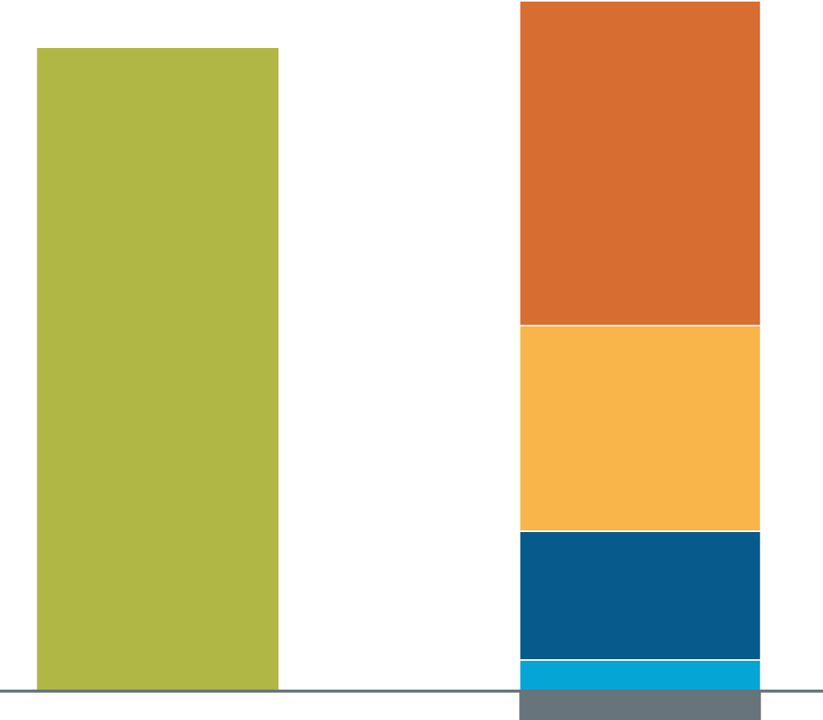
Diversification
Original $200,000 investment portfolios after 25 years
$919,002
$858,374
$433,388
10%
6%
$273,939
8%
$171,675
6%
$40,000
0%
–$40,000
Loss
Single investment
Diversified
This hypothetical example is used for illustrative purposes only. Taxes, fees, and other expenses are not included. Actual results will vary.
Notes:
Here’s a hypothetical example of how diversification can work based on two $200,000 portfolios.
If the single-investment portfolio were to grow at a hypothetical 6 percent average annual rate of return, the account would be worth almost $860,000 after 25 years. That’s not bad.
However, the diversified account, which was divided into five equal parts, would have grown at various rates of return during the same period. As you can see, some of the investments did very well, achieving 10 percent, 8 percent, and 6 percent returns. But one investment didn’t grow at all, and another resulted in a total loss. Overall, even though each individual investment performed differently, the diversified portfolio earned considerably more. After 25 years, it was worth nearly $920,000, about $60,000 more than the single-investment portfolio.
The diversified portfolio was able to take advantage of investment opportunities that provided a greater potential for return because it wasn’t relying on a single investment to meet its goals. And in this way, it was able to reduce the total risk.
Remember that this hypothetical example is used for illustrative purposes only. The results are not indicative of any specific investments, and the returns do not consider the effects of taxes, fees, brokerage commissions, or other expenses typically associated with investing. Investments offering the potential for higher rates of return also involve a higher degree of risk. Diversification does not guarantee a profit or protect against loss; it is a method used to help manage investment risk. Actual results will vary.
SLIDE 0300

Slide 30

Asset Allocation
A systematic approach to diversification that determines an efficient mix of assets for a given investor
Notes:
The second fundamental investment strategy is asset allocation. This is a systematic approach to diversification that determines an efficient mix of assets for a given investor, based on his or her individual needs.
Asset allocation involves strategically dividing a portfolio into different asset classes — typically, stocks, bonds, and cash alternatives — to seek the highest potential return within a designated level of risk. It utilizes sophisticated statistical analysis to determine how different asset classes perform in relation to one another, and its goal is to achieve an appropriate balance of security and growth potential.
Asset allocation is a method used to help manage investment risk. It does not guarantee a profit or protect against investment loss in declining markets. Investments seeking the potential for higher rates of return carry an increased level of risk.
SLIDE 0310

Slide 31

Personalizing Your Asset Allocation Model
1 Investment Goal(s)
2 Time Frame
3 Risk Tolerance
Notes:
Three primary factors contribute to your specific asset allocation strategy: your goal(s), your time horizon, and your risk tolerance.
We’ve already discussed the importance of goal setting, so let’s move to your time horizon.
The amount of time you have before you retire can have a tremendous impact on the investment categories you choose for your portfolio. That’s because fluctuations in the financial markets can affect the short-term value of certain types of investments.
For example, if you don’t expect to retire for another 20 to 30 years, you may be able to invest more aggressively because your portfolio would have more time to recover from short-term market fluctuations.
On the other hand, if retirement is just around the corner, you might want to invest more conservatively to help shelter your portfolio from potential losses.
SLIDE 0320

Slide 32
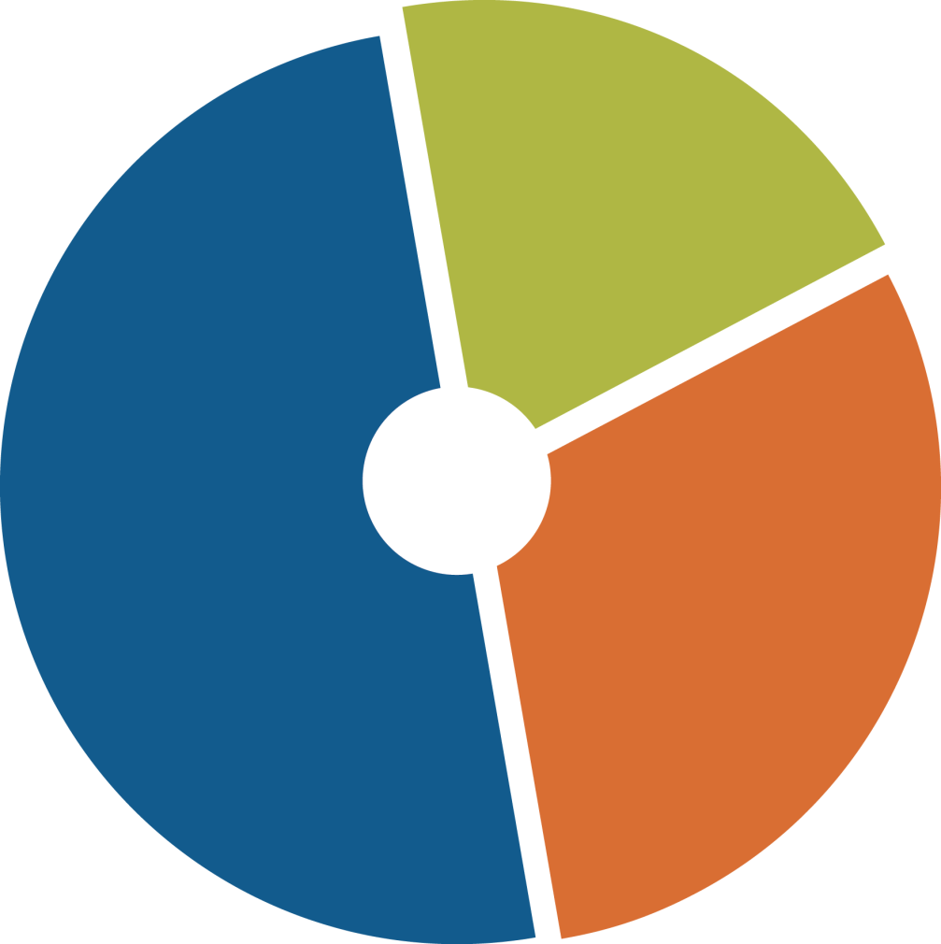
Conservative Asset Allocation Model
Time frame
20 years
Primary goal
minimize volatility
Cash alternatives
20%
Bonds
50%
2002–2021 performance
Best year 19.69%
Worst year –13.43%
Avg. annual 6.61%
Stocks
30%
Source: Refinitiv, 2022. This hypothetical example is used for illustrative purposes only. Past performance is not a guarantee of future results. The returns shown do not include taxes, fees, and other expenses. Actual results will vary.
Notes:
Let’s take a minute to examine two asset allocation models.
This allocation might be appropriate for a conservative investor who has a time frame of about 20 years. His primary concern is to manage the upward and downward swings in his portfolio. He needs an appropriate mix of investment categories for such a time frame.
An appropriate portfolio for a conservative investor might look like this: 50 percent in bonds, 30 percent in stocks, and 20 percent in cash alternatives. These investment categories would be somewhat volatile over the years. But because this investor has a fairly long time frame, this mix of investments could give him an adequate potential return for the risk he is willing to take.
During the best year over this time period (2002 through 2021), this portfolio would have earned 19.69 percent. During the worst year, it would have lost 13.43 percent. The average annual return was 6.61 percent.
Of course, this hypothetical example is used for illustrative purposes only. The returns shown do not include taxes, fees, and other expenses typically associated with investing. The performance of an unmanaged index is not indicative of the performance of any particular investment. Individuals cannot invest directly in an index. Past performance is not a guarantee of future results. Actual results will vary.
Source: Refinitiv, 2022. Performance described is for the period 1/1/2002 to 12/31/2021. Stocks are represented by the S&P 500 Composite Index total return, which is generally considered representative of the U.S. stock market. Bonds are represented by the Citigroup Corporate Bond Composite Index, which is generally considered representative of U.S. corporate bonds. Cash alternatives are represented by the Citigroup One-Month Treasury Bill Index. T-bills are generally considered representative of short-term cash alternatives and are backed by the full faith and credit of the U.S. government as to the timely payment of principal and interest. The return and principal value of an investment in stocks and bonds fluctuate with changes in market conditions and, when sold, these securities may be worth more or less than the original investment amount.
SLIDE 0330

Slide 33
Aggressive Asset Allocation Model
Aggressive investor
Time frame
20 years
Primary goal
pursue growth
Bonds
20%
Stocks
75%
2002–2021 performance
Best year 27.94%
Worst year –28.82%
Avg. annual 8.68%
5%
Cash alternatives
Source: Refinitiv, 2022. This hypothetical example is used for illustrative purposes only. Past performance is not a guarantee of future results. The returns shown do not include taxes, fees, and other expenses. Actual results will vary.
Notes:
This asset allocation might be more appropriate for an aggressive investor who is willing to take on more risk and to accept more volatility in exchange for higher growth potential. She has the same 20-year time frame as the conservative investor. But because she is more comfortable with risk, her investment allocation looks different even though the time frame is the same. An appropriate investment mix for an aggressive investor might be only 5 percent in cash alternatives, 20 percent in bonds, and 75 percent in growth-oriented stocks.
The individual investments in the portfolio would have more volatility, but over this 20-year time horizon (2002 through 2021), this investor hopes that a more aggressive mix will ultimately yield a higher overall potential return than the conservative investor’s portfolio.
During the best year, the portfolio would have earned 27.94 percent. During the worst year, it would have lost 28.82 percent. The average annual return was 8.68 percent.
Because aggressive investments are typically more volatile, they have the potential to produce higher highs and lower lows than their conservative counterparts, with accompanying risk. However, investors who are willing to wade through the market’s ups and downs may also achieve higher average returns over time.
Of course, this hypothetical example is used for illustrative purposes only. The returns shown do not include taxes, fees, and other expenses typically associated with investing. The performance of an unmanaged index is not indicative of the performance of any particular investment. Individuals cannot invest directly in an index. Past performance is not a guarantee of future results. Actual results will vary.
Source: Refinitiv, 2022. Performance described is for the period 1/1/2002 to 12/31/2021. Stocks are represented by the S&P 500 Composite Index total return, which is generally considered representative of the U.S. stock market. Bonds are represented by the Citigroup Corporate Bond Composite Index, which is generally considered representative of U.S. corporate bonds. Cash alternatives are represented by the Citigroup One-Month Treasury Bill Index. T-bills are generally considered representative of short-term cash alternatives and are backed by the full faith and credit of the U.S. government as to the timely payment of principal and interest. The return and principal value of an investment in stocks and bonds fluctuate with changes in market conditions and, when sold, these securities may be worth more or less than the original investment amount.
SLIDE 0340

Slide 34
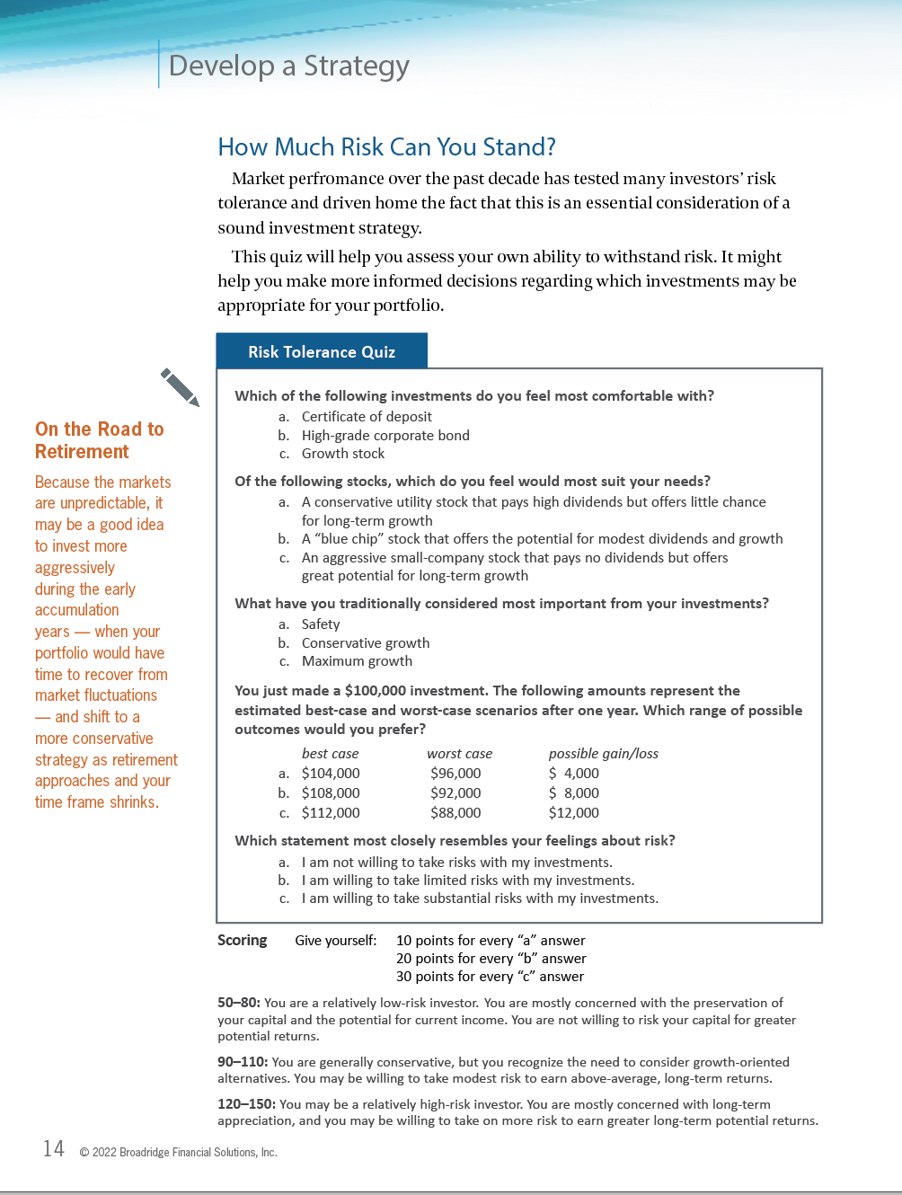
How Much Risk Can You Stand?
Page 14
Notes:
The final factor is your risk tolerance: the amount of risk you are willing to take to pursue your financial goals. It basically refers to how well you are able to withstand potential losses in your portfolio without becoming queasy. Generally, the more potential for growth offered by an investment, the more risk of loss it carries.
Market performance over the past decade has tested many investors’ risk tolerance and driven home the fact that risk tolerance is an essential consideration of a sound investment strategy.
We’ve developed a Risk Tolerance Quiz to help you assess your ability to withstand risk. You’ll find it on page 14 in your workbook.
[Note to presenter: Pause to give participants time to locate the quiz and answer the questions. If time permits, conduct the quiz and allow participants to tally their scores and view the results. Or, if you prefer, you can recommend that they take the quiz at home.]
Hopefully, your answers to the quiz will give you a better idea of your risk tolerance and help you make informed decisions regarding which investments may be appropriate for your portfolio.
SLIDE 0350

Slide 35
Why Your Time Horizon and Risk Tolerance Matter
1997–2021
40%
Stocks
9.76% average
annual return
Corporate
bonds
5.98% average
annual return
T-bills
1.85% average
annual return
30%
20%
10%
0%
–10%
–20%
–30%
–40%
1997
2001
2005
2009
2013
2017
2021
Source: Refinitiv, 2022. The returns shown do not include taxes, fees, and other expenses. Past performance is not a guarantee of future results. Actual results will vary.
Notes:
This graph shows the volatility and historical performance of various types of investments from 1997 through 2021. It’s a good reminder of why it is important to keep your time frame and risk tolerance in mind when developing a sound investment strategy. Of course, keep in mind that past performance is not a guarantee of future results.
Although stocks are generally considered to be growth investments, their performance can be unpredictable. Over the last 25 years, the annual performance of stocks has reached a high of nearly 38 percent and a low falling below –35 percent. The average annual return over this time period was 9.76 percent. Because of the characteristic volatility of stocks, most experts suggest investing in them only when you have at least 5 to 10 years before you’ll need the money.
Historically, corporate bonds have not performed as well as stocks over time, but they are typically less volatile. The average annual return over this 25-year period was 5.98 percent.
On the other hand, Treasury bills and other cash alternatives almost always produce positive returns, but their potential for growth — and keeping pace with inflation — is much lower. The average annual return of Treasury bills was 1.85 percent over this 25-year time period. Inflation averaged 2.28 percent over this period, so if you had invested all your money in this conservative asset class during this time period, you would not have broken even.
Source: Refinitiv, 2022, for the period 1/1/1997 to 12/31/2021. Stocks are represented by the Standard & Poor’s 500 Composite Index total return. The S&P 500 is an unmanaged index that is generally considered to be representative of the U.S. stock market. Corporate bonds are represented by the Citigroup Corporate Bond Composite Index, which is generally considered to be representative of the U.S. corporate bond market. Treasury bills are represented by the Citigroup One-Month Treasury Bill Index. T-bills are generally considered representative of short-term cash alternatives and are backed by the full faith and credit of the U.S. government as to the timely payment of principal and interest. The returns shown do not reflect taxes, fees, brokerage commissions, or other expenses typically associated with investing. The performance of an unmanaged index is not indicative of the performance of any particular investment. Individuals cannot invest directly in an index. Actual results will vary.
SLIDE 0360

Slide 36

Dollar-Cost Averaging
A strategy that involves investing a set amount of money at regular intervals on an ongoing basis
Notes:
The third fundamental investment strategy is dollar-cost averaging.
Dollar-cost averaging involves investing a set amount of money at regular intervals and on an ongoing basis. Here’s how it works.
An individual invests a specific amount of money in the stock market at regular intervals — say $100 each month. This is essentially what investors do when they automatically contribute a set amount of their salary to their retirement savings plan every pay period. The set amount invested, in this case $100, buys more shares when prices are low and fewer shares when prices rise, resulting in an overall lower average cost per share over time.
Let’s take a closer look.
SLIDE 0370

Slide 37
Dollar-Cost Averaging Example
Regular Market Shares
Investment Price/Share Acquired
Month 1 $100 $ 6.00 16.7
Month 2 $100 3.00 33.3
Month 3 $100 4.00 25.0
Month 4 $100 8.00 12.5
Month 5 $100 5.00 20.0
Total $500 $26.00 107.5
Average price per share: $5.20 ($26 ÷ 5)
Average cost per share: $4.65 ($500 ÷ 107.5)
This hypothetical example is used for illustrative purposes only. Actual results will vary.
Notes:
In this hypothetical example, an investor uses dollar-cost averaging to invest $100 per month in a mutual fund with fluctuating share prices. At the end of five months, she has 107.5 shares. As you can see, the average price per share during the period was $5.20, but because the investor purchased more shares when prices were low, she paid an average of $4.65 per share.
Dollar-cost averaging can help you take advantage of stock market fluctuations without the stress and risk of trying to time the markets. It can be an effective way to steadily accumulate shares to help meet long-term goals.
Although dollar-cost averaging can be a useful strategy, it does not ensure a profit or prevent a loss. To take full advantage of the benefits of this strategy, you must be financially able to continue making purchases through periods of high and low price levels.
This hypothetical example is used for illustrative purposes only and does not represent the performance of any specific investment. Actual results will vary.
SLIDE 0380

Slide 38
Three Keys to Funding a
Comfortable Retirement
1. Evaluate Your Needs and Set a Goal
2. Develop a Strategy
3. Protect Your Nest Egg
Notes:
The final key to funding a comfortable retirement is to be sure you’re doing everything you can to help protect your nest egg — both before and during retirement.
SLIDE 0390

Slide 39

Periodic Portfolio Reviews and Maintenance
  Typically, at least once a year
  After a major lifestyle change
  As the result of a change in your
  investing outlook
Notes:
First, in order to help protect your nest egg as it grows, your portfolio will need periodic reviews and maintenance. Typically, your investment mix and performance should be reviewed at least once a year.
You should also review your portfolio any time you have a major change that might affect your objectives. For instance, when you get a promotion or a raise, you might increase your savings rate and reevaluate your investment mix. Other situations might include a change in marital status, the birth of a child, when children graduate from college, when you change jobs, and, of course, when you are preparing to retire.
Over time, your portfolio’s asset allocation might shift due to changes in the financial markets. In that case, it may be necessary to rebalance your portfolio — in other words, buy and sell specific securities in order to bring your portfolio back to an appropriate allocation.
Note: Rebalancing may result in a taxable event.
SLIDE 0400

Slide 40

Prepare for the Unexpected
  Insurance products can help you:
  Provide for loved ones
  Fund unexpected expenses
  Protect a business
  Preserve your estate
Notes:
Finally, insurance products are designed to help protect you from unexpected financial risk, both before and during retirement. Specifically, I’m referring to life insurance and long-term care insurance.
Most people purchase life insurance to provide financially for their loved ones in the event of their death — to cover funeral expenses, settle debts, pay for a child’s education, pay off a mortgage, or replace a breadwinner’s income.
Whole life insurance can also be accessed during the policy owner’s lifetime to fund unexpected expenses. Whole life insurance accumulates cash value that may be borrowed against or withdrawn to pay emergency expenses or to provide additional income in retirement.
Life insurance can also be used to help protect a business in the event that an owner dies unexpectedly. The benefit may be used to help fund a buy-sell agreement or provide income for the surviving family.
Finally, life insurance can also be a powerful estate preservation tool. It can provide heirs with funds to help pay estate taxes and fees so they won’t have to liquidate assets.
As with most financial decisions, there are expenses associated with the purchase of life insurance. Policies commonly have mortality and expense charges. In addition, if a policy is surrendered prematurely, there may be surrender charges and income tax implications. The cost and availability of life insurance depend on such factors as age, health, and the type and amount of insurance purchased. Before implementing a strategy involving life insurance, it would be prudent to make sure that you are insurable. For whole life policies, access to cash value is through withdrawals or loans. Policy loans will reduce the cash value by the amount of any outstanding loan balance plus interest, will reduce the policy’s death benefit, increases the chance that the policy will lapse, and may result in a tax liability if the policy terminates before the death of the insured. Additional out-of-pocket payments may be needed if actual dividends or investment returns decrease, if you withdraw policy values, if you take out a loan, or if current charges increase.
SLIDE 0410

Slide 41

Long-Term Care Strategy
Today’s 65-year-olds have a nearly
70% chance of needing some form of
long-term care services during their lifetimes.
Source: U.S. Department of Health and Human Services, 2022
Notes:
Long-term care insurance (or hybrid life and long-term care insurance policies) can be used to help defray the costs of long-term care. Studies show that most people will need some form of long-term care during their lifetimes. In fact, today’s 65-year-olds have a nearly 70 percent chance of needing long-term care services at some point.¹
Think about that for a moment: It means you and your parents may have a high risk of needing long-term care at some point in retirement.
Consider that the national median cost of a home health aide is about $62,000 a year for 44 hours of care per week. Even more eye-opening, the national median annual cost for a semi-private room in a nursing home is nearly $95,000. Costs can vary substantially depending on where you live.²
[Note to presenter: Consider visiting Genworth.com to research average costs for your geographic area and incorporate them into this section.]
Unfortunately, Medicare and most traditional health insurance plans offer little or no relief for those who need custodial care.
Planning for long-term care in your younger years can help you avoid a potentially devastating financial crisis in your retirement years.
A complete statement of coverage, including exclusions, exceptions, and limitations, is found only in the long-term care insurance policy. It should be noted that long-term care insurance carriers have the discretion to raise their rates and remove their products from the marketplace. Additionally, a long-term care policy may not cover all the expenses associated with a person’s long-term care needs.
With hybrid life and long-term care insurance, an individual should have a need for life insurance and should evaluate the policy on its merits as life insurance. Optional benefit riders are available for an additional fee and are subject to contractual terms, conditions, and limitations as outlined in the policy; they may not benefit all people. Any payments used for covered long-term care expenses would reduce (and are limited to) the death benefit or annuity value and can be much less than those of a typical long-term care policy.
Sources: 1) U.S. Department of Health and Human Services, 2022; 2) Genworth 2021 Cost of Care Survey
SLIDE 0420

Slide 42

What Can You Do Today?
Commit to developing and keeping
your retirement savings plan a high priority
Notes:
We’ve covered a lot of information today. I hope you’ve come away from this session with some important information and actions you can take right away.
Ultimately, what’s most important is for you to commit to developing and keeping your retirement savings plan a high priority, even as you face the more immediate financial challenges you face on a day-to-day basis.
The sooner you start, the better off you’ll be.
SLIDE 0430

Slide 43
Start Saving Now
$800,000
$700,000
$600,000
$500,000
$400,000
$300,000
$200,000
$100,000
$0
$3,000 annual investment
6% annual rate of return
Reinvestment of earnings
Taxes not considered
$679,500
Beginning at age 20
$254,400
Beginning at age 35
$120,000
Beginning at age 45
20
25
30
35
40
45
50
55
60
65
Age
This hypothetical example of mathematical compounding is used for illustrative purposes only and does not represent the performance of any specific investments. Taxes are not considered. Rates of return will vary over time, particularly for long-term investments. Investments offering the potential for higher rates of return also involved a higher degree of investment risk. Actual results will vary.
Notes:
Why should you make saving for retirement a priority now? Because time can be one of your strongest allies. Consider the hypothetical example shown here.
If you invest $3,000 every year starting when you’re 20 years old, at age 65 you would have accumulated almost $680,000 (assuming a 6% annual growth rate and no tax). If you wait until age 35 and invest the same amount at the same assumed rate, you would accumulate about $254,000. And if you wait until age 45 to start saving, you would accumulate only about $120,000 by age 65.
This doesn’t mean there’s no hope if you’re 50 years old and you haven’t set aside anything for retirement yet. It just makes it even more important that you implement a plan today.
This hypothetical example of mathematical compounding is used for illustrative purposes only and does not represent the performance of any specific investments. Taxes are not considered. Rates of return will vary over time, particularly for long-term investments. Investments offering the potential for higher rates of return also involved a higher degree of investment risk. Actual results will vary.
SLIDE 0440

Slide 44

Putting Your Knowledge to Work
Do it yourself
Work with us
Procrastinate
Notes:
Now that you’ve made the commitment to your future self, how can you put this knowledge to work? There are several ways to proceed.
You can do it yourself, which could be a tremendous amount of work, or work with others.
You could work with us. I hope you feel comfortable with what you’ve learned about our professional knowledge and the approach we take with our clients.
Finally, you can procrastinate. Given the long-term ramifications of the decisions you must make, procrastination is not a prudent move.
Of course, I hope you’ll decide to work with us, and I hope you’ll come to the complimentary consultation. I don’t expect you to make any decisions now, nor do I expect you to decide when you come to the office. I want you to decide only when you’re ready. As you get to know us better, I feel confident that you’ll want to work with us. But, again, the choice is totally up to you.
SLIDE 0450

Slide 45
Thank You
Notes:
Thank you for coming to our retirement seminar. I commend you for the initiative you’ve shown in wanting to improve your financial future and build a successful retirement.
I look forward to seeing you again in the near future.
[Note to presenter: As people leave, shake hands with them and collect their evaluation forms.]
SLIDE 0470

Slide 46
Disclaimer
Content in this material is for general information only and not intended to provide specific advice or recommendations for any individual. All performance referenced is historical and is no guarantee of future results. All indices are unmanaged and may not be invested into directly.
The information provided is not intended to be a substitute for specific individualized tax planning or legal advice. We suggest that you consult with a qualified tax or legal professional.
LPL Financial Representatives offer access to Trust Services through The Private Trust Company N.A., an affiliate of LPL Financial.

