Slide 1

Building Your Personal Brand

Slide 2
Agenda
Date:
9:00am - 9:15am Introductions
9:15am - 10:00am Building Your Personal Brand
10:00am - 10:15am Establishing Engagement

Slide 3
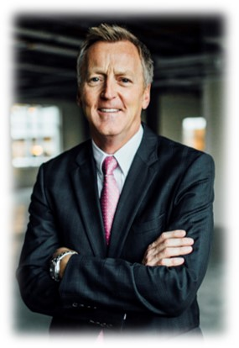
Introductions
Mark Brakel has over 30 years of experience in the financial services industry serving in various capacities. In his current position as a business consultant with Financial Resources Group Investment Services, Mark works with advisors, program managers, and financial institution senior management groups to improve program performance and grow top line revenue.
Prior to joining Financial Resources Group Investment Services, Mark was the program manager at First International Bank & Trust and also held a position as senior vice president at Investment Centers of America (ICA) and was responsible for the financial solutions team, new business development, and the financial institution division. Before joining ICA in 2010, Mark served as senior vice president, chief investment officer for Bank Forward with direct responsibility for the investment portfolio and liquidity management functions of the institution. Mark also had responsibility for commercial cash management, retail brokerage, marketing, and sales training. Additionally, he sat on Bank Forward’s board of directors and assisted with new product development.
Prior to his position at Bank Forward, Mark was the national sales manager for ICA working with over 250 different financial institutions across the United States. Mark also held positions as vice president of investment services – program manager for Community First Bank, a $6 billion organization located in 12 states throughout the Midwest. Mark was also a regional vice president for PrimeVest Financial Services and spent eight years with Security State Bank of North Dakota providing financial planning services to small business owners and retail clients.
Licenses/Registrations: FINRA Series 7, 24, and 63 securities registrations and is insurance licensed in North Dakota. He is a CERTIFIED FINANCIAL PLANNER™, Chartered Financial Consultant, and a Certified Retirement Counselor. Securities registrations held with LPL Financial and Financial Resources Group Investment Services.
Mark Brakel, CFP®,ChFC®,CRC®

Slide 4
Disclosures
Member of FINRA/SIPC
For training purposes only. Not for further distribution.
Not FDIC/NCUA Insured | Not Bank/Credit Union Guaranteed | May Lose Value
Not Insured by Any Federal Government Agency | Not a Bank/Credit Union Deposit
Notes:
Read disclosures

Slide 5
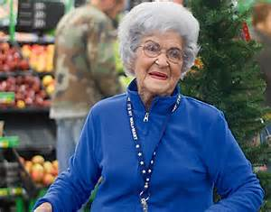
Building Your Personal Brand
When you go into Walmart, you are greeted by someone!
              Why are they there? Want to be or have to be….
              Did they have a favorite banker they liked to work with? Possibly…
              Did we take care of them or miss some opportunities?
Notes:
I have them visualize the Walmart greeter we have all seen and been greeted by.
I then read the bullet points as laid out on the slide and ask the questions presented.

Slide 6

Building Your Personal Brand
What’s the most important piece of a jigsaw puzzle?
Notes:
I ask them the question on the slide.
After they respond I inform them the most important piece of a jigsaw puzzle is the picture on the box.

Slide 7

Building Your Personal Brand
How do you put a puzzle together when your focus is just on a few pieces and you don’t know what you’re supposed to build?
Notes:
I ask them to imagine how hard it would be to put a jigsaw puzzle together if you had no idea what type of picture you were trying to create.

Slide 8
Building Your Personal Brand
5 Clients Touches Greatest Need
1. _____________________
2. _____________________
3. _____________________
4. _____________________
5. _____________________
_______
_______
_______
_______
_______
_____________________
_____________________
_____________________
_____________________
_____________________
X
X
X
X
X
Their greatest need is your next greatest opportunity!
Notes:
Take them through a short exercise?
1. Have them list their top 5 clients
2. Have them list their greatest needs
3. Have them circle the red X if they have not talked to the client about their greatest need
4. Have them list the number of times they have an opportunity to be in front of the client over the course of a year.

Slide 9
Lesson #1
Moments of Truth!
  What are they?
  How many?
  Each day, week, month (do the math)
  What opportunities are you missing?
Notes:
Describe what a moment of truth is: It is the opportunities you have to engage your clients to find out more about them and what their needs are.
I have them visualize one of the clients they listed on the previous slide and add up the number of opportunities they have had over the course of the last 12 months and ask them what they did with those opportunities. Did they make the most of them and engage the client or squander them and do nothing with them.

Slide 10
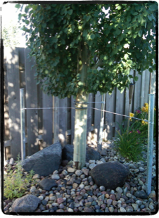
Lesson #2
Things change!
Notes:
I tell the story of a tree in my backyard that blew over twice in windstorms over the course of 8 years and the investment, planning, and teamwork it required to save the tree the second time compared to the first time due to the growth of the tree. The point is as things grow the problems encountered usually become more complex and require more expertise, teamwork, planning and investment to solve.

Slide 11

Lesson #3
The impact of the coins in the cushions!
Notes:
I tell the story of me as a little boy saving up coins I found in the cushions of couches and car seats to save up enough money to buy a bike. The point of this slide is to drive home the point that we develop credibility and build value with clients over time by focusing on helping them with the little things that may seem insignificant. It is the cumulative effect of all the small things we do that position us to win the knife fights.

Slide 12

Objective
Create meaningful engagement with the 50 to 65 year old customer base of your financial institution and assist them with planning for critical issues facing them during retirement!
Notes:
I discuss with them the objective of what were are talking about in this session is to create meaningful engagement with the 50 to 65 year old customer base of their institution and provide them with solid financial planning advice regarding issues facing them during retirement.

Slide 13

Benefits
Catalyst for getting target group in your branch
Leverages your brand by providing relevant & client specific information on a critical planning decision that impacts everyone
Sets up discovery event for developing relationship breadth
Provides differentiator to build outside client referral base
Provides unique opportunity to engage the client
Grows non-interest income
Notes:
I state the benefits of the program being the bullet points listed on the slide.

Slide 14
Program Overview
Run query age 50 plus (name, phone #, birthday)
Create birthdate call list by branch relationship manager
Implement banker call program on client birthday utilizing following script:
  (hello, this is (banker) with (bank). I wanted to call you and wish you a happy birthday and thank you for banking with us. We really appreciate the opportunity to work with you and have found that many people over age 50 have questions about their options when it comes to social security planning. When would be a good time for you to come in and meet with (name of rep) who can assist you with understanding all of the planning options available when it comes to social security?)
Schedule appointments to meet with advisor
Identify target FI products & services for group
Educate advisor on FI products & services
Notes:
I provide an overview of the program by reading the bullet points listed on the slide

Slide 15
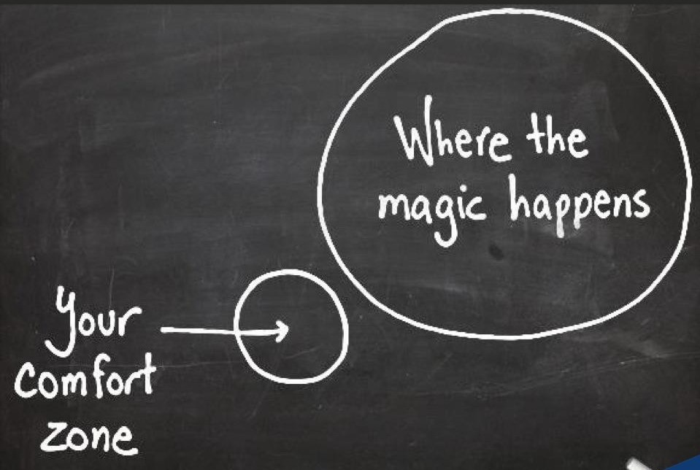
Getting Comfortable With Calling
Notes:
I talk to them about getting comfortable with stepping outside of their comfort zone to engage the client.

Slide 16
Developing Your Script
  (hello, this is (banker) with (bank). I wanted to call you and wish you a happy birthday and thank you for banking with us. We really appreciate the opportunity to work with you and have found that many people over age 50 have questions about their options when it comes to social security planning. When would be a good time for you to come in and meet with (name of rep) who can assist you with understanding all of the planning options available when it comes to social security?)
———————————————————————————————————————————————————————————————————————————————————————————————————————————————————————————————————————————————————————————————————————————————————————————————————————————————————————————————————————————————————————————————————————————————————————————————————————————————————————————
Notes:
I read this sample script of a birthday call program and work with them to personalize it to themselves.

Slide 17
Practicing Your Call!
Notes:
We spend 20 to 30 minutes practicing their script by pairing them up into groups of 3.

Slide 18
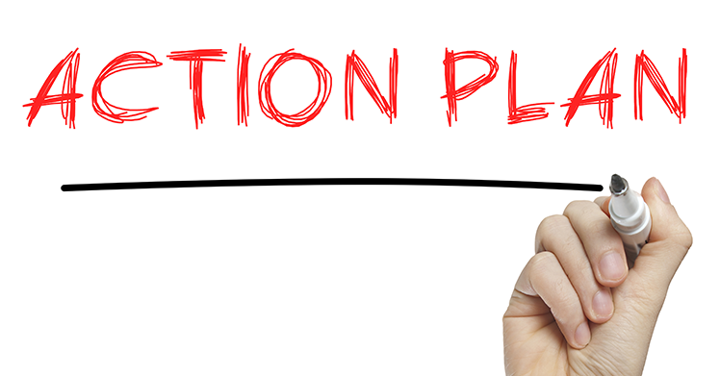
When Do I Call?
First thing the morning of
their birthday…
  Maximize impact
  Be the first to recognize them
Notes:
I review with them the details regarding when they should make their birthday calls as detailed in the bullet points.

Slide 19
Why You Need To Do This!
They are counting on you!
                Make the most of every opportunity…
                (Lesson #1 – Moments of Truth)
                They don’t know what they don’t know…
                (Lesson #2 – Things Change)
                They have to do the best they can with
                what they have
                (Lesson #3 – The impact of coins in
                the cushions)
Notes:
I end the session by revisiting the story of the Walmart greeter and reviewing the three bullet points listed on the slide.

Slide 20
Comments
&
Questions?

