Slide 1





Private & Confidential. Not For Public Distribution.

Slide 2
Why Financial Resources Group Investment Services?

Slide 3

About Us
  Mission Statement
  Our goal is to provide our financial advisors with customized tools and resources to create long-term, prosperous relationships with their clients, resulting in business growth. We are a layer of services in addition to what is available through LPL Financial. We provide a personal, customized experience in business consulting, marketing, technology, and other services.

Slide 4




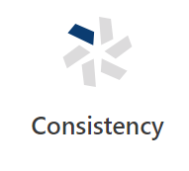

About Us
  The Six Fundamentals of Our Organization
We exist to provide exceptional service for our financial advisors and financial institutions.
The status quo was yesterday’s strategy – every day we must adjust our strategies to meet tomorrow’s challenges and opportunities.
We strive to be an all-inclusive employer and member of the communities we serve.
To grow in today’s business environment, we must constantly search for new ways to make our financial professionals more effective.
To operate at a high-level is good, to operate at a consistently high-level is amazing.
We believe that you need to give 110% every day. No amount of creativity or innovation will help you achieve your goals if you do not work hard. Any plan will work, as long as you do.

Slide 5
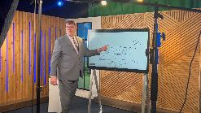









Services
  What We Offer
  Through a combination of impressive technology solutions and customer service, we provide objective sales support and proven program management, tailored to our clients’ individual needs, through a variety of models and resources. We offer 100% of the LPL Financial value proposition – adding these additional enhancements and our commitment to high-touch service in a more personal, one-on-one setting.
Advisor Development
Advisor & Institution
Training
Business Development, Recruiting & Consulting
Commissions & Accounting
Compliance & Supervision
M&A & Succession Planning Consulting
Marketing & Design
Onboarding & Transition Support
Technology
Consulting
Virtual Admin Services

Slide 6
The Power of Partnership
Financial Resources Group Investment Services
Added Value of Branch
Total support staff exceeding 50 (excluding financial advisors & assistants)
Field sales/business consulting
team of 17 (included in above)
OSJ team of 9
3 marketing professionals
Recruiting support
Onboarding support
Service escalations
Commissions
Technology integration & assistance
Training
Managed programs
LPL Financial
Base Value Proposition
All Broker/Dealer, RIA,
Insurance Services
Operations Support
Compliance
Technology
Core Marketing Support
Business Consulting
Indemnifies financial institution
for all Securities, RIA,
and Insurance activities

Slide 7
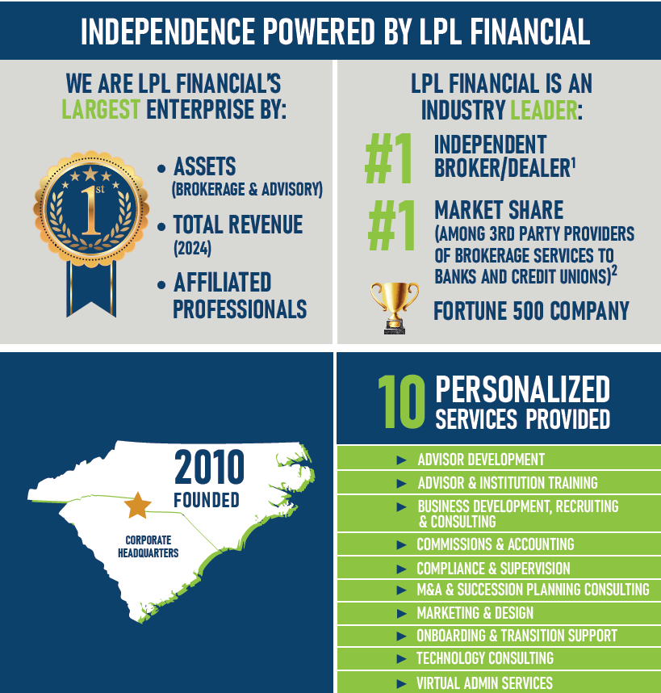
Corporate Snapshot
As reported by Financial Planning Magazine, June 1996-2023, based on total revenue.
2. 2024/2025 Kehrer Research Annual Industry Checkup Based on market share of AUM, revenue and advisors.

Slide 8
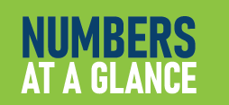
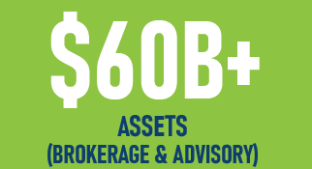
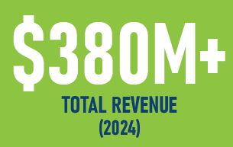
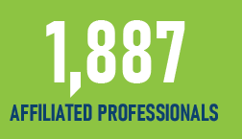

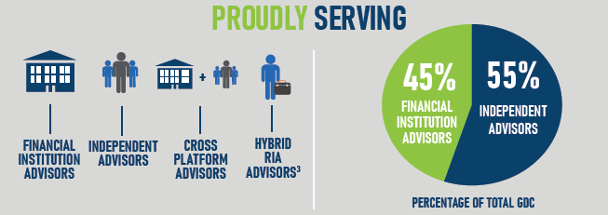
Corporate Snapshot
3. Hybrid RIA services provided by Gladstone Institutional Advisory.
Data as of January 31, 2025

Slide 9
Branch Overview as of 1/31/2025
2024 Total Revenue $380+ Million
Assets Under Management $60+ Billion
Total Associated Professionals 1,887
Total Advisors 1,032
Bank & CU Advisors 330
    Managed 113
    Dual 134
    Independent 83
Licensed Branch Employees 71
Financial Institutions 74
Independent Advisors 702

Slide 10
Program Types
Expense | Managed Employee | Dual Employee | Dual with Outsourced Management | Independent
Rep Compensation | FRG | FI | FI | Advisor
Rep Benefits | FRG | FI | FI | Advisor
Rep Technology | FRG | FI | FI | Advisor
E/O Insurance | FRG | FI | FI | Advisor
Licensing & Registration | FRG | FI | FI | Advisor
Office Space | FI | FI | FI | Advisor or FI
Phone | FI | FI | FI | Advisor or FI
Internet Access/Printing & Scanning | FI | FI | FI | Advisor or FI
Computer | FRG | FI | FI | Advisor
Program Marketing | FI | FI | FI | FI
Referral Program | FI | FI | FI | FI
Training | FRG | FI | FRG | FRG/LPL
Sales Management | FRG | FI | FRG | FRG

Slide 11







Leadership
Bruce Miller
CEO
(704) 816-8009
bruce.miller@lpl.com
Steve Lank
President
(704) 816-8018
steve.lank@lpl.com
Jeff Holden
Chief Operating Officer
(704) 816-8014
jeff.holden@lpl.com
Christa Franse
Director of Project
Management
(704) 816-8002
christa.franse@lpl.com
David Rich
Chief Compliance Officer
(704) 816-8006
david.s.rich@lpl.com
Chris Thompson
Director of Business Consulting & Marketing
(231) 357-7421
chris.thompson@lpl.com
J.J. Hudock
Director of Business Development
(704) 816-8022
jj.hudock@lpl.com

Slide 12



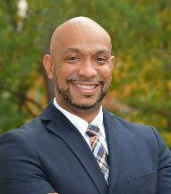


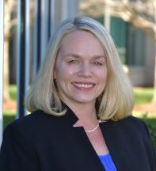



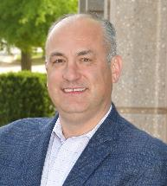

Business Consulting Leadership
Adam Rean Bohlen
Director of Business Consulting
(704) 219-9263
a.bohlen@lpl.com
David Foster
Director of Business Consulting
(608) 215-1804
d.foster@lpl.com
Kristen Vitale
Director of Business Consulting
(708) 712-8576
k.vitale@lpl.com
Jon Rodriguez
Director of Business Consulting
(704) 816-8046
jon.rodriguez1@lpl.com
Matt Ruppe
Director of Business Consulting
(210) 930-9857
matt.ruppe@lpl.com
Tina Bakalas
Director of Business Consulting
(718) 938-9512
tina.bakalas@lpl.com
Gloria Dubose, MBA
Director of Mergers, Acquisitions, and Practice Succession
(704) 816-8020
gloria.dubose@lpl.com
Karl Williams
Director of Business Consulting
(704) 816-8004
karl.b.williams@lpl.com
Heather Rossitto
Director of Business Consulting
(860) 997-9466
h.rossitto@lpl.com
Jennifer Wallace
Practice Management Consultant
(405) 591-8232
j.wallace@lpl.com
Dan Pellegrino
Director of Business Consulting
(617) 894-8955
dpellegrino@websterbank.com
David Coppola
Director of Business Consulting
(203) 232-9435
dcoppola@websterbank.com

Slide 13



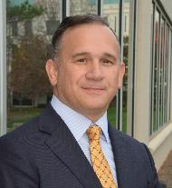


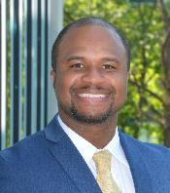





Home Office Staff
Jim Liddington
LPL General Securities
Principal
(704) 816-8016
jim.liddington@lpl.com
Lindsey Bessant
LPL General Securities Principal
(704) 816-8021
lindsey.bessant@lpl.com
Warren Williams
LPL General Securities
Principal
(704) 816-8012
warren.c.williams@lpl.com
Jeffrey Orlouski
LPL General Securities
Principal
(704) 816-8016
jeffrey.orlouski@lpl.com
Chris Zehetmaier
LPL General Securities
Principal
(704) 816-8034
chris.zehetmaier@lpl.com
Trent Moran
Compliance Coordinator
(704) 816-8003
trent.moran@lpl.com
Stephen Locker
Sr. Associate Recruiter
(704) 816-8035
s.locker@lpl.com
Tricia Hutchinson, PHR
Sr. HR Generalist
(704) 816-8015
tricia.hutchinson@lpl.com
Jennifer Hallmark
Director of Marketing,
Corporate and Independent Advisor Services
(704) 816-8019
j.hallmark@lpl.com
Katie Dayton
Director of Marketing,
Institution Services
(704) 816-8044
katie.dayton@lpl.com
Emilie Lucier
Marketing Account Manager
(704) 816-8043
emilie.lucier@lpl.com
Corrie Drummond
Marketing Account Manager
(704) 816-8047 corrie.drummond@lpl.com

Slide 14



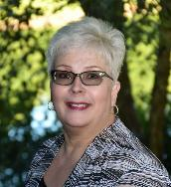

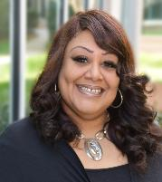


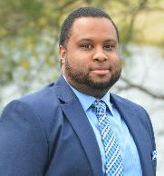
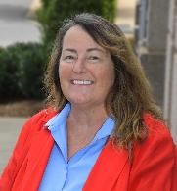
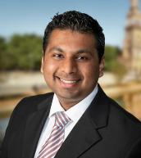

Home Office Staff
Casey Hall
Director of Onboarding &
Integration
(704) 816-8042
casey.g.hall@lpl.com
Kristin Hill
Onboarding and
Integration Manager
(704) 816-8039
kristin.hill@lpl.com
Shannon Lattal
Onboarding and
Integration Specialist
(704) 816-8007
Shannon.latal@lpl.com
Susan Andre
Transition Support Partner
(704) 816-8027
susan.andre@lpl.com
Toni Dunlap
Virtual Relationship Specialist
(704) 816-8029
t.dunlap@lpl.com
Angela Boykin-Wiley
Virtual Relationship Specialist
(704) 816-8032
a.boykin@lpl.com
Diana Heinimann
Sr. Commissions Specialist
(704) 816-8017
diana.heinimann@lpl.com
Donna Coggins
Senior Accounting Manager
(704) 816-8026
d.k.coggins@lpl.com
Raymond Miller
Accountant II
(704) 816-8038
raymond.miller2@lpl.com
MJ Mulligan
Director of Training
(516) 444-3214
mj.mulligan@lpl.com
Adesh Hariprashad
Associate Trainer
(516) 327-7964
adesh.hariprashad@lpl.com
William T. Brice
Director of Advisor Development
(704) 816-8040
william.brice@lpl.com

Slide 15
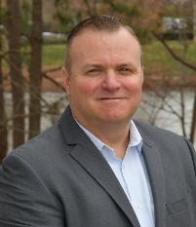


Home Office Staff
Brandon Beall
Sr. Manager of Technology and Data
(704) 816-8033
brandon.beall@lpl.com
Matt Danner
Sr. Technology Systems Manager
(704) 816-8024
matt.danner@lpl.com
Chris Freeman
Technology Systems Manager
(704) 816-8025
christopher.freeman@lpl.com

Slide 16

Advisor Development
  Create Revenue & Value For Your Practice
Whether you are looking to begin a career in financial services, want to expand your practice through acquisitions or build a meaningful continuation for your practice, Advisor Development delivers highly effective, multi-faceted programs designed to meet your business needs.
Our team is available to help you with the following areas:
      Starting a career in financial advising
      Growing practices through acquisitions
      Adding producers to your office
      Partnerships with other advisors
      Succession planning

Slide 17

Advisor & Institution Training
  Customized Training Support
  Our Training team’s goal is to help advisors, admins and financial institutions understand, learn and adopt LPL tools and related technology to better serve client investment needs. We strive to provide you with the training, resources and strategies you need to manage and grow your books of business.
  Our team is available to help you with the following areas:
      One-on-one or group training sessions
      Monthly Advisor Overview training series
      Consultations on select vendor digital tools
      ClientWorks troubleshooting assistance
      Collaboration with other departments to ensure you have the necessary tools for success

Slide 18
Business Development & Recruiting
  Growing Your Business
  Our Business Development & Recruiting team helps guide you through the due diligence process to choose the best partner for you and/or your program’s future success.
Our team is available to help you with the following a areas:
      Broker-dealer due diligence
      Contract negotiations
      Conversion support from existing broker-dealer to LPL Financial
      Onboarding support for advisors
      Support in designing compensation plans for staff member
  Through the Power of Partnership, LPL Financial and Financial Resources Group Investment Services provide our partners with recruiting support through a dedicated team.
  The end-to-end recruiting process includes seven key components:
Exploring the need
Obtain Job Approval
Profile Process
Candidate Sourcing
Candidate Interview
Candidate Selection
Transition Assistance

Slide 19
Business Consulting
  Growing Your Business
  Our Business Consulting team helps guide you towards a path of success by developing effective ways to enhance your business, grow revenue, attract new relationships, strengthen existing relationships and attract and retain top talent.
We will focus on:
      Best practice/solution sharing
      Consultation around branch/advisor optimization strategies
      Consultation & development of business & marketing plans
      Customized growth initiatives
      Analytics modeling
      Optimal office setup & representative territory consultation
      Business process Review
      Compensation plan design
  VALUE-ADDED COMMITMENTS
      Business acquisition guidance
      Responsive liaison and advocate
      Recruiting top talent
      For managed programs
        Fiduciary management of staff
        Sales & activity management to accomplish goals

Slide 20

Commissions & Reporting
  Financial Reporting & Analytics
  Our commissions team assists financial consultants with navigating ClientWorks, understanding their commission statements, and providing insight on best practices around payouts. We aid financial consultants with estimating their income in advisory accounts or forecasting brokerage commissions.
  Our advisory account analysis includes:
      Client fees & cycles
      Assets under management
      Market performance
      Account values

Slide 21

Compliance & Supervision
  First Line of Defense
  The goal of our OSJ Supervision team is to form a more focused and resourceful supervision platform, protecting our clients, effectively mitigating risk, and helping support our advisors to produce more efficiently and compliantly.
  The OSJ Supervision team uses cutting edge technology and the tools provided by LPL to:
      Identify and address trends, patterns & concerns surrounding clients’ accounts/practice
      Monitor various account changes, third party cash & security disbursements
      Review advisors’ outside business activities and emails

Slide 22


Marketing & Design
  Turn-key Marketing Support
  Leveraging the strong foundation of marketing knowledge and resources that LPL Financial offers, we provide professional marketing support to help you effectively promote your investment services program.
  Our team is available to help you with the following areas:
      E-marketing strategies
      Multichannel marketing
      Access to exclusive Marketing Library for turn-key materials, including webinars
      Logo design & brand development
      Stationery design
      Collateral creation & customization
      Website/social media consultations

Slide 23

Onboarding & Transition Support
  Personalized Transition Planning & Implementation
  We coordinate with LPL Financial to ensure the onboarding and transition process is as smooth as possible – for both you and your clients. We have developed proven methods, which we adapt to your specific business model and needs for your best possible outcome.
  We will assist you with the following that includes:
      Business development & consulting strategies
      Training plan coordination with LPL
      Introduction to LPL Service360 team
      Personal transition plan
      Business analysis & product mapping
      Marketing & Technology support

Slide 24

Technology Consulting
  Technology Solutions
  Our skilled Technology team is dedicated to keeping you up to date with the latest requirements involving your hardware and software needs. The consultants work vigorously to troubleshoot any issues that may arise, keeping you efficient and focused on growing your practice.
  Our team is available to help you with the following areas:
      Technology best practices
      Hardware & software requirements
      Compliance requirements
      Compatibility troubleshooting
      Office networking

Slide 25

Virtual Admin Services
  Creating Efficiencies for Your Business
  Our Virtual Resources team is dedicated to helping you become more efficient in your practice through turn-key virtual support. Let us be your dedicated resource for exceptional support so you can focus on growing your business!
  Our team is available to help you with the following areas:
      Assist with new account establishment
      account maintenance, moving money, etc.
      Client reporting
      Project support
      Dedicated specialist
      Flexible service contract terms

Slide 26
Why LPL Financial?

Slide 27
LPL Financial Mission Statement
“
We take care of our advisors, so they can take care of their clients. That’s our mission at LPL Financial. It permeates everything we do – and is embraced by every employee.
”

Slide 28
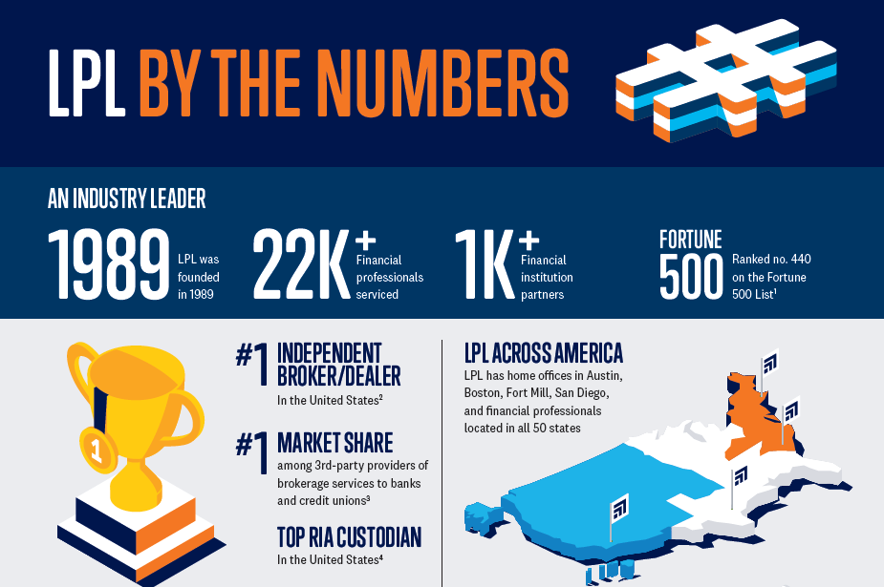
LPL Financial By the Numbers as of October 30, 2023

Slide 29
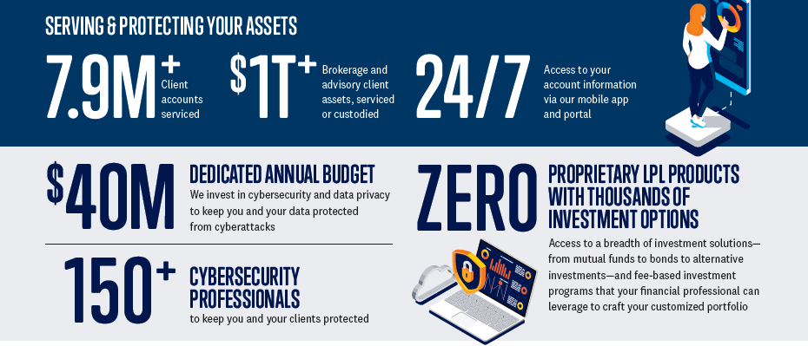
LPL Financial By the Numbers as of October 30, 2023

Slide 30
LPL Financial Business Model
  Foundations
  LPL Financial enables their client advisors and financial institutions though the following:
  Broker/Dealer Services
  Securities Clearing
  Registered Investment Advisory
  Custody
  Robust Technology Platform
    Aggregates brokerage, advisory and direct positions
    Integrated with a variety of CRM, planning, analytics and management tools
  Insurance BGA
  Trust Services
  Practice Management & Training Programs
  Independent Research
  Marketing Services & Support

Slide 31
Industry Trends Supporting a Move
to LPL Financial

Slide 32

Expanded Product Offering
  Robust Products
  LPL offers a robust product set that allows financial institutions to enhance their value proposition to their end clients:
Insurance
Research
      Internal underwriting
      Case design & strategy
      Advanced case team
      Field insurance consulting team to drive advisor adoption
      60+ research professional supporting end-clients, advisors & financial institutions
      Product due diligence, initial & ongoing review
      Client approved, publications, letters, presentations & campaigns

Slide 33
Expanded Product Offering
Financial Planning
LPL Retirement Partners
  Client Goals (integrated individual goal planning modules)
  WealthVision (integrated financial planning tools through eMoney)
  MoneyGuide Pro (integrated financial planning tools)
  Analytical tools: Portfolio Review Tool to support asset allocation assessment
  Financial planning team with advanced degrees and designations
  Tools designed to enhance an advisor's retirement planning business
  Assigned retirement consultant designed to increase sales and leverage internal resources
  Dedicated retirement partners recruiting team
LPL Private Client & The Private Trust Company
  Supporting RIA and all trust business
  Enhancement to attract high-net worth customers

Slide 34
LPL Financial Advisory Platforms
Increased capabilities for customizing portfolios
Advisor Solutions
Guided Wealth Portfolios (GWP) | Optimum Market Portfolios (OMP) | Model Wealth Portfolios (MWP) | Personal Wealth Portfolios (PWP) | Manager Select | SAM I & II
Digital interface + strategic models | Sub-advised mutual fund models | Strategist MF & ETP models | Unified managed account | Separately managed account supermarket | Rep as portfolio manager
$5K | $10K | $25K+ | $250K | $100K+ | $25K
Strategist Solutions

Slide 35
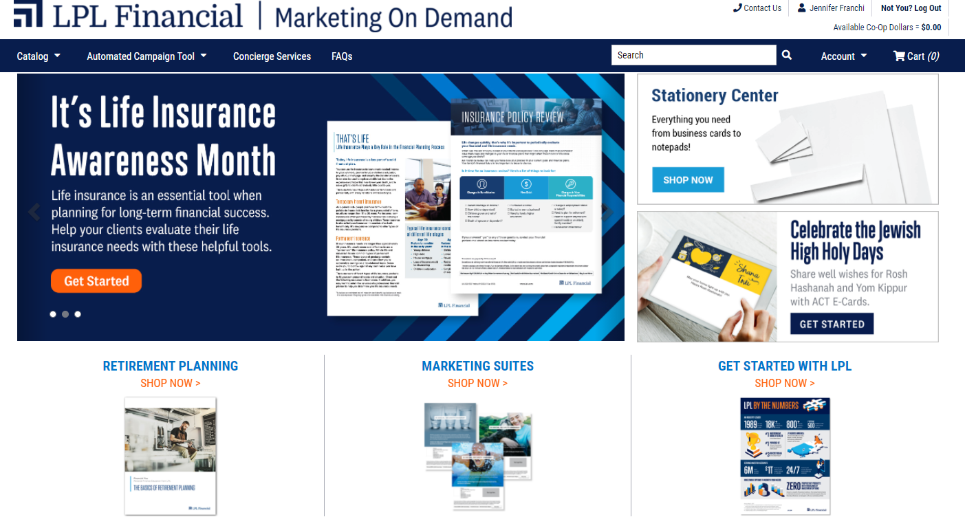
Marketing Team
  Robust Products
  LPL offers advisors access to marketing resources to assist in optimally positioning your program, both inside and outside of the institution.
    Leading edge solutions
    Social Media
    Data based analysis and targeted marketing (IXI)
    Thousands of compliance approved marketing pieces available through Marketing on Demand system.

Slide 36
LPL Technology & Operations
  STRAIGHT THRU PROCESSING VIA SELF-CLEARING PLATFORM
  Technology Support
  LPL provides financial institution and advisor functionality that help shape a positive experience for the advisor and end-clients that cannot be replicated by a smaller firm. These capabilities have been achieved through LPL’s size and scale.
    Aggregation of brokerage, direct and advisory business
      Aggregated client-facing account information via the internet and brokerage statements
      Aggregated performance reporting via portfolio manager tool
    Electronic account opening and trading for direct and brokerage business
    E-Signature for brokerage and advisory business
    Remote deposit capture for trade settlement
    FINRA approved imaging system eliminating the need for paper files
    Mobile applications for clients and advisors

Slide 37
Investing to Enhance Advisor
& End Investor Value
Technology Spend for New Capabilities* (in millions)
Key Points
Single point of focus—advisor practices and institutions—allows to spend on delivering key capabilities and workflows to turn our existing competitive offering into an industry-leading platform
Vertical integration (custodian, B/D, RIA, investment platform) allows us greater flexibility and competitiveness
Additional funding allocated in 2020 above our original base of $140M
~$150
~$160
~$105
~$120
~$85
~25%
CAGR
$135
$140
~$60
2015
2016
2017
2018
2019
Current 2020
* This does not include the spend on maintenance/core infrastructure

Slide 38



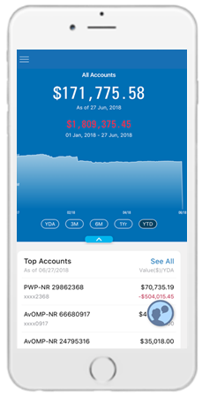
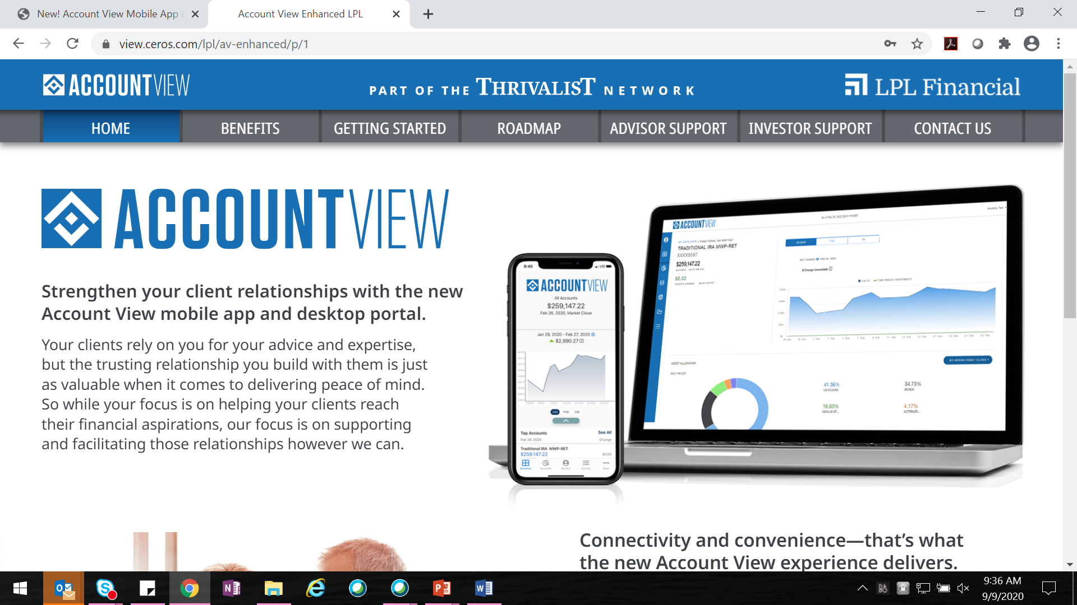






Provide End Investors the Experience
They Expect – Leveraging Digital Channels
Be informed
Focus on what matters
Feel connected & empowered
Marketing tools keep them up-to-date on key topics
Focus on goals, not benchmark-relative performance
Transparency into their finances and ability to take some action
Automated Campaign Tool (ACT)
ClientWorks Client Goals
MoneyGuide
Marketing on Demand (MOD)
Social media tools allow for sharing of key information, with personal touches
Make delivery of documents frictionless
Ability to connect with their advisor, when and how they want
ClientWorks eSig
ClientWorks eDelivery
Advisor-client texting
Make investing simple and easy (if it’s right for them)
Self-service scheduling
Enabled compliantly through Social Patrol
Guided Wealth Portfolios (GWP)

Slide 39


Allow Advisors to Focus on Adding Value to End Investors By Driving Efficiency & Growth
ClientWorks contains all advisor tools, structured around key advisor workflows
ClientWorks
Customer Relationship Mgmt. (CRM)
Financial Planning
Proposal Generation
Portfolio Analytics
Trading
Performance Reporting
Marketing and Servicing
1
2
3
Attracting Prospects
(lead gen)
Turning
Prospects
into Clients
New Account Onboarding
Finding new clients to serve
Getting prospects to say “YES”
Attracting new assets
4
5
6
Managing Portfolios
Servicing Client
Requests
Client
Management
Creating great investor outcomes
Helping clients live their lives
Getting clients to their goals
Innovation to solve key advisor problems leads to new capabilities
ClientWorks Meeting Manager

Slide 40

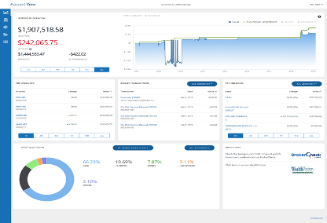
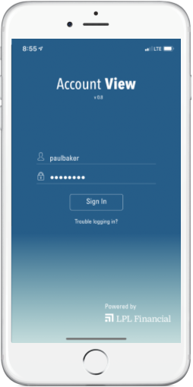
Enhanced Account View Portal
Desktop & Mobile App
Our new, enhanced Account View portal features a modern and sophisticated design, with a layout you can customize for your unique business, accessible from your desktop or mobile app.
New Enhancements:
Details and information in one place
Embedded client goals
Ability to complete client-initiated tasks
**Please note that final product including, but not limited to design, functionality, etc. is subject to change.

Slide 41
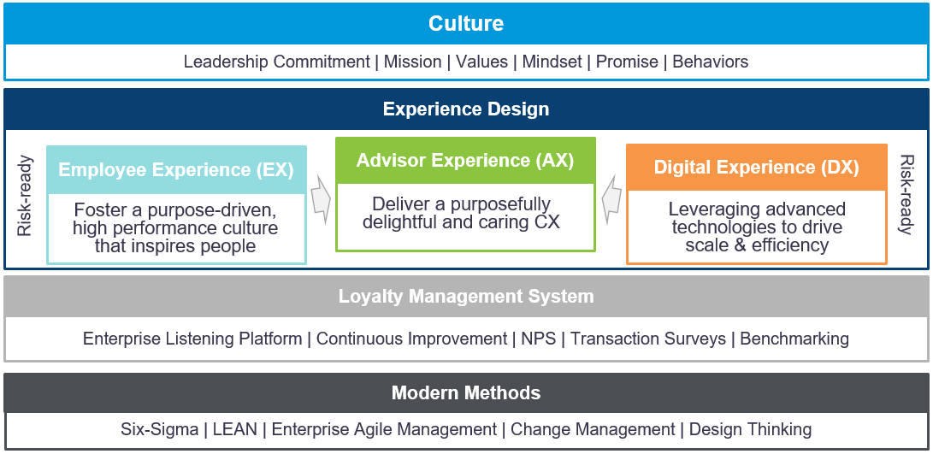
Care Model
The Care Model consists of seven core elements: culture, risk and compliance, digital experience, employee experience, and advisor experience best practices that rest upon loyalty management system and modern management methods.
**Please note that final product including, but not limited to design, functionality, etc. is subject to change.

Slide 42





Providing a Differentiated Service Experience
Online resources
and self service capabilities
Omni Channel
(Interactive voice response, Chat, Call Me)
Highly-trained service professional
(Dedicated service team)
Journey Map
Technology driven interactions
Human driven interactions
Case Management (Managing complexities of the business)

Slide 43
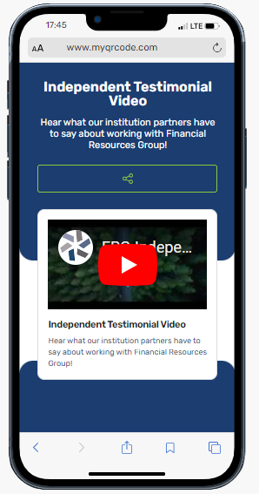




Let Us Guide You on Your Journey
  Testimonial Video
  To learn more about Financial Resources Group’s commitment to helping independent advisors expand their current offerings, please visit watch our independent testimonial video via the QR code. Also, follow us on social media for the latest news and events!
Rev 10.28.21
Rev. 03.05.24

