Slide 1



PROGRAM
RELAUNCH
Best Practices for Relaunching or Rebranding Your Program
Private & Confidential. Not For Public Distribution.
Notes:
Today we’re going to go over the tools and resources you need to launch a successful program relaunch/rebrand.

Slide 2
Getting Started
Executing a Program Relaunch/Rebrand
In partnership with your Business Consultant, your designated Marketing Account Manager will guide you through your relaunch/rebrand to ensure you have the tools and resources you need for success. We will discuss:
  Best practices for organizing staff for implementation
  Best practices for optimizing your online presence
  Educating branch employees on investment services program and advisor(s)
  How institutions can help raise brand awareness for investment services program
  Brand awareness kickoff campaign
  Developing a calendar for monthly campaigns to stay top of mind
Notes:
In partnership with Cindy, I will guide you through your relaunch/rebrand to ensure you know about the tools available for success. So today we’ll go over…

Slide 3
Step 1: Develop Your Task Force
Choosing your Support Team

Slide 4
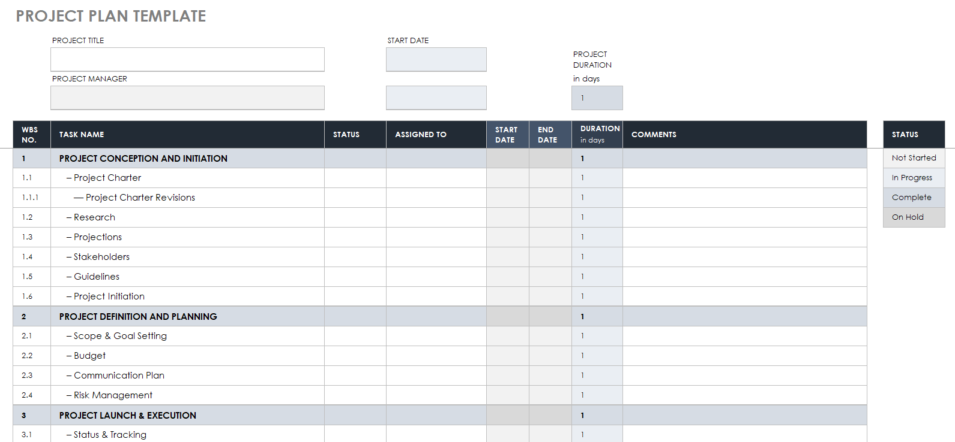
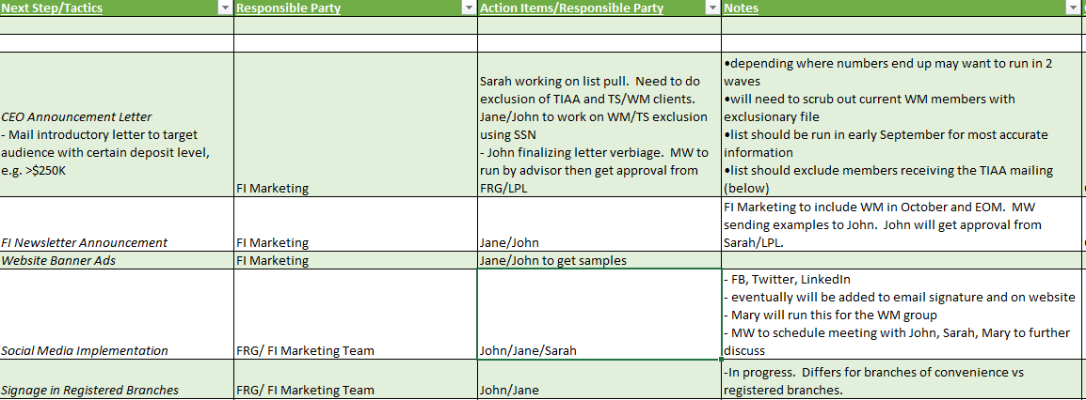
Assembling Your Relaunch/Rebrand Team
Identifying Roles
Before beginning any relaunch or rebrand, it is essential to establish a project manager along with designated individuals to create a team for execution.
Best practices for organization:
  Assign a project manager
  Assign team members to be responsible for specific tasks
  Utilize a spreadsheet to stay organized with tasks and responsible parties broken out into separate phases
  Your Marketing Account Manager and Business Consultant will be valuable resources to assist where needed

Slide 5
Step 2: Enhancing Online Presence
Updating Your Digital Footprint

Slide 6
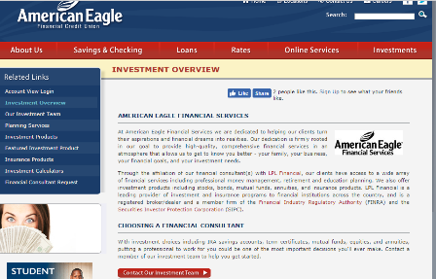
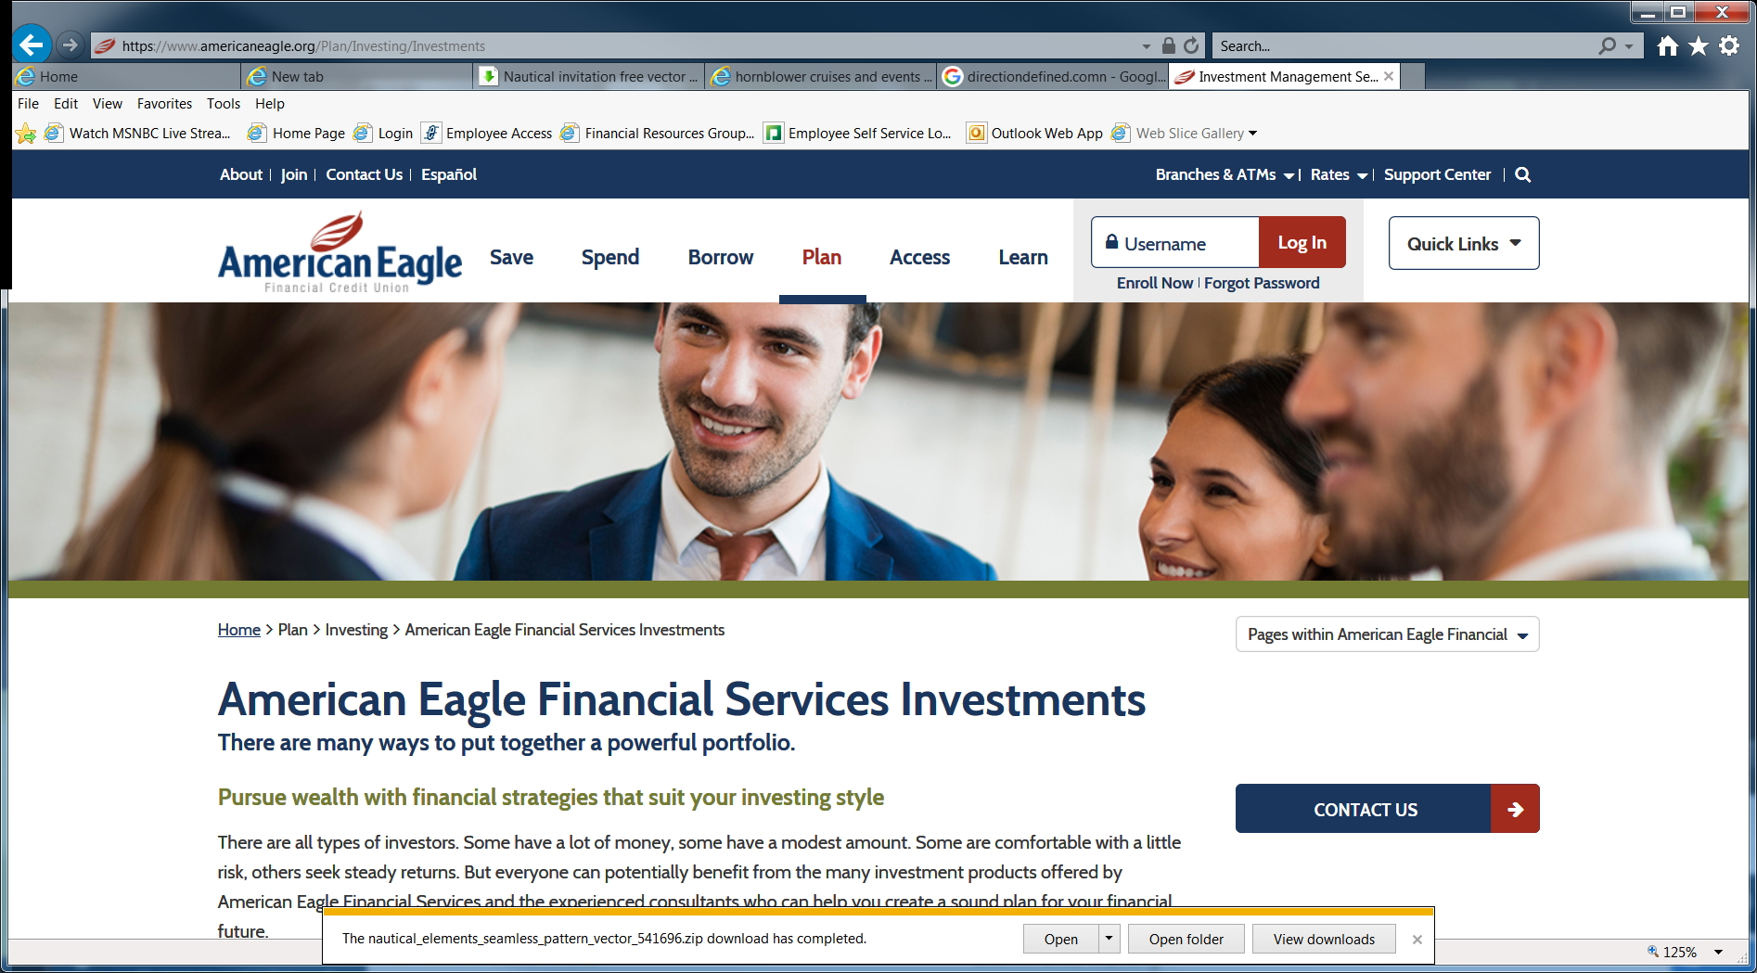
Website Consultation
Know the Facts
IS Program Website Before Enhancements
88% will look up an advisor online after they are referred and 63% will make a decision based on their findings.
Together we will discuss:
  Best platform for website (in-house vs. third party vendor)
  Website content and layout guidance
    Updated bios, services, call to actions, social logos, images
  SEO best practice guidance
  Lead magnets for gated content – promote on social media
  How institutions can help raise awareness for investment services program on homepage via banner ads
IS Program Website After Enhancements

Slide 7




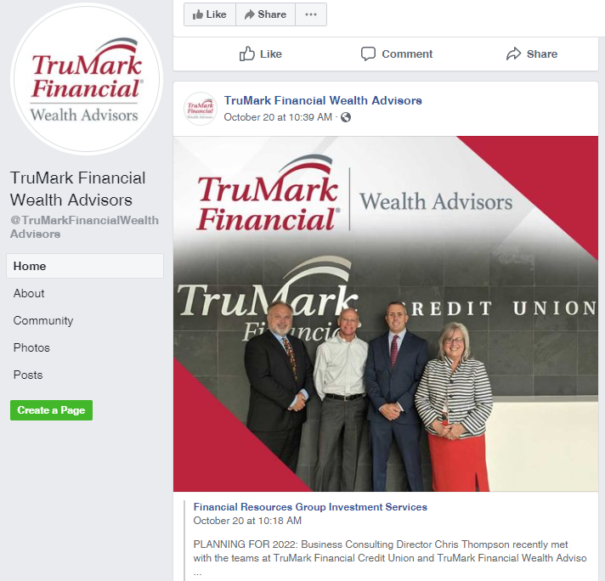

Social Media Consultation
Know the Facts
A 2021 study with Think Advisor showed that 86% of advisors who use social media reported gaining an average of $5 million in business.
Together we will discuss:
  Best practices for optimizing social media profiles
  Guide you to pre-approved content for posts – Gainfully
  Share content schedule best practices
  How institutions can help raise awareness for investment services program on their social media pages via like/share (Example to the right)
Investment Services page
Institution “sharing” investment services post for increased visibility

Slide 8
Step 3: Preparing for Launch
Internal & External Preparation

Slide 9

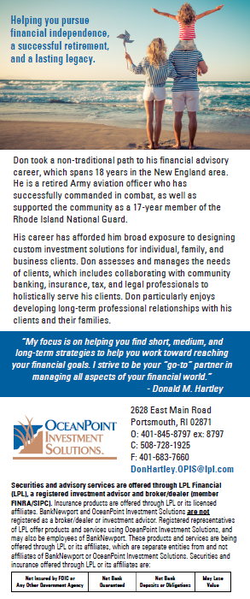
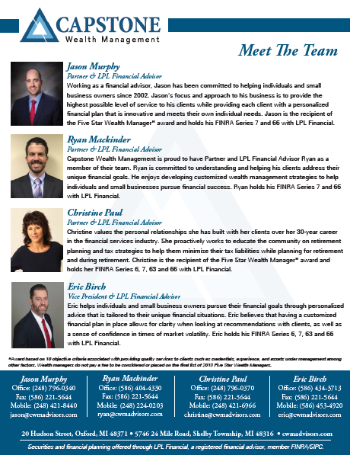
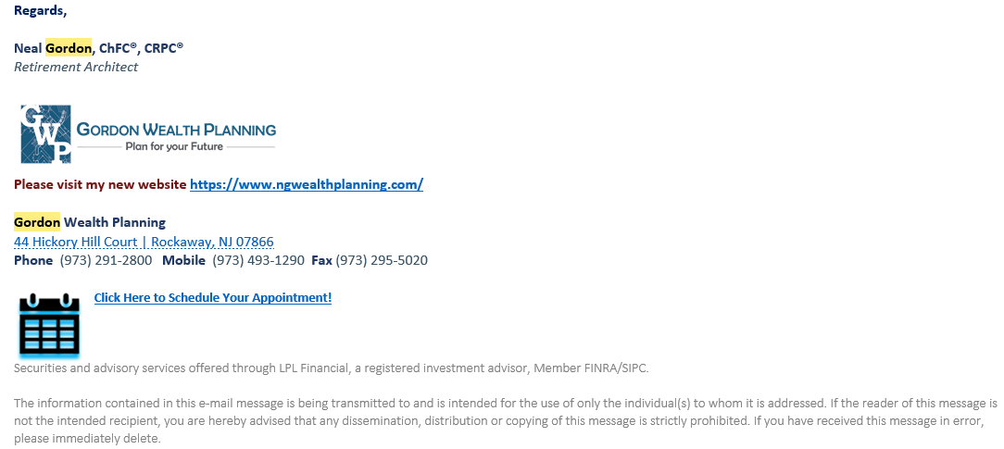
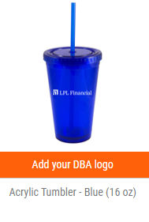
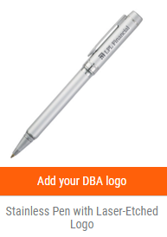
Promotion Opportunities
Updating Tactics for Brand Awareness
In preparation for the launch, it is essential to have the following items created/updated to aid in building brand awareness.
  Bio take ones, flyers (individual and/or team)
  Program brochures with call to actions (QR codes and/or social media icons for easy connections)
  Branded promo items
Often overlooked are email signatures. Enhance with direct links to ScheduleOnce for appointment setting, social media icons for easy connections and call to actions.

Slide 10
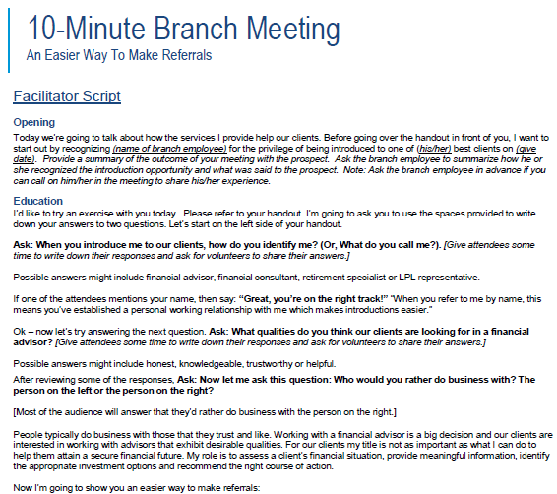
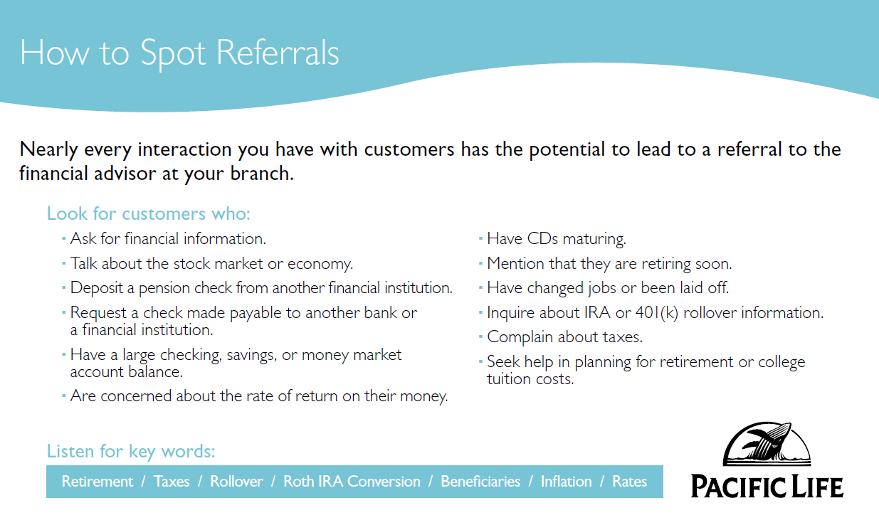
Branch Trainings
Educating Branch Employees
Plan to set aside some time for branch trainings where employees can be educated on how to spot referrals and learn more about the investment services program.
10 Minute Branch Meetings – “An Easier Way to Make Referrals”
  Available via ClientWorks’ Resource Center
Institution Referral Programs – “How to Spot Referrals”
  Available via ClientWorks’ Resource Center
Biosheets/cards – Program overview and background on advisor(s)

Slide 11


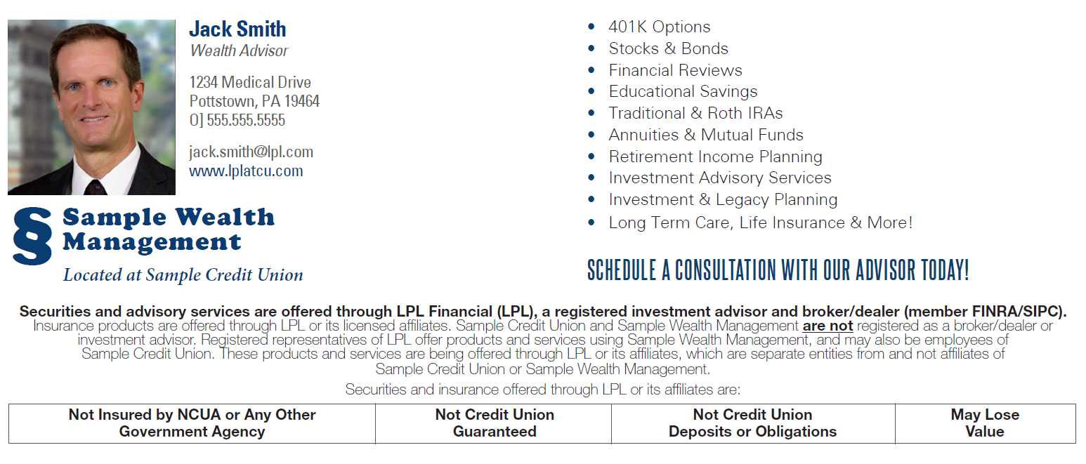

Choosing Your Kickoff Campaign
Selecting Your Relaunch/Rebrand Theme
When preparing for your relaunch/rebrand, it is important to select a theme that you can promote through various marketing channels for consistency and maximizing exposure. This includes formatting for:
Print collateral
Social Media
Website banners
Electronic Communications
  E-Newsletters, Emails, etc.

Slide 12
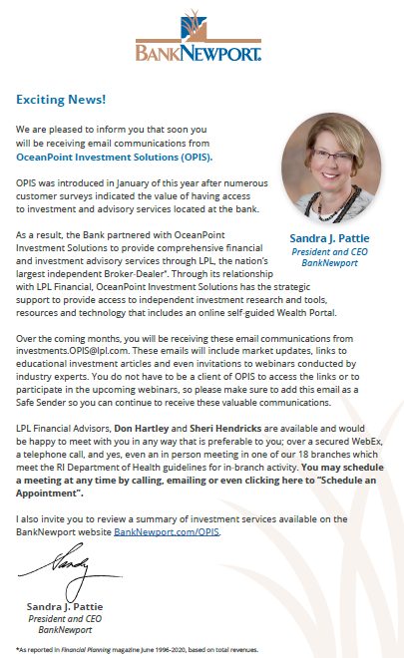
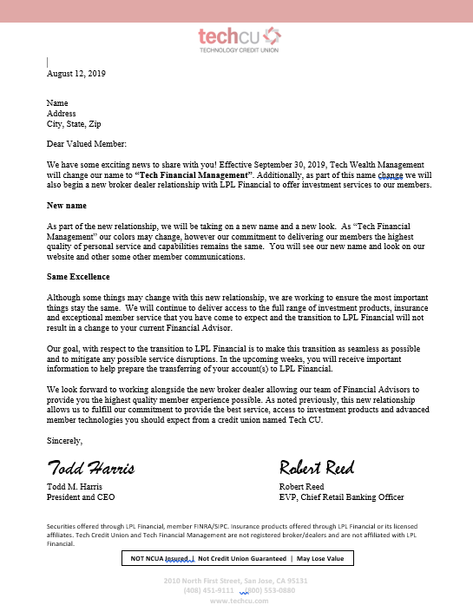
CEO Announcement Letter
Kickoff Communication
In preparation for the launch, a CEO announcement communication should be developed.
CEO Announcement letter/email raising awareness of the investment services program
Letter to be placed on institution letterhead and signed by CEO
Permissible for initial program announcements and relaunches

Slide 13
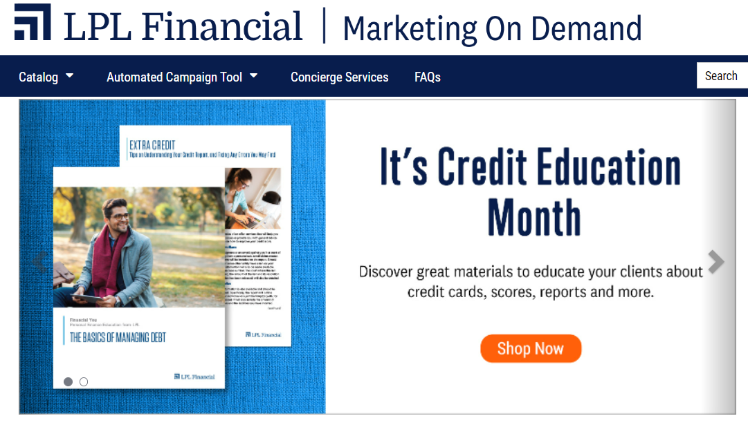
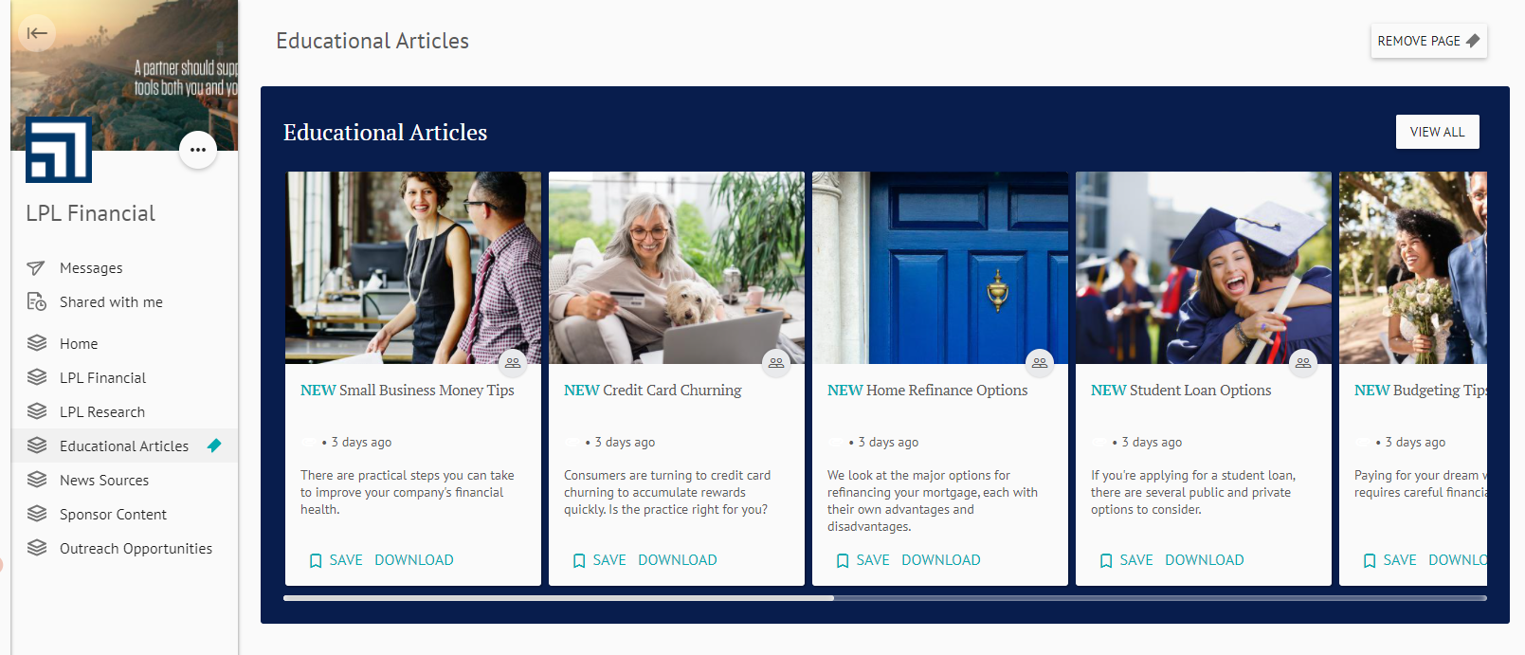
Advisor/Admin Trainings
Working With Your Marketing Account Manager
Your designated Marketing Account Manager will be
happy to assist you and/or your admin(s) in training on
the various LPL marketing tools available to utilize during your relaunch/rebrand campaign & beyond.
One-on-one demos at a time of convenience for you
  Automated Campaign Tool (ACT)
  Marketing on Demand
  Gainfully

Slide 14
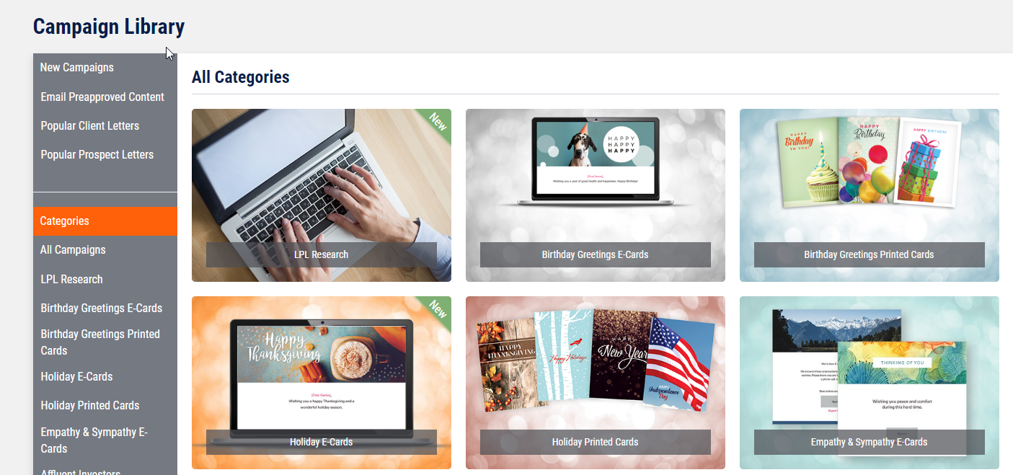

Advisor/Admin Trainings
Automated Campaign Tool
LPL’s email marketing tool where advisors can organize their contacts into segmented groups to drip on them with targeted, pre-approved messaging with a “set it and forget it approach”.
Available through Marketing on Demand
Monthly, quarterly and customized launch dates available
Advisors can assign up to 2 delegates to manage on their behalf
Content includes, LPL’s Weekly Market Commentary, financial topics, lifestyle topics, birthday/holiday/greeting cards, and customized content

Slide 15
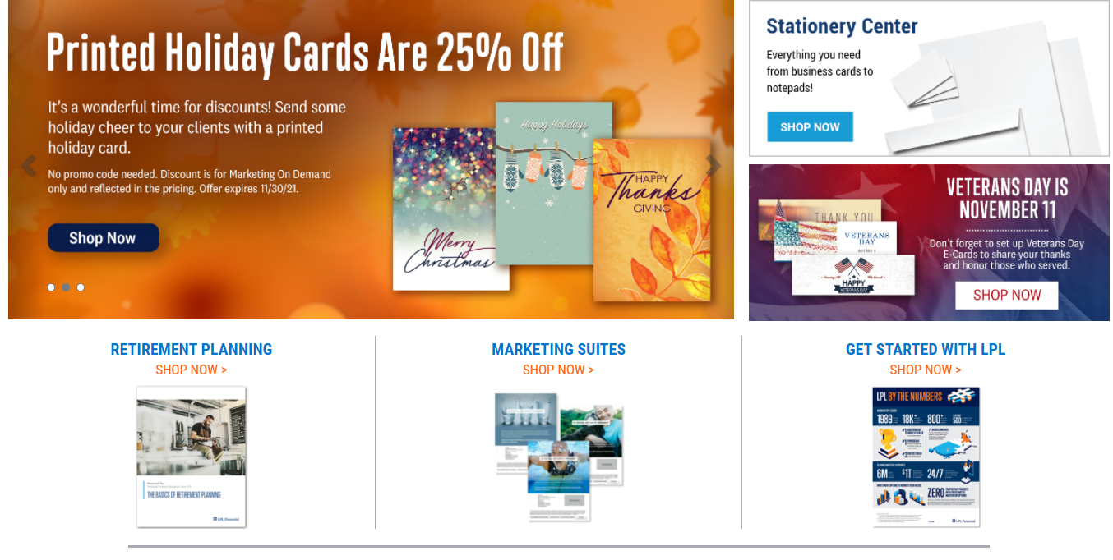
Advisor/Admin Trainings
Marketing on Demand
All-in-one platform that provides advisors with pre-approved, customizable marketing materials for building brand awareness and communicating with clients and prospects. Includes access to:
Articles
Letters
Promo items
Brochures
Seminars
…and more!

Slide 16

Advisor/Admin Trainings
Gainfully
  LPL’s extensive Social Media Content Library
  Available through Resource Center
  Automated – “Set it and forget it”
  Assign delegates to manage on your behalf
  Pre-approved content includes: LPL Research, Educational and Lifestyle articles, News
  Set to launch daily, monthly, quarterly, etc.

Slide 17
Step 4: Time for Liftoff!
Executing your Launch

Slide 18

It’s Go Time!
Launching Your Brand/Rebrand Campaign!
All of your hard work has paid off! Now that steps 1-3 are complete, it’s time to execute and see everything in action!
Your Business Consultant and Marketing Account Manager will walk alongside you and answer any questions you may have during your launch.

Slide 19
CEO Announcement
Formatted for email and/or mail

Slide 20

Brand Awareness Campaign Pieces
Flyers/Posters
Institution Homepage Website Banner Ad / E-Newsletter Banner Ad
Social Media
Inserts/Postcards

Slide 21
Step 5: Keep the Momentum Going –Building Your Brand

Slide 22

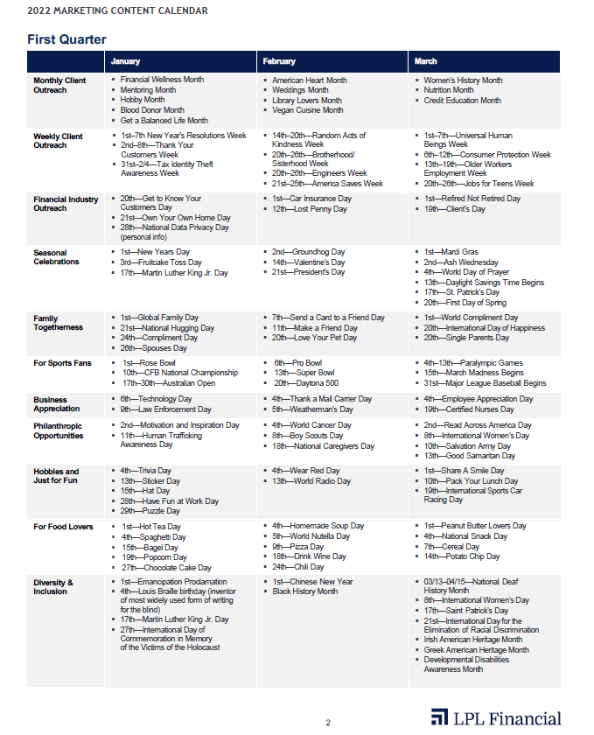

Timely Customized Campaigns
Creating a Marketing
Content Calendar
Leverage LPL’s Marketing Content Calendar for timely monthly observances for ideas on campaign topics to stay top of mind throughout the year.
We exist to provide exceptional service for our financial advisors and financial institutions.
Financial Wellness Month
Credit Education Month
Social Security Month
College Savings Month
Long-Term Care Awareness Month

Slide 23
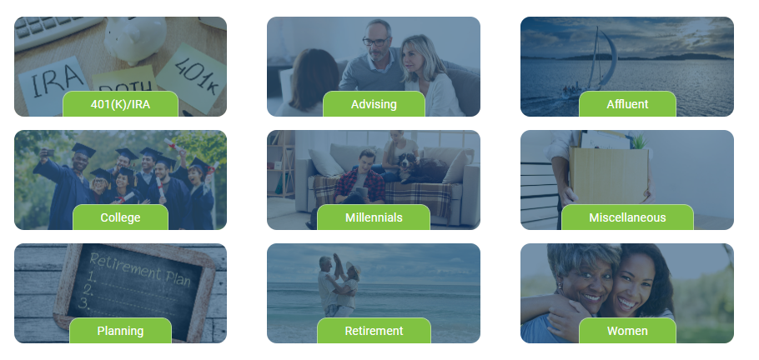
Resource Library - Financial Resources Group
FRGIS Marketing Resource Library
Access our Marketing Resource Library for pre-approved content to implement into your marketing strategies:
  Campaign content for digital and print organized by topic/target audience
  Checklists
  Webinars and seminar kits
  Enhanced branch training kits

Slide 24



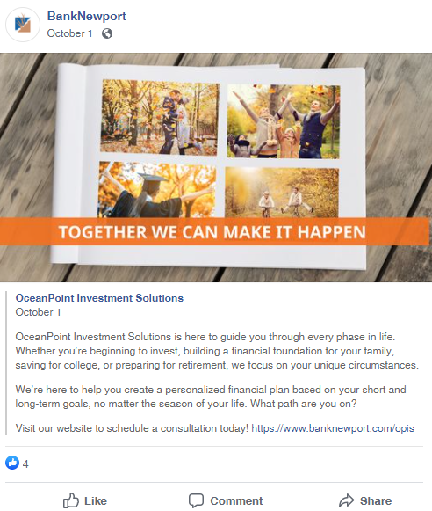

Campaign Materials Formatted for Digital and Print
Posters/Flyers
Statement Inserts/Handouts
Social Media
We exist to provide exceptional service for our financial advisors and financial institutions.
Web banners, E-Mail/E-News Graphics

Slide 25

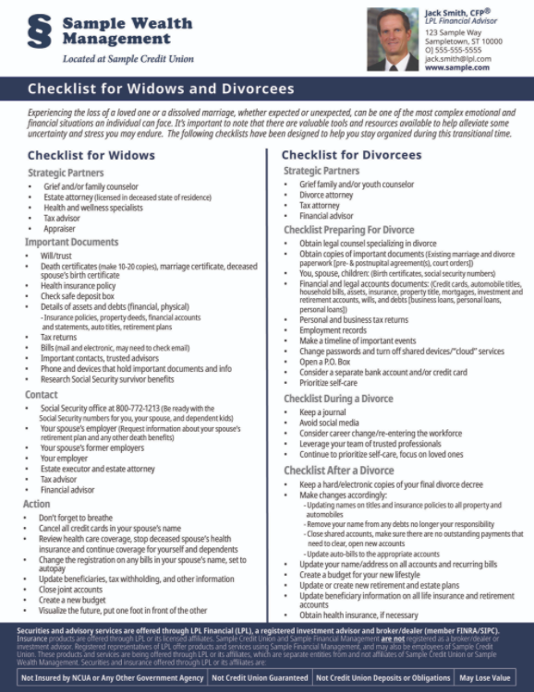

Important Checklists
Notes:
Comprehensive customized campaigns with all formats for digital and print communications

Slide 26
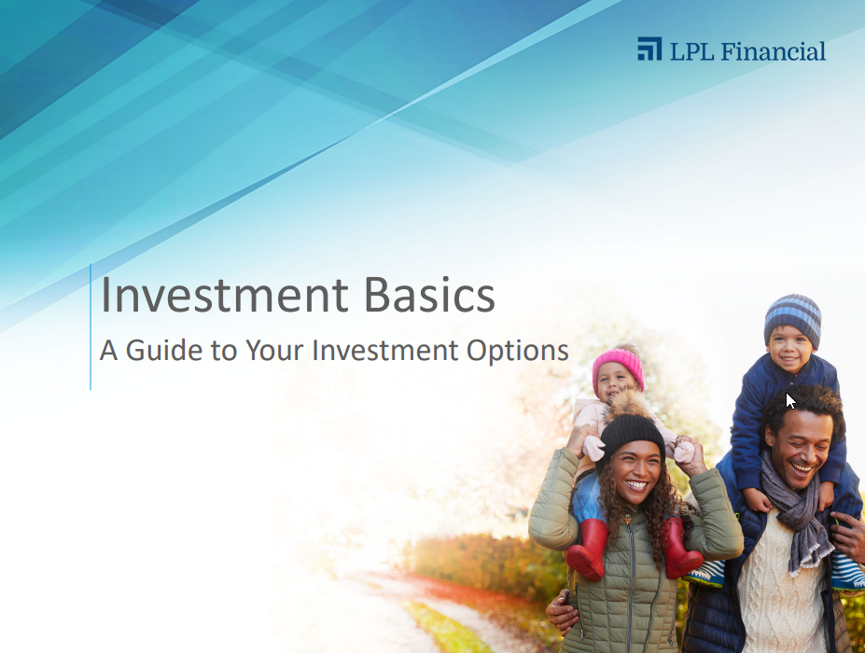


Seminars & Webinars (from Broadridge)
Turnkey seminar kits with all the materials you need - from promoting to presenting

Slide 27



Enhanced Branch Trainings

Slide 28
Marketing Best Practices
Website, Social Media, Email Marketing

Slide 29
Website Redesign Considerations
Redesign your site using these best practices to achieve a better user experience and improve SEO:
  Create a responsive design so the site works correctly on all devices
  Hyperlink social media icons and email address within the contact information
  Add a “call to action” button on every page of website with an accent color that stands out
  Use video to incorporate an interactive and educational component. This helps increase time the viewer spends on the site
  Feature a Blog Page to add another educational component and increase traffic to the site. NOTE: Blogs should be between 1800-2400 words for optimization
  Utilize industry “keywords” in headers and copy
  NAP (Name, address, phone) needs to be listed consistently everywhere online to satisfy algorithms. (Ex: If you are spelling out “suite”, be sure to do that everywhere else).

Slide 30
Website MRR Guidelines
Contact your assigned
Marketing Account Manager for additional assistance
Basic LPL Marketing Regulatory Review Requirements:
  The investment services (IS) webpage(s) can reside in the institution website or they can be a separate website with its own direct URL.
  Navigation to the main IS “homepage” should be built as part of the main navigation in the header area.
  If setting up a separate site, you can provide a basic DBA page (with appropriate disclosures) in the institution
  website that links to the new site using a “Leaving Current Site” message.
  Most institutions have a set header where their brand is located in the top left corner. You can add the DBA brand to each of the pertinent IS pages but it must be distinct and located at the top of the page above the main content area.
  The required Broker/Check language and link to their site must reside on the IS homepage and on the pages where the advisor is listed (bio, contact and team pages). This information should not be placed in the footer with the disclosures.
  Basic banner ads can be used throughout the website but must not contain any contact information or disclosures. The banner ad must link to an approved IS webpage where the details about the topic lives and includes the required disclosures.
  Appropriate disclosures are mandatory on every page in the IS section of the site.
  All pages must be reviewed and approved by MRR before pushing the site live to the public.

Slide 31
Social Media Set-Up
Getting Started with Social Media at LPL
To begin using social media at LPL, you need to complete a few simple steps:
  First, complete the social media training available on the Learning Center.
  Second, sign up for social media access on ClientWorks.
  Third, your social media static profiles must be reviewed and approved by Marketing Regulatory Review (MRR) before they are authorized for use.
    LinkedIn company pages and YouTube profiles must be submitted to C-Max as a PDF.
    Facebook Business pages, LinkedIn individual profiles, and Twitter profiles, however, will be automatically sent to MRR for review once you complete step 4. No action is required on your part.
Fourth, authorize Social Patrol on all approved social media profiles you intend to use.

Slide 32
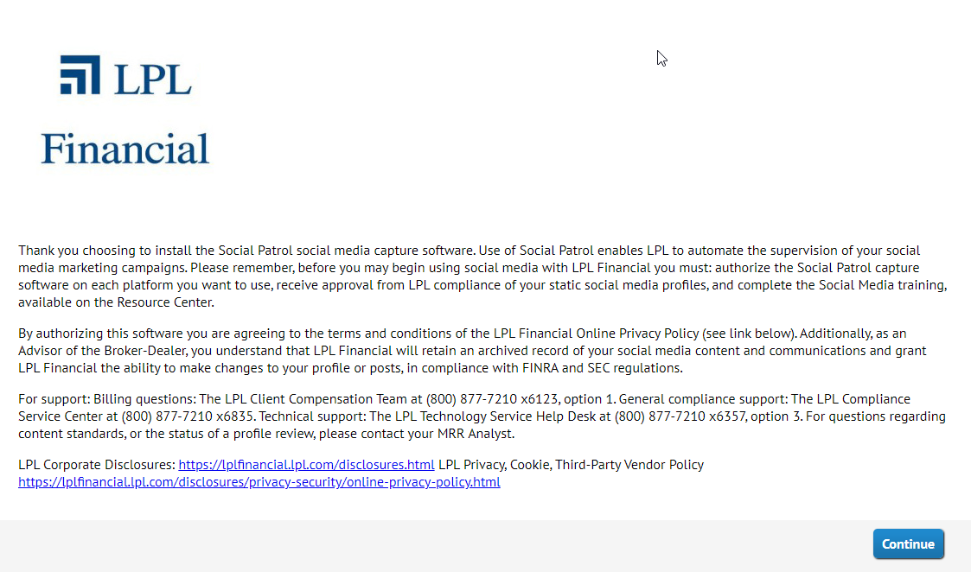
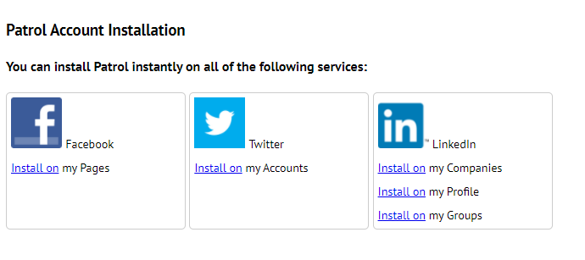
Social Patrol: Installation and Authorization
After you’ve completed Social Media Training and the Social Media Onboarding Form, the Social Patrol account is created and an email is sent from socialpatrol-noreply@lpl.com to you with an installation link.
  1) Use the link in your email to begin the authorization process. (Please use Chrome browser).
  2) Read the disclosure language on the Social Patrol landing page.
  3) On the “Patrol Account Installation” screen, enter your LPL.com email address.
  4) Select the social media account you wish to install the Social Patrol application on. This procedure must be completed one account at a time.
  5) When you select the “Install on” link for the chosen platform, you’re directed away from Social Patrol and asked to sign into that platform. Use the social media account credentials to log in. You will be asked to authorize the Social Patrol application; please provide all permissions that are requested.
Upon completion, you’ll see a message thanking you for installing Patrol on that account. A link is available on the “thank you” screen to add Social Patrol to other social media accounts.

Slide 33
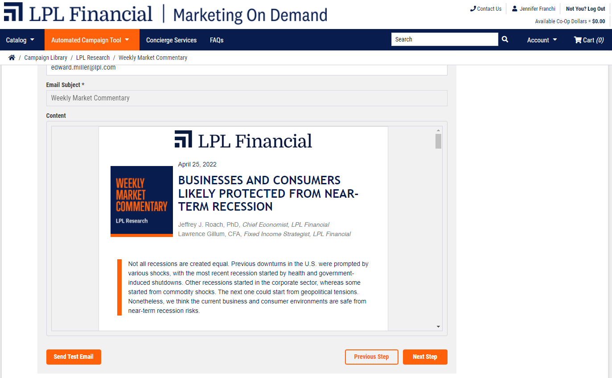
Email Guidelines
Advisors
Advisors are free to communicate through the following channels for email:
LPL approved email address
LPL approved DBA email address
LPL approved journaled email address
Automated Campaign Tool (ACT)
Utilizing one of LPL’s Vendor Affinity Program providers that have email integration (ex: Constant Contact, FMG Suite, MarketingPro, etc.) that links to their approved LPL email address

Slide 34
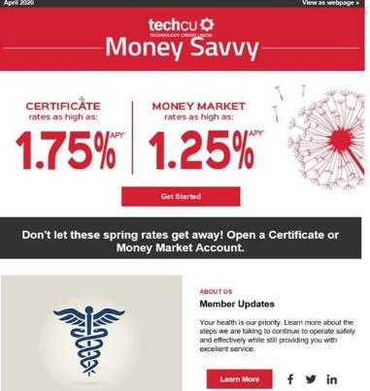
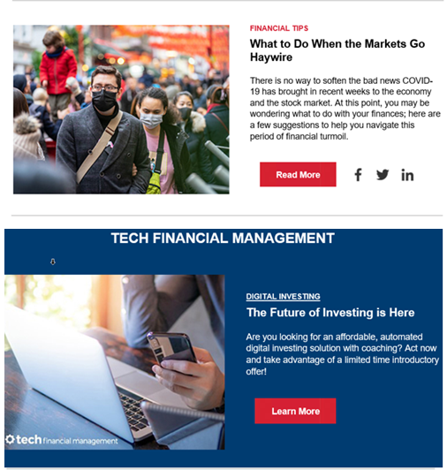
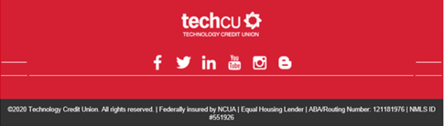
Email Guidelines
Institutions
Financial institutions can promote the investment services program through the use of a banner ad in their electronic newsletters. Here are some helpful tips for compliant formatting:
The focus of the newsletter is on the institution with an “incidental reference” to the investment services program
The banner ad is self-contained by a border and visually distinct from the rest of the email content
The banner ad is branded with the approved Investment Program DBA
The content of the banner ad is limited and generic in nature as to not give away all of the details of the message. Ex: “Click here to see upcoming ABC Investment Services events”
The banner ad content links to an approved investment services page

Slide 35
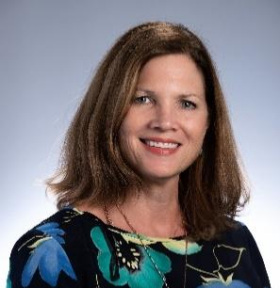

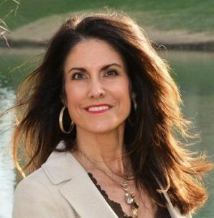
Your FRGIS Marketing Team
Tanya Beshears
Senior Marketing Account Manager
Jenny Franchi Senior Marketing Account Manager
Jennifer Hallmark Senior Marketing Account Manager
Let us help you on your program relaunch/rebrand journey!
Rev 5.2.22

