Slide 1

Building Additional
Basis Points of Value

Slide 2
FRGIS does not provide tax advice. The examples in this presentation are for hypothetical purposes only.

Slide 3
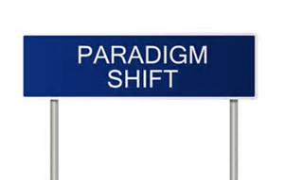
The Shift
Give away ADVICE, charge for PRODUCT
Give away PRODUCT, charge for ADVICE

Slide 4
Creating Engagement

Slide 5

The Objective
e.conom.ic ef.fi.cien.cy
NOUN
a situation in which nothing can be improved without something else being hurt.
Economic Efficiency is the objective of the planning relationship.

Slide 6
Areas of FOCUS
in.ef.fi.cien.cy
NOUN
the state of not achieving maximum productivity; failure to make the best use of time or resources:
Identify, isolate, & eliminate (or reduce) the inefficiencies:

Slide 7

The Opportunity
op·por·tu·ni·ty
NOUN
a set of circumstances that makes it possible to do something:
favorable time/occasion/moment
Gather assets from other advisors exiting the industry.
Enhance your brand with more holistic financial planning approach.
Expand your expertise, offerings and value proposition.

Slide 8

The Path
The game of WEDGES!

Slide 9

Redirecting your approach
Building Additional Basis Points of Value
Selling against yourself?
Repairing verses Innovating?
Attacking verses Defending?

Slide 10

Self Assessment
Where are YOU vulnerable?
  Cashflow utilization
  Asset management & distribution planning
  Debt structure
  Strategic tax management planning
  Risk management (asset protection, DI, Life Insurance, LTC, Liability)
  Asset transfer
  Healthcare directives
CLIENT NAME | GAPS | PROSPECT NAME | GAPS
1. |  | 1.
2. |  | 2.
3. |  | 3.
4. |  | 4.
5. |  | 5.

Slide 11

Creating Engagement:
SIMPLE Case Study
  John & Mary Smith Age 65
  Investments:
  $800,000 Q
  $400,000 NQ @ 4% $16,000 annual
  SS @ 65:
  Husband $2,660 per month
  Wife $1,506 per month $50,000 annual
  Expenses @ Retirement:
  $4,000 basic expenses
  $1,500 lifestyle $66,000 annual

Slide 12

What They Want to Know
1. Can we retire?
2. How do we fund it?

Slide 13






Default Approach
Turn on SS $50,000
Take NQ Earnings (4%) $16,000
Keep deferring the IRA until RMD kicks in. Don’t pay any more tax than you need to!

Slide 14




Things to consider & discuss
in.ef.fi.cien.cy
NOUN
the state of not achieving maximum productivity; failure to make the best use of time or resources:
Identify, isolate, & eliminate (or reduce) the inefficiencies:

Slide 15
Things to Discuss With the Client
Should you pay $0 of tax?
Should you pay $1,940 of tax?
Should you pay $ 9,086 of tax?
Should you turn on SS now or wait?

Slide 16
Option 1
Should you pay $0 of tax and how much income does $0 of tax represent?

Slide 17
How much of SS Benefit is Taxable?
SS Benefit itself is not taxable. What makes SS benefit taxable is other income!
How much of my Social Security income is taxable?For married couples filing jointly, you will pay taxes on up to 50% of your Social Security income if you have a combined income of $32,000 to $44,000. If you have a combined income of more than $44,000, you can expect to pay taxes on up to 85% of your Social Security benefits.
Example:
  Investment Income:
  $400,000 NQ @ 4% $16,000 annual
  SS @ 65:
  Husband $2,660 per month
  Wife $1,506 per month $50,000 annual
  $4,498 of Social Security Benefit is taxable!

Slide 18
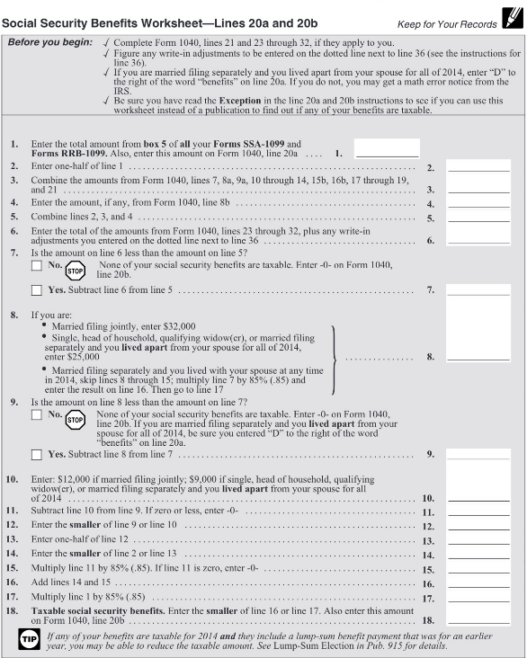
Social Security Worksheet Example
Doing The Math: Determining how much of the SS Benefit is subject to tax

Slide 19
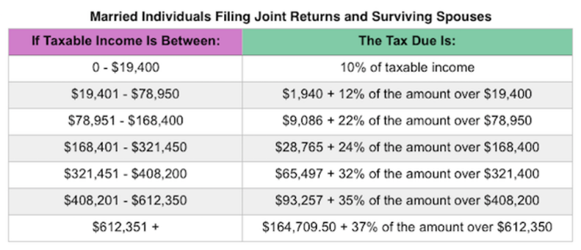
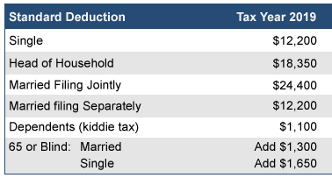
2019 Rates & Deductions
Option 1: Unpacking the tax tables

Slide 20
Option 1
Default Approach
Turn on SS $50,000
Take NQ Earnings (4%) $16,000
Keep deferring the IRA until RMD kicks in. I don’t want to pay tax!
We waste opportunity to take another $6,502 out of IRA without paying tax every year we do this.
We added value to Uncle Sam but not our client with this approach.

Slide 21
Option 1
Doing The Math: How much income = $0 of TAX?
Standard deduction $24,400
Over 65 bonus deduction $ 2,600
Total to get to ZERO $ 27,000
NQ Interest Income $ 16,000
Taxable SS Benefit $ 4,498
Available to get to $0 $ 6,502

Slide 22

Option 1
What to do with $6,502
Travel
Gift away
Fund ROTH Conversion
Buy LTC
Other ideas

Slide 23
Option 2
Should you pay $0 of tax?
Should you pay $1,940 of tax?

Slide 24
2019 Rates & Deductions
Option 2: Unpacking the tax tables

Slide 25
Option 2
Doing The Math: How much income = $1,940 of TAX?
Standard deduction $24,400
Over 65 bonus deduction $ 2,600
Income Limit $19,400
Getting to $1,940 of Tax
NQ Interest Income $ 16,000
Q Plan Income $ 14,250
(Need to recalculate 1040 Line 20 B) Taxable SS Benefit $ 15,559*
Available excess cash after tax: ($14,250 - $1,940) $ 12,310

Slide 26
Option 2
What to do with $12,310
Travel
Gift away
Fund ROTH Conversion
Buy LTC
Other ideas

Slide 27
Option 3
Should you pay $0 of tax?
Should you pay $1,865 of tax?
Should you pay $ 9,086 of tax?
Should you turn on SS now or wait?

Slide 28
2019 Rates & Deductions
Option 3: Unpacking the tax tables

Slide 29
Option 3
Doing The Math: How much income = $9,086 of TAX?
Standard deduction $24,400
Over 65 bonus deduction $ 2,600
Income Limit $78,950
Getting to $9,086 of Tax
NQ Interest Income $ 16,000
Q Plan Income $ 45,560
(Need to recalculate 1040 Line 20 B) Taxable SS Benefit $ 42,173*
Available excess cash after tax: ($45,560 - $9,086) $ 36,474

Slide 30
Option 3
What to do with $36,474
Travel
Gift away
Fund ROTH Conversion
Buy LTC
Other ideas

Slide 31
Option 3 / Social Security Deferred
Another Option to $9,086
Defer SS until age 70
Take NQ earnings $ 16,000
Pull additional income need from NQ account $ 50,000
Pay taxes from NQ account $ 9,086
Do annual ROTH conversion $ 87,650

Slide 32
Fast Forward 5 Years….
  Husband & Wife Age 65 Age 70
  Investments:
  IRA $800,000 $361,750
  ROTH $ 0 $438,250
  NQ $400,000 @ 4% $100,000
  SS @ 65:
  Combined Benefit $ 48,000 $ 74,955

Slide 33





Opportunities to create ENGAGEMENT & add VALUE!

Slide 34

Other Items to Discuss…
  Revisit the Risk discussion
  Rebalance portfolios
  Make shift to advisory
  NQ shift to other vehicles
      Lock gains
      Leverage death benefit
      Index for upside
      Trail revenue
  Call while you are up

Slide 35
Questions?

