Slide 1

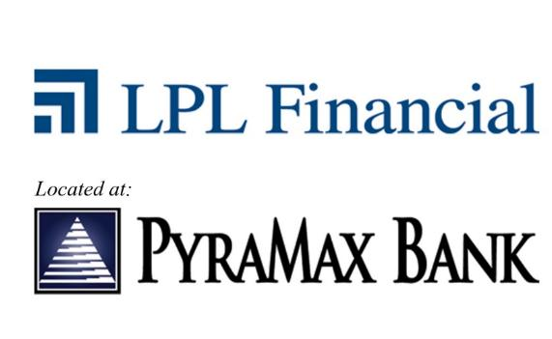
Commercial Workshop

Slide 2
Agenda
February 28:
10:30am - 10:45am Introductions
10:45am - 12:00pm Creating Opportunities
12:00pm - 12:30am Lunch
12:30pm - 1:30pm Managing Risk

Slide 3

Introductions
Mark Brakel has over 30 years of experience in the financial services industry serving in various capacities. In his current position as a business consultant with Financial Resources Group Investment Services, Mark works with advisors, program managers, and financial institution senior management groups to improve program performance and grow top line revenue.
Prior to joining Financial Resources Group Investment Services, Mark was the program manager at First International Bank & Trust and also held a position as senior vice president at Investment Centers of America (ICA) and was responsible for the financial solutions team, new business development, and the financial institution division. Before joining ICA in 2010, Mark served as senior vice president, chief investment officer for Bank Forward with direct responsibility for the investment portfolio and liquidity management functions of the institution. Mark also had responsibility for commercial cash management, retail brokerage, marketing, and sales training. Additionally, he sat on Bank Forward’s board of directors and assisted with new product development.
Prior to his position at Bank Forward, Mark was the national sales manager for ICA working with over 250 different financial institutions across the United States. Mark also held positions as vice president of investment services – program manager for Community First Bank, a $6 billion organization located in 12 states throughout the Midwest. Mark was also a regional vice president for PrimeVest Financial Services and spent eight years with Security State Bank of North Dakota providing financial planning services to small business owners and retail clients.
Licenses/Registrations: FINRA Series 7, 24, and 63 securities registrations and is insurance licensed in North Dakota. He is a CERTIFIED FINANCIAL PLANNER™, Chartered Financial Consultant, and a Certified Retirement Counselor. Securities registrations held with LPL Financial and Financial Resources Group Investment Services.
Mark Brakel, CFP®,ChFC®,CRC®
Notes:
Go around the room and have everyone introduce themselves.

Slide 4
Disclosures
Member of FINRA/SIPC
For training purposes only. Not for further distribution.
Not FDIC/NCUA Insured | Not Bank/Credit Union Guaranteed | May Lose Value
Not Insured by Any Federal Government Agency | Not a Bank/Credit Union Deposit
Notes:
Read the disclosures

Slide 5
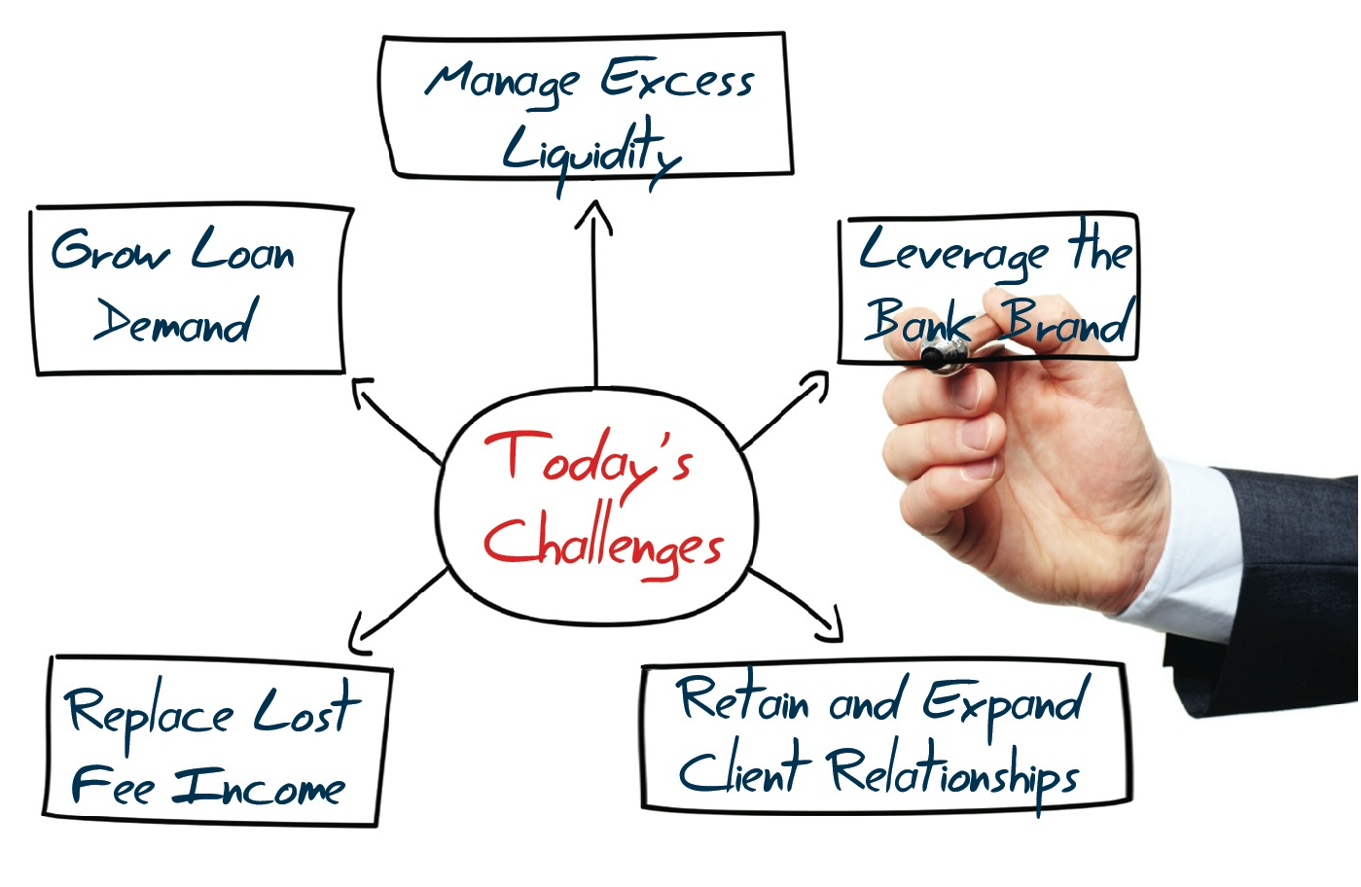
Today’s Challenges
Notes:
Review the challenges facing financial institutions:
1. Managing excess liquidity
2. Leveraging the brand of the institution
3. Retaining and expanding client relationships
4. Replacing and growing non interest income revenue sources
5. Growing loan demand

Slide 6
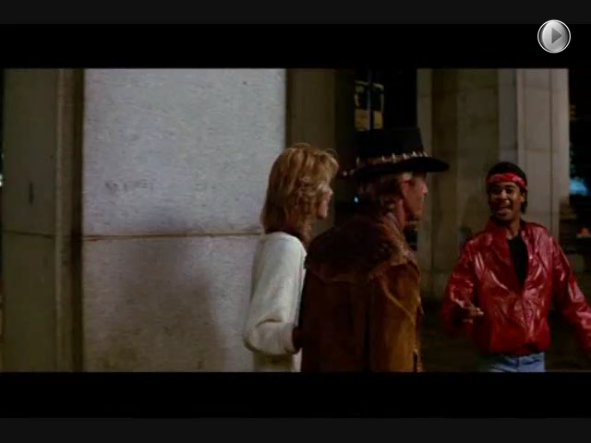
Something To Think About!
Notes:
Play a short video clip depicting a knife fight. Drive home the point that the approach most people take to winning a knife fight is to try and introduce a bigger knife.

Slide 7
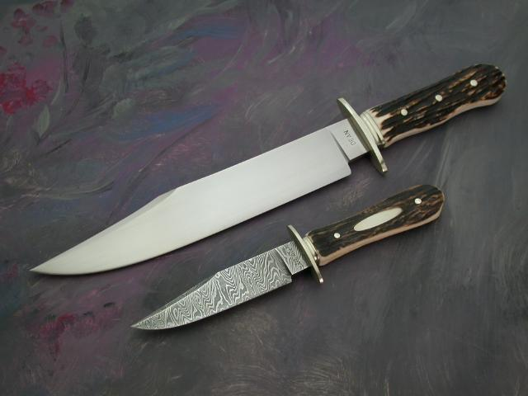
Someone Always Has A Bigger Knife!
There is always a higher rate, better price, or better performing product.
Notes:
Reinforce the point that someone always has a bigger knife, a higher rate, a better price, a better performing product. If you are fortunate enough to be at the forefront today you can rest assured tomorrow you will not be.

Slide 8
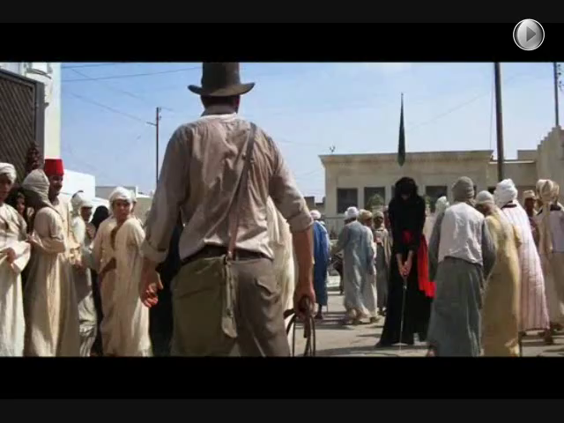
Another Knife Fight!
Notes:
Show a video clip depicting another knife fight and a non conventional approach to winning the knife fight. Ask the question what are you going to do to differentiate yourself and position yourself to win the never ending knife fight.

Slide 9
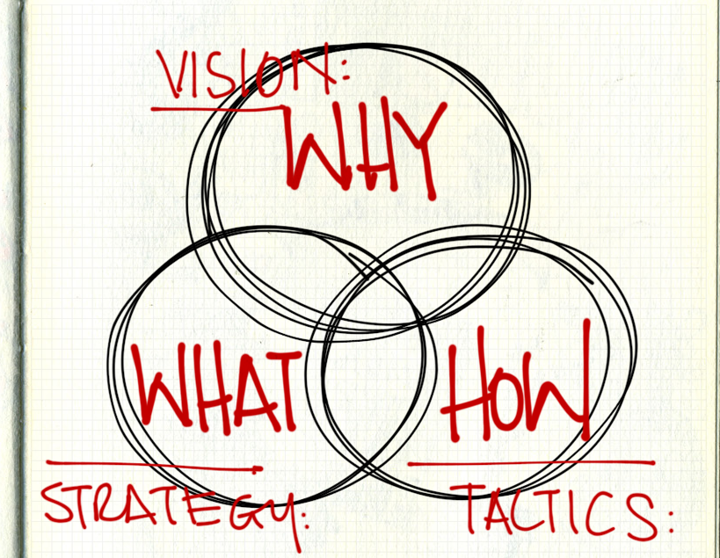
Power Questions:
  What makes you difference from your competitors?
  Why will the client care?
  How will they benefit?
Notes:
Ask the 3 questions?
1. What makes you different from your competitors?
2. Why will the client care about what makes you different?
3. How will the client directly benefit?

Slide 10
Simple Assessment
5 Clients Touches Greatest Need
1. _____________________
2. _____________________
3. _____________________
4. _____________________
5. _____________________
_______
_______
_______
_______
_______
_____________________
_____________________
_____________________
_____________________
_____________________
X
X
X
X
X
Their greatest need is your next greatest opportunity!
Notes:
Take them through a short exercise?
1. Have them list their top 5 clients
2. Have them list their greatest needs
3. Have them circle the red X if they have not talked to the client about their greatest need
4. Have them list the number of times they have an opportunity to be in front of the client over the course of a year.

Slide 11
Moments Of Truth
  What are they?
  How many?
  Each day, week, month (do the math)
  What opportunities are you missing?
Notes:
Describe what a moment of truth is: It is the opportunities you have to engage your clients to find out more about them and what their needs are.
I have them visualize one of the clients they listed on the previous slide and add up the number of opportunities they have had over the course of the last 12 months and ask them what they did with those opportunities. Did they make the most of them and engage the client or squander them and do nothing with them.

Slide 12

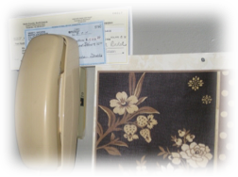
Case Study
A Case Study of Missed Opportunities
Notes:
I tell the story of a friend of mine who is a contractor and the missed opportunities his banker had over the course of a year to engage him to uncover more opportunities to add value and deepen the relationship regarding loans, remote merchant capture and cash management services.

Slide 13
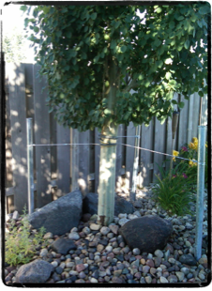
Lesson #1
Things change!
Notes:
I tell the story of a tree in my backyard that blew over twice in windstorms over the course of 8 years and the investment, planning, and teamwork it required to save the tree the second time compared to the first time due to the growth of the tree. The point is as things grow the problems encountered usually become more complex and require more expertise, teamwork, planning and investment to solve.

Slide 14
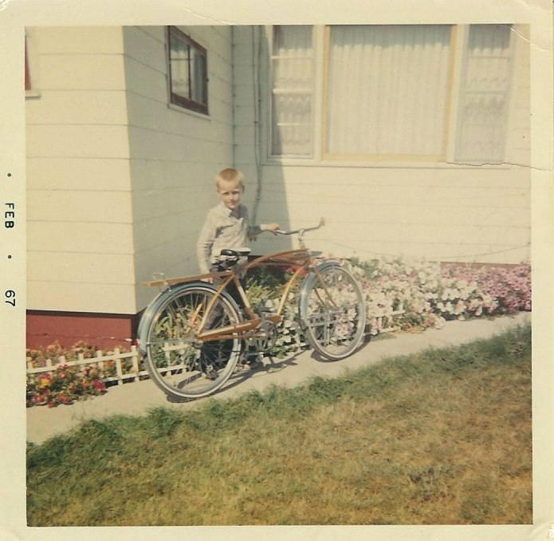
Lesson #2
The impact of the coins in the cushions!
Notes:
I tell the story of me as a little boy saving up coins I found in the cushions of couches and car seats to save up enough money to buy a bike. The point of this slide is to drive home the point that we develop credibility and build value with clients over time by focusing on helping them with the little things that may seem insignificant. It is the cumulative effect of all the small things we do that position us to win the knife fights.

Slide 15
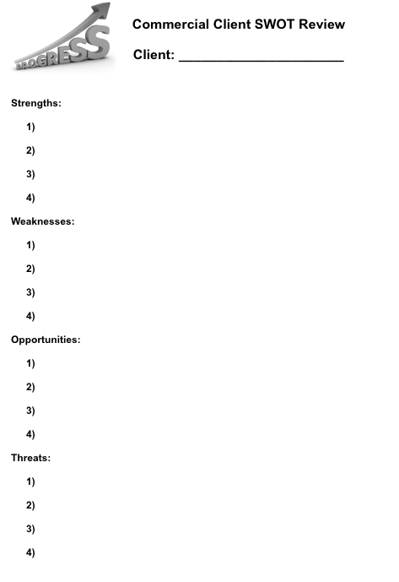
Best Practice Idea
Notes:
I introduce the best practice idea of visiting a clients work place and taking them through an informal SWOT analysis to find out more about the client and uncover missed opportunities to add value and deepen the relationship.

Slide 16
Setting Up The SWOT
As your commercial banker, I want to thank you for giving me the opportunity to work with you. Your business and the trust you place in myself and our institution is greatly appreciated. I’d also like to set up a time when I could come out and visit with you about your business so I can find out more about what I can do to partner with you to continue to add value and assist you with accomplishing your goals and objectives.
Thanks again for your time and consideration and for the opportunity to continue to work with you.
Notes:
I read the script and suggest they create a similar script to position a visit and the SWOT with their top clients

Slide 17
Conducting the SWOT
  What do you do really well?
  What are your inefficiencies & bottlenecks?
  What opportunities are you working on?
  What are your major concerns?
Notes:
I read the bullet points on the script and walk them through an informal dialogue with the client to complete the SWOT.

Slide 18
Networking Idea
The 4 Way Lunch
      Focus on A clients
      Identify compatibilities
      Be intentional
Notes:
I introduce a 4 way lunch networking idea where they invite 2 clients out for a lunch to thank them for their business and introduce them to one another to assist both of them with growing their client base and referral network.

Slide 19
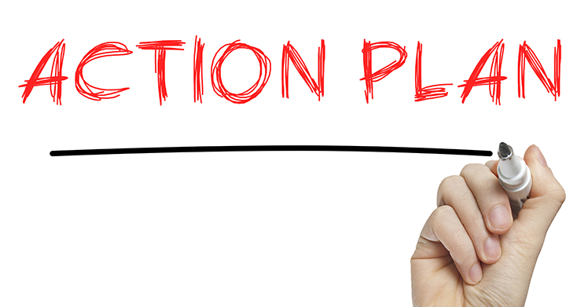
Developing Your Plan
First hour every other
Wednesday…
  Week 1 & 3
    - Call 1 A customers to schedule
    SWOT visit
  Week 2 & 4
    - Call 2 A customers to schedule
    4 way lunch
        One to introduce
        One to bring someone to introduce
        to you
Notes:
Lay out an action plan regarding putting the concepts we discussed into action.
Just read the bullet points as written.

Slide 20
10 Minute Break

Slide 21
Buy-Sell Consultative Review
Focus is the commercial client base
Implements a process to establish entry point
Enhances and protects the brand
Reduces loan repayment risk
Sets the stage for transition planning
Grows non-interest income
Notes:
Transition to the 2nd part of the workshop regarding business buy-sell review.
Read the bullet points as written to outline the benefits of this program.

Slide 22

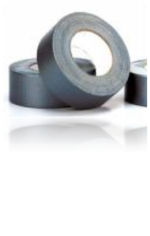
Why You Need To Do This!
Billy and Bobby
“A Love Store Gone Bad”
Notes:
Introduce a case study of Billy and Bobby to drive home the reasons to visit with clients about the need for a buy-sell agreement

Slide 23
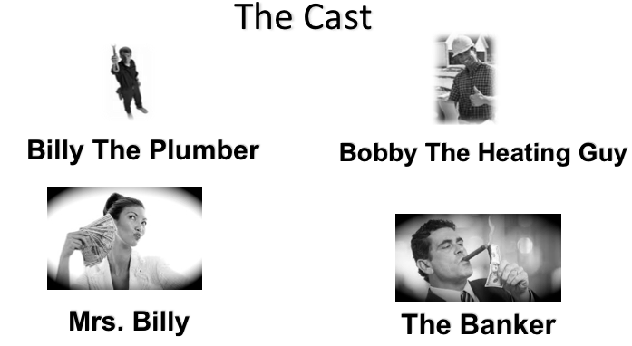
Why You Need To Do This!
The Cast
Notes:
Introduce the cast of the role play: Billy the plumber:Bobby the heating guy:Mrs. Billy:The Banker:
I have four people from the group come up front an play the role of the four characters listed.
I walk them through the following storytelling line:
Billy and Bobby were best friends growing up in a small town.
They went to trade school together so they could be business partners.
They moved back to their hometown and started a plumbing and heating contracting company after they finished trade school.
They went to their local community bank and borrowed money to start here business.
The local banker borrowed them the money based on their character and reputations but didn’t do a good job of helping them manage risk when it came to structuring a buy sell agreement and disability buy sell agreement.
Billy gets married and ends up getting hurt on the job. He ends up in a coma for 12 months and then dies.
We outline the problems this has created for the following entities:
The bankThe bankerBobbyMrs. Billy
We talk about the limited options to resolve this after the accident and the impact.

Slide 24


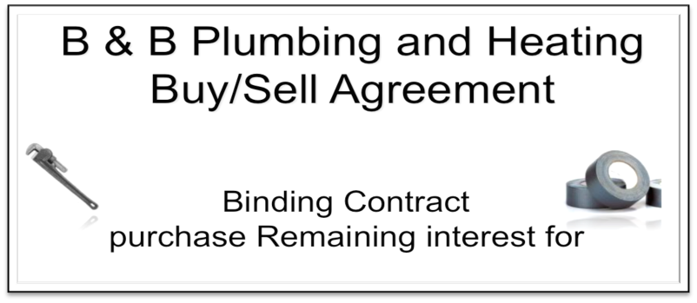
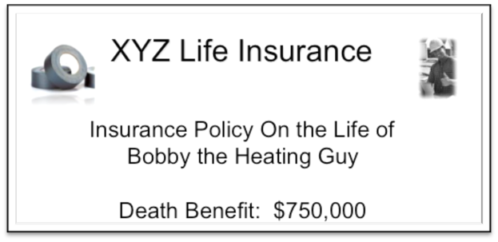
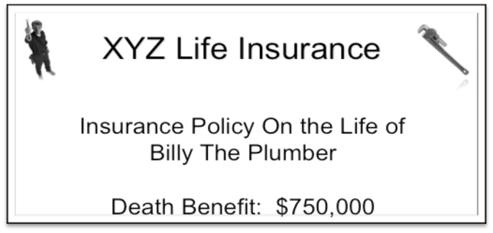
The Solution
Notes:
We them rewind the story line and add in the banker introducing the need for a buy-sell agreement and a disability buy-sell agreement and implementing it and the different outcome this created for the following entities:
The bankThe bankerBobbyMrs Billy

Slide 25

Cross Purchase Strategy
Life Insurance Company
Policy
Policy
Business
Premium
Premium
Owner A
Agreement
Owner B
Notes:
On this slide we talk about the structure of a cross purchase strategy for a buy sell agreement. We just outline the flow chart as it is presented.

Slide 26
Stock Redemption Strategy
Life Insurance Company
Policies
Premiums
Business
Agreement
Owner A
Owner B
Notes:
On this slide we talk about the structure of a stock redemption strategy for a buy sell agreement. We just outline the flow chart as it is presented.

Slide 27
Cross Purchase vs.
Stock Redemption
Cross Purchase Stock Redemption
One policy per owner No Yes
Tax Free death benefit Yes Yes*
Step up in basis Yes No
Perceived premium equity No Yes
Perceived certainty of funding No Yes
Premiums deductible No No
*Potential AMT Corporate Tax liability
Notes:
On this slide we just compare the major differences between the two structures from the previous 2 slides.

Slide 28
Developing Your Action Plan
Notes:
On this slide I talk about developing your action plan to put all of the things we have discussed into an action plan:
WhereWhenHow WhatWho Why

Slide 29
Developing Your Plan
First hour every other
Wednesday…
  Week 1 & 3
    - Call 1 A customers to schedule
    SWOT visit
Notes:
Read the slide bullet points.

Slide 30
Who Do I Contact?
5 Clients Touches Greatest Need
1. _____________________
2. _____________________
3. _____________________
4. _____________________
5. _____________________
_______
_______
_______
_______
_______
_____________________
_____________________
_____________________
_____________________
_____________________
X
X
X
X
X
Their greatest need is your next greatest opportunity!
Notes:
Review what they wrote down from this previous slide:
1. Have them list their top 5 clients
2. Have them list their greatest needs
3. Have them circle the red X if they have not talked to the client about their greatest need
4. Have them list the number of times they have an opportunity to be in front of the client over the course of a year.

Slide 31
What Do I Say?
As your commercial banker, I want to thank you for giving me the opportunity to work with you. Your business and the trust you place in myself and our institution is greatly appreciated. I’d also like to set up a time when I could come out and visit with you about your business so I can find out more about what I can do to partner with you to continue to add value and assist you with accomplishing your goals and objectives.
Thanks again for your time and consideration and for the opportunity to continue to work with you.
Notes:
Have them read through this script and develop their own version.

Slide 32
What Do I Do?
  What do you do really well?
  What are your inefficiencies & bottlenecks?
  What opportunities are you working on?
  What are your major concerns?
Notes:
Review the outline for conducting the SWOT

Slide 33
Inefficiencies & Concerns
  What have you done to plan for the unexpected?
  Is your current plan properly structured?
  Is your current plan properly funded?
  Is your current plan updated annually?
Notes:
Provide them with some specific questions to ask relating to the threat and weakness segment of the SWOT

Slide 34
Creating The Entry Point
I would like to set up a time for you and I to meet with “Advisor” so we can review your current business continuation plan and assist you with identifying any potential revisions you may need to consider. If you don’t currently have one in place we can discuss ideas to develop one.
Thanks again for your time and consideration and for the opportunity to continue to work with you.
Notes:
Provide positioning statement to utilize to set up meeting with client and the advisor.

Slide 35
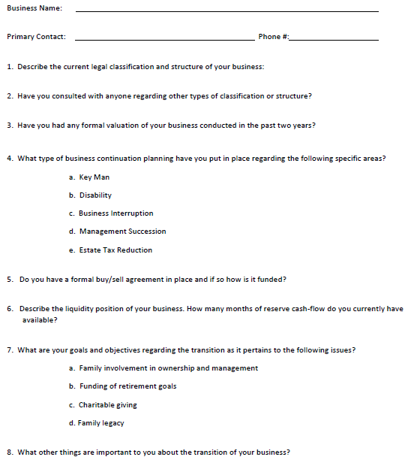
Business Questionnaire
Notes:
Review the questions outlined in the questionnaire. This is the resource the advisor will utilize to initiate the planning process with the client.

Slide 36
Comments
&
Questions?

